Slide 1

ACEP Update
Paul Kivela, MD, MBA, FACEP
President ACEP

Slide 2


ACEP turns 50

Slide 3

Wellness
Wellness Week
Solution Resources
Work Environment
Work with AHA, ENA
House of EM

Slide 4
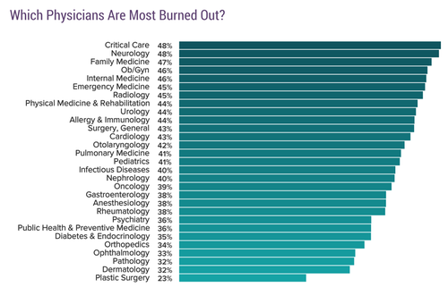
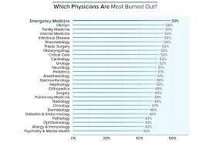
Burnout peaked???
Notes:
2018 46%
2017 59%
2015 53%
2016 46%

Slide 5

Overall wellness

Slide 6

Burnout
Work environment
Schedule
Safety
Compensation

Slide 7
Objectives
Value add to members and Emergency Physician Centric
Transparency
Efficiency/ Communication
Improve patient care

Slide 8
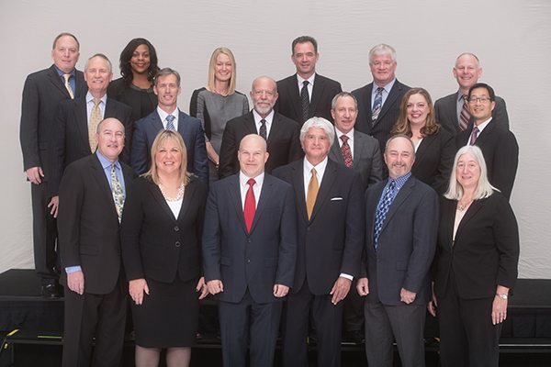
Transparency
Representation
  Geographic
  Diversity
  Skill sets
  Practice type
BOD Campaign reform

Slide 9
28 ACEP Committees
Committee Manual
Academic Affairs Committee
Audit Committee
Awards Committee
Bylaws Committee
Bylaws Interpretation Committee
CEDR - Clinical Emergency Data Registry Committee
Clinical Policies Committee
Coding & Nomenclature Advisory Committee
Compensation Committee
Disaster Preparedness & Response Committee
Education Committee
Emergency Medical Services Committee
Emergency Medicine Practice Committee
Ethics Committee
Federal Government Affairs Committee
Finance Committee
Medical-Legal Committee
Membership Committee
National Chapter Relations Committee
Pediatric Emergency Medicine Committee
Public Health and Injury Prevention Committee
Public Relations Committee
Quality and Patient Safety Committee
Reimbursement Committee
Research Committee
State Legislative/Regulatory Committee
Well-Being Committee

Slide 10


36 Sections

Slide 11

National advocacy
Opioids
Gun Violence
Trauma integration
May 20-23, 2018

Slide 12
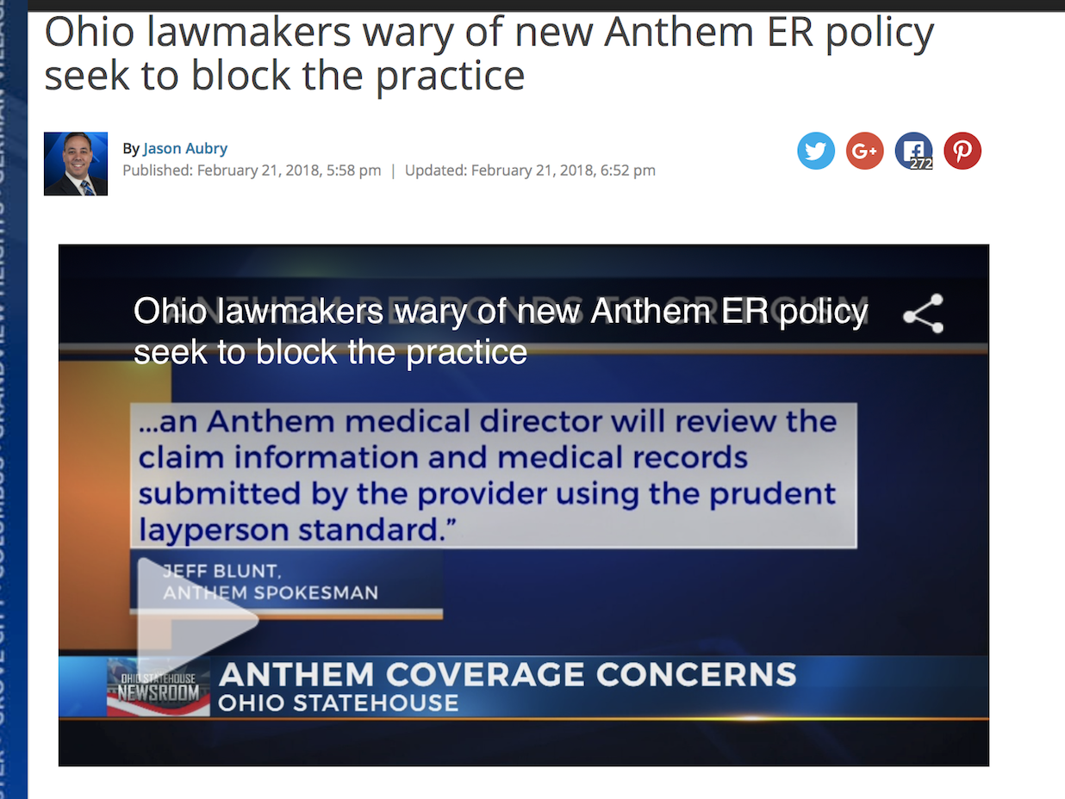
State Advocacy
Mandatory CME
Prudent Layperson
Out-of-Network Legislation
Opioid

Slide 13
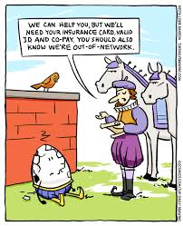
Payment
ECG
RUC
Downcoding
OON Billing/Surprise Coverage
Failure to pay
Insurer Scorecard

Slide 14
Alternative Payment Methodologies
Models
  Avoidable admissions
  Coordinating care
  Avoid frequent
Bundled payments
Single Payer

Slide 15

CEDR

Slide 16

Communication
New Website
Emails
ACEPNow
Updates
Social Media
  Twitter handles

Slide 17
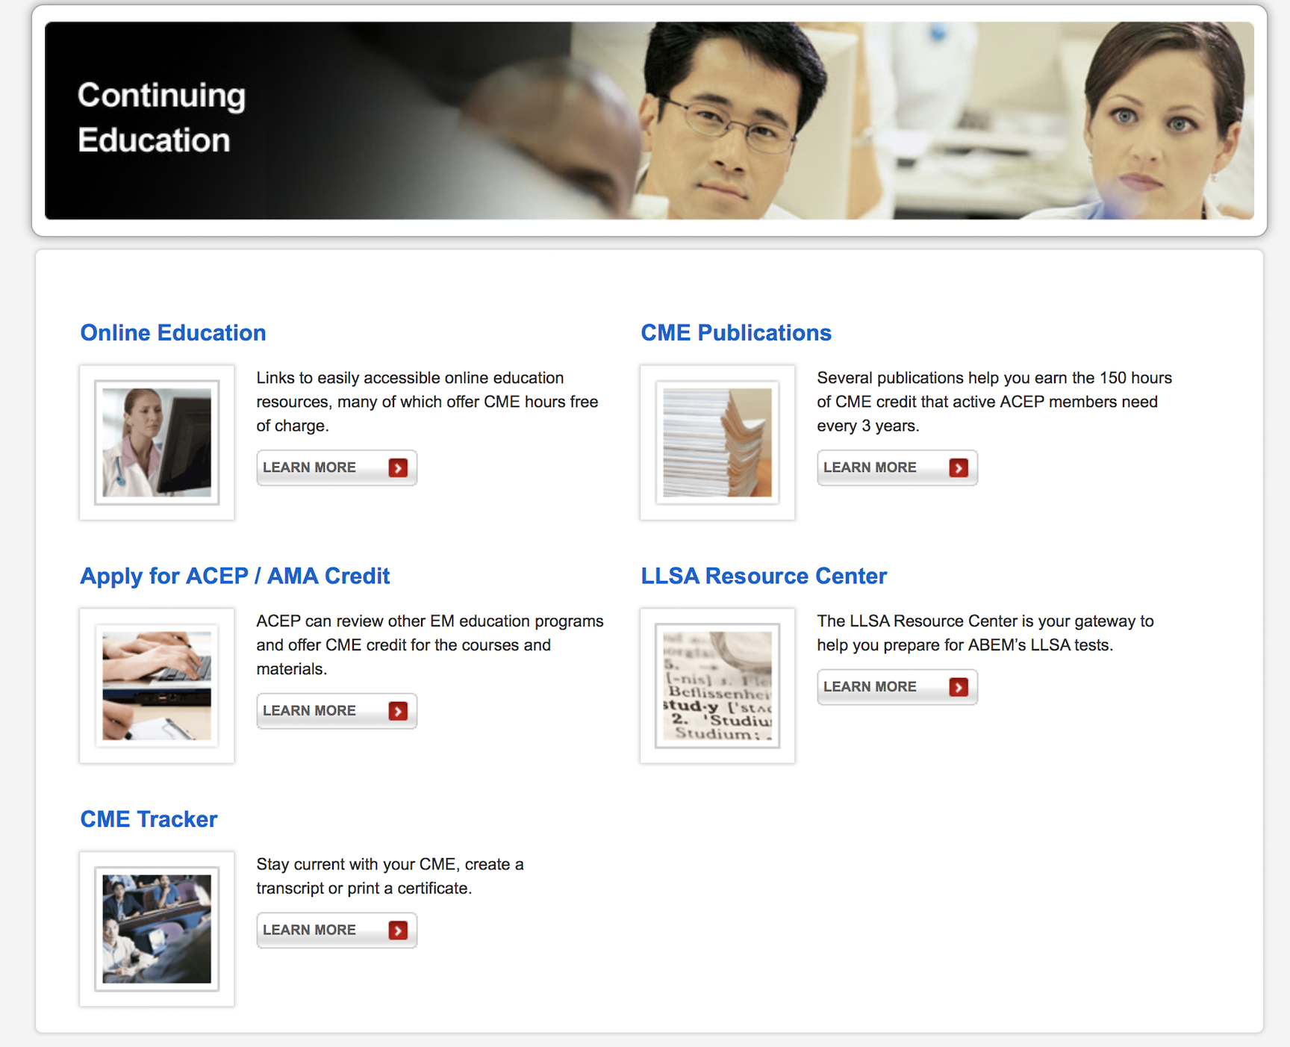
Educational Support

Slide 18

EMS Week
May 20-26, 2018
Monday - Education
Tuesday - Safety Tuesday
Wednesday - EMS for Children Day
Thursday - Save-A-Life (CPR and Stop the Bleed)
Friday - EMS Recognition Day

Slide 19
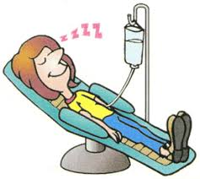
Procedural Sedation
ASA Guidelines
Clinical policy questions
Met with CMS
Redoing Procedural Sedation Guidelines

Slide 20
Problem Solving
Opiates
End-of-life
Violence
Medication shortages
PDMP

Slide 21
Boarding
Working with AHA as this is systems problem
Working APA on solutions to expedite discharge from the Emergency Department

Slide 22
Psychiatric Paradigm
ED-Safe
Psychiatric Receiving Centers (Alameda Model)
Psychiatric Policy Writing Group
CMS meetings to clarify EMTALA

Slide 23

ACS/COT
Trauma Certification
Stop the Bleed
Joint Policy Statements

Slide 24
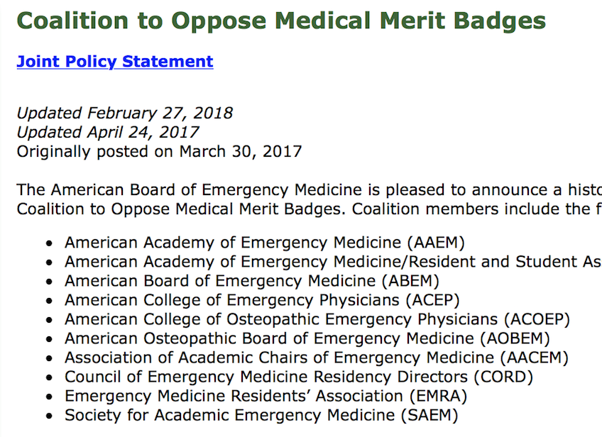
COMMB
ACLS
APLS
PALS
ATLS CME

Slide 25
Leadership Development
Emergency Department Directors Academy
LAC2018
Executive Directors meeting at LAC and Summit in Dallas

Slide 26

Medical Legal
Egregious witness testimony
Peer Review Requirement
Clinical Policies

Slide 27
Protect the Individual Physician
Egregious Testimony
Insurance
Scope of Practice
Improve work environment
Wellness Resources
“Plan B”

Slide 28
Contract transitions
In light of consolidation and certain occurrences
120 day

Slide 29
Individual Contract Support
Emergency Department Directors Academy
Democratic Group Section
Billing & Coding Conference
Contract Transitions

Slide 30
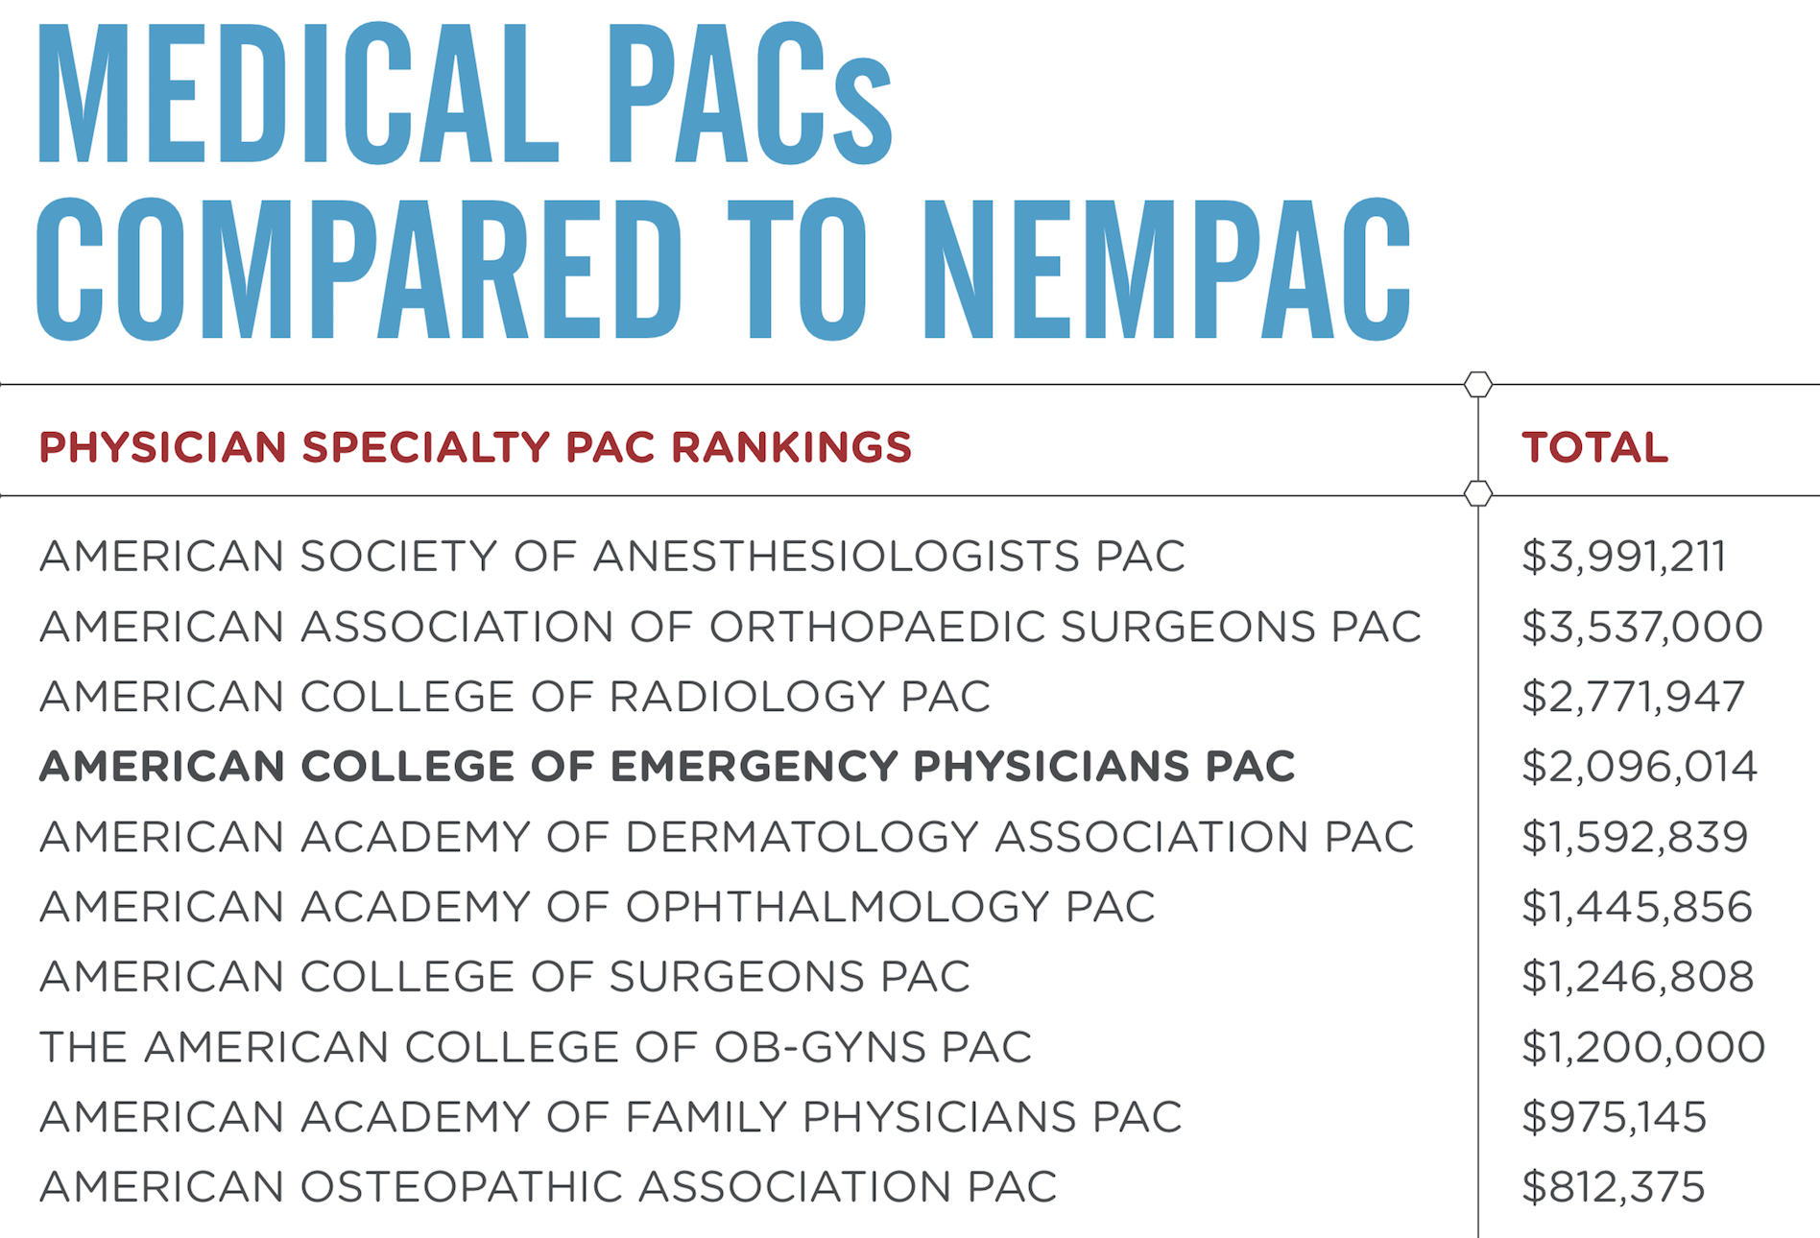
PAC

Slide 31
What is ACEP Worth (125x12 hours)
Value Add
ROI
COMMB
ECG (-25 modifier)
RUC Valuation of 99281-5 (8%)
PLI (-5%)
Procedural Sedation
ACS-COT Trauma CME
CEDR
OON
20 hours
10 hours
90 hours
5 hours
10 hours
16 hours
14 hours
?????

Slide 32

You are all leaders

Slide 33
What is ACEP Worth (125x12 hours)
Value Add
ROI
COMMB
ECG (-25 modifier)
RUC Valuation of 99281-5 (8%)
PLI (-5%)
Procedural Sedation
ACS-COT Trauma CME
CEDR
OON
20 hours ($4000)
10 hours ($20x 100=$2000)
90 hours ($18000)
5 hours ($1000)
10 hours ($200 x10)
16 hours ($3200)
14 hours ($2800)
?????

