Slide 1
Advances in Psychiatric Emergency Medicine
Paul Kivela, MD, MBA, FACEP
Napa California

Slide 2
Perceived Conflicts
My spouse is a board psychiatrist that does telepsychiatry
President, American College of Emergency Physicians
Member, American Association of Emergency Psychiatry

Slide 3
Important to suggest solution to any problem
Perfect is the enemy of good

Slide 4
The Problem

Slide 5
Decreased Psychiatric Facilities & Beds
1955- 558,922 patients
1970- 413,044 beds
1998- 63,525 beds
2005- 50,509 beds
2010- 43,318 beds
2016- 37,679 beds
Notes:
http://www.beckershospitalreview.com/patient-flow/amid-shortage-number-of-psychiatric-beds-in-us-down-13-from-2010.html

Slide 6
Increased demand
Ambulatory mental health
1969 1,202,098
1998 3,967,019
2013 Estimated 4.7 million ED visits
https://www.cdc.gov/nchs/data/ahcd/nhamcs_emergency/2013_ed_web_tables.pdf

Slide 7
Psych patients are a big part of crowding

Slide 8
Psychiatric Patients
Longer Length of Stay
Overcrowding
Boarding
Diversions
Wall time

Slide 9
Psychiatric Boarding (Per Scott Zeller)
Studies showing average psychiatric patient in medical emergency departments boards for an average of between 8 and 34 hours
2012 Harvard study: Psych patients spend an average of 11.5 hours per visit in ED; those waiting for inpatient beds average 15-hour stay
2012 California Hospital Association Study: After decision made for psychiatric admission, average adult waits over ten hours in California EDs until transferred

Slide 10
Cost of Psychiatric Boarding
“Costs” a hospital $100/ hour in lost revenue
Treatment Advocacy Center, 2012
Average cost to an ED to board a psychiatric patient estimated at $2,264
Nicks B, Manthey D. Emerg Med Int. 2012.

Slide 11
Why Now?
Mental Health is getting far more attention
There is funding for opiate abuse
This is already a tremendous expense for hospitals
This is a potential cost and time savings
New advances in treatment have arrived and more are coming

Slide 12
Issues
There just simply inadequate psychiatric services
81% of emergency physician leaders polled believed that a regional dedicated emergency psychiatric facilities would improve the system
2008 ACEP Study
Majority of psychiatric patients had a poor experience in the ER and would prefer a specialized psychiatric center
2003 Allen MH Study Journal of psychiatric practice

Slide 13
Why is psychiatry different then orthopedic surgery?
With numbers it would like admitting every patient with chest pain.
It would be like admitting every patient with a broken bone

Slide 14
The Solutions
ACEP Clinical Policies
Psychiatric Fellowships
Dedicated Psychiatric Emergency Services (PES) Units
Crisis Stabilization Units (CSU)
Acute Psychiatric Care in the Emergency Department

Slide 15
ACEP Policy on Psychiatric Boarding
4 questions approved January 2017

Slide 16
ACEP Policy on Psychiatric Boarding
Question 1. In the alert adult patient presenting to the emergency department with acute psychiatric symptoms, should routine laboratory tests be used to identify contributory medical conditions (nonpsychiatric disorders)?
Patient Management Recommendations. Level C: Do not routinely order laboratory testing on patients with acute psychiatric symptoms. Use medical history, previous psychiatric diagnosis, and physician examination to guide testing.
In addition, it is likely that subsets of patients with higher rates of disease (eg, elderly, immunosuppressed, new-onset psychosis, substance abuse) may benefit from routine laboratory testing. Routine urine toxicology testing has not been shown to provide benefit in terms of influencing the management or disposition of ED patients, but it may be helpful for an objective understanding of the patient’s potential substance abuse on transfer to a psychiatric facility.

Slide 17
ACEP Policy on Psychiatric Boarding
Question 2. In the patient with new-onset psychosis without focal neurologic deficit, should brain imaging be obtained acutely?
Patient Management Recommendation Level C:
Use individual assessment of risk factors to guide brain imaging in the emergency department for patients with new-onset psychosis without focal neurologic deficit (consensus recommendation).
There were no Class I, II, or III studies to answer this question. In the Class X studies that did categorize imaging abnormalities, the percentage of imaging findings described as being clinically relevant, influencing clinical management, or altering diagnosis ranged from 0 percent to approximately 5 percent.

Slide 18
ACEP Policy on Psychiatric Boarding
Question 3. In adult patients presenting to the emergency department with suicidal ideation, can risk-assessment tools in the emergency department identify those who are safe for discharge?
Patient Management Recommendations Level C:
In patients presenting to the emergency department with suicidal ideation, physicians should not use currently available risk-assessment tools in isolation to identify low-risk patients who are safe for discharge. The best approach to determine risk is an appropriate psychiatric assessment and good clinical judgment, taking patient, family, and community factors into account.
Class III studies were identified that investigated whether risk assessment can identify patients who are at risk for future self-harm. The designs of these studies were problematic, and no tool has been demonstrated to accurately predict the risk of suicide among patients in the emergency department.

Slide 19
ACEP Policy on Psychiatric Boarding
Question 4. In the adult patient presenting to the emergency department with acute agitation, can ketamine be used safely and effectively?
Patient Management Recommendations Level C:
Ketamine is an option for immediate sedation of the severely agitated patient who may be violent or aggressive (consensus recommendation).
Management of acutely agitated patients in the emergency department remains a critical issue. Most of these patients can be sedated safely with antipsychotics and/or benzodiazepines. However, there remains a subset of extremely agitated patients for whom this approach will not be effective. Although there is a lack of Class I, II, or III studies establishing the safety and efficacy of ketamine to control acute agitation in the emergency department, the skills set of emergency physicians and their familiarity with the use of ketamine make it a reasonable choice when immediate control of the acutely agitated patient is required for patient and/or staff safety.

Slide 20
Emergency Psychiatric Fellowships

Slide 21
Regional Dedicated Psychiatric Facilities
Can be expensive to staff and maintain 24/7
Typically only makes sense for systems >3000 psychiatric emergencies/year
Medicaid pays hourly “Crisis Stabilization” rate in several states, as do many private insurers via contract, but difficult to get adequate Medicare reimbursement
Currently our team in contact with CMS and SAMHSA urging Crisis Stabilization-style reimbursement nationally

Slide 22
Shift from identifying depression to treating suicidality
It is okay to discharge someone with suicidal ideation
Move from identification and boarding to treatment and discharge
Make sure patient is safe
Make sure empathic
Work to find follow-up

Slide 23
Alameda Model
76% of patients treated in a Psychiatric Emergency Services (PES) Unit can be discharged home or to a community based program within 24 hours so that
They are treated in the least restrictive setting
Disruption of their lives is minimized
Psychiatric boarding in hospital ED’s is eliminated
Unnecessary psychiatric hospitalization are prevented

Slide 24
Alameda Model
Regional Dedicated Psychiatric Emergency Service (PES) for all of Alameda County
Accepts patients from 11 adult medical Emergency Departments in the region as soon as medically stable, regardless of insurance coverage
Psych patient boarding times in area EDs were only 1 hour, 48 minutes – compared to California average of 10 hours, 3 minutes
Approximately 76% of these patients were able to be discharged
Notes:
an improvement of over 80%

Slide 25
Crisis Stabilization Unit
Lower Volumes
Can be used like observation

Slide 26
Examples are either free standing or integrated with hospital/emergency department
Burke Centers in Texas

Slide 27
Billing Codes??
Facility based “Crisis Stabilization” codes
Medicaid often pays
Many insurers pay
G05002 goes into service next year.
Initial 70 minutes of psychiatric care for patients where the provider initiates and coordinates a patient’s psychiatric care

Slide 28
Even California Medi-Cal pays

Slide 29
LABS and Evaluation
Must rule out medical causes
Focused ordering of CBC, electrolytes, fasting glucose, lipid profile, liver, renal and thyroid function tests
White blood cell (WBC) count with differential for patients treated with clozapine
ECG for patients with a cardiac history or those being treated with antipsychotics that may prolong the QT interval such as clozapine, thioridazine, iloperidone, ziprasidone.

Slide 30
Initiating Treatment in the Emergency Department
It is inappropriate to warehouse “psychiatric” patients in the emergency department awaiting psychiatric care

Slide 31
Poor Outcomes with Anti-depressants
10% of Americans will take antidepressants sometime in their lifetimes,
National Institutes of Mental Health estimates that these medications are only slightly more effective than placebos.
Only 1/3 of patients respond to the first medication tried
Trial and error with alternative and multiple medications is required before an additional 1/3 of patients find some relief.
30% of those who suffer from depression do not respond to any medication at all.
Notes:
As it happened, Melissa had gotten her genome sequenced as part of an earlier research project, so scientists in her lab learned after her death that she had duplication of the CYP2D6 gene, which codes for enzymes that breakdown and inactivate drugs like Paxil.
This discovery lead the doctors to conclude that Melissa’s genetic make-up doomed Paxil to fail from the start because her system was doubly efficient at breaking down the drug, eliminating it from her system and making it unavailable to her brain.
Someday doctors will routinely have such genetic information before they prescribe psychoactive medication and greatly improve the hit and miss results that contributed to Melissa’s death.
And that someday is today.
Like Melissa, Andrew had suffered from severe anxiety and depression for years. His problem wasn’t that antidepressants didn’t work, but that the drugs caused severe side effects. In desperation, he turned to the Mayo Clinic where “pharmacogenomic” testing had recently been implemented. Mayo doctors discovered that Andrew had the opposite problem from Melissa: he lacked the genes to code for enzymes to breakdown the drug properly, so that the antidepressant remained in his system in abnormally high doses, producing severe side effects.

Slide 32
Start with SSRI’s
Response (reduction of baseline symptoms ≥50 percent) was better with escitalopram, mirtazapine, sertraline, and venlafaxine, compared with duloxetine, fluoxetine, fluvoxamine, paroxetine, and reboxetine.
Less side effects with citalopram, escitalopram, and sertraline
Therefore escitalopram and sertraline are likely first choice medications

Slide 33
Secondary options for depression
2nd Generation
Selective serotonin reuptake inhibitors (SSRIs)
Serotonin-norepinephrine reuptake inhibitors (SNRIs)
Atypical antidepressants
Serotonin modulators
Older, first-generation antidepressants
Tricyclic antidepressants- Try to Avoid
Monoamine oxidase inhibitors (MAOIs)- Avoid from the ED
Notes:
Citalopram2020 to 40^{Δ}10 to 40^{Δ}Escitalopram1010 to 205 to 30Fluoxetine2020 to 6010 to 80Fluvoxamine5050 to 20025 to 300Fluvoxamine CR100100 to 200100 to 300Paroxetine2020 to 4010 to 50Paroxetine CR2525 to 5012.5 to 62.5Sertraline5050 to 20025 to 300Serotonin-norepinephrine reuptake inhibitorsDesvenlafaxine25 to 5050 to 10050 to 400◊Duloxetine30 to 6060 to 12030 to 120§Levomilnacipran2040 to 8020 to 120Milnacipran12.5100 to 20050 to 300Venlafaxine37.5 to 7575 to 37575 to 375Venlafaxine XR37.5 to 7575 to 22575 to 375Atypical agentsAgomelatine§ (not available in United States)2525 to 5025 to 50Bupropion200300 (maximum single dose 150 mg)100 to 450Bupropion SR 12 hour150300 (maximum single dose 200 mg)150 to 400Bupropion XL 24 hour150300150 to 450 (United States)
150 to 300 (Europe)Bupropion hydrobromide 24 hour174348174 to 522Mirtazapine1515 to 457.5 to 60Serotonin modulatorsNefazodone‡200300 to 60050 to 600Trazodone100200 to 500100 to 600Trazodone ER150375150 to 375Vilazodone104010 to 40Vortioxetine10205 to 20Tricyclics and tetracyclics†Amitriptyline25150 to 30010 to 300Amoxapine25200 to 30025 to 400Clomipramine25100 to 25025 to 300Desipramine25150 to 30025 to 300Doxepin25150 to 30025 to 300Imipramine25150 to 30010 to 300Maprotiline25100 to 22525 to 225Nortriptyline2550 to 15010 to 150Protriptyline1015 to 605 to 60Trimipramine25150 to 30025 to 300Monamine oxidase inhibitors†Isocarboxazid1010 to 4010 to 60Phenelzine1515 to 907.5 to 90Selegiline transdermal6 mg/24 hour patch6 to 12 mg/24 hour patch6 to 12 mg/24 hour patchTranylcypromine

Slide 34
Medications for Depression

Slide 35
Medications for Depression

Slide 36
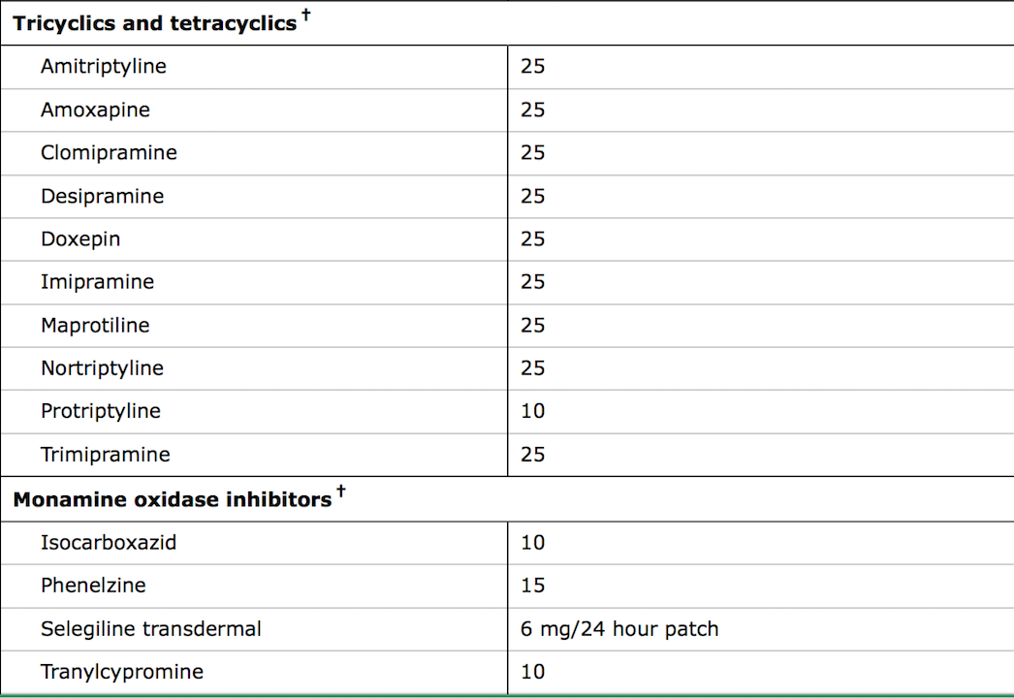
Medications for Depression

Slide 37
Ketamine: Thought to be effective

Slide 38
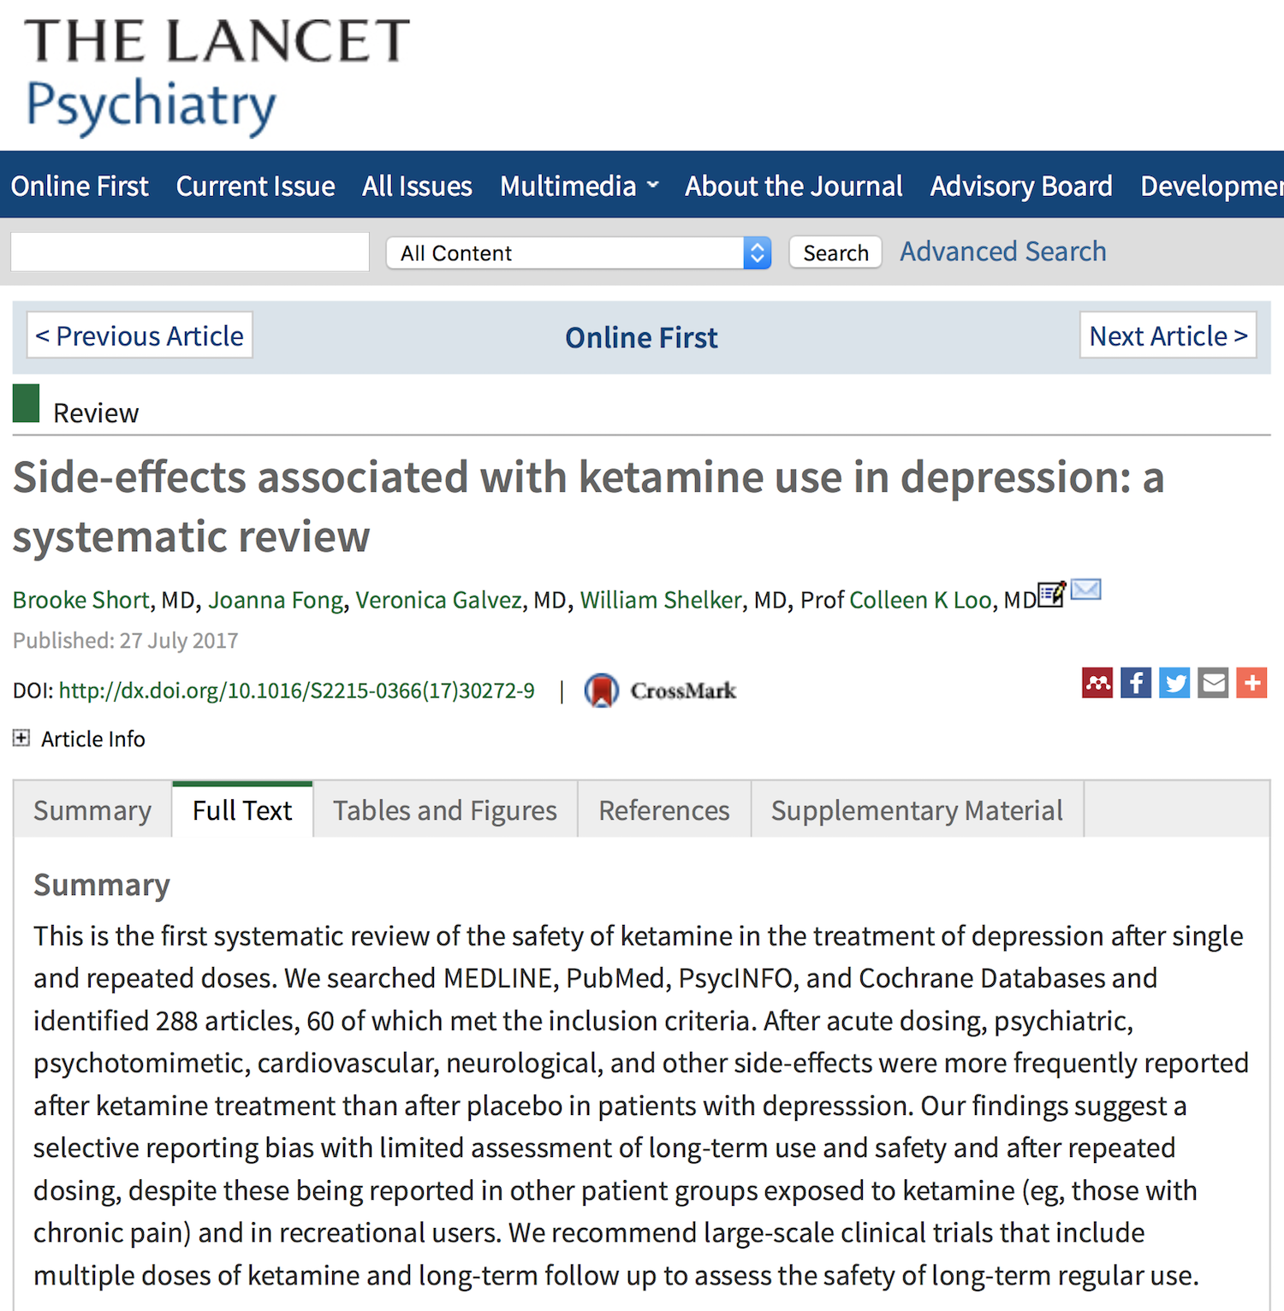
Is Ketamine Safe for Repeated Use?

Slide 39
Sleep Disorders and Depression
One of the most common symptoms is insomnia
Insomnia is most common sleep disorder

Slide 40
Psychogenomic testing
A recent clinical trial further revealed (based on genetic tests discussed below) that up to 70% of patients are prescribed medication that has no chance of working.
And a quarter of patients who take antidepressants, report significant side effects
Likely to be widespread use in the next 10 years

Slide 41
Advances in Schizophrenia
landmark study links together how a specific genomic variant confers increased risk of schizophrenia. Namely, the C4 gene, which encodes the complement protein C4, may increase schizophrenia risk by influencing synaptic pruning during critical periods of brain development.
findings that schizophrenia is associated with immune genes (specifically those within the major histocompatibility complex [MHC] locus), has a usual age of onset in young adulthood, and is associated with cortical thinning and synapse loss.
Nature 530, 177–183 (11 February 2016)

Slide 42
Acute management of psychosis
Non-sedating agents can also be effective for reducing agitation. Risperidone 1 to 2 mg or olanzapine 5 to 10 mg
Oral rapidly dissolving
Risperidone
Olanzapine
asenapine
aripiprazole.
Short-acting intramuscular (IM) injectable formulations (eg, haloperidol, olanzapine, aripiprazole, and ziprasidone): Olanzapine 5 or 10 mg administered intramuscularly is a good choice under most circumstances.
Inhaled loxapine

Slide 43
Acute management of psychosis
•A combination of haloperidol 5 mg, lorazepam 2 mg, and benztropine 1 mg given intramuscularly can be effective to treat severe agitation in schizophrenia.
Safe
Fast 10 to 30 minutes IM Versus 30 to 60 oral administration.

Slide 44
Where do we go from here
Measure the Issue.
Create Vision
Develop the Proposed Solution
Work through the “Financial Model”
Build Consensus and Get “Buy-in”
Implement
Measure the Results
Show Value

