Slide 1
Critical Access Survival Tips
Doing more with less, off the beaten path

Slide 2
Critical Access Survival Tips
What is a Critical Access Hospital?
Defined in 1997 (Public Law 105-33) in response to closures of rural hospitals in 80s and 90s.
Intended to reduce the financial vulnerability of rural hospitals.

Slide 3
Critical Access Survival Tips
25 or fewer acute care/inpatient beds
35 miles or more from next nearest hospital
(15 if in mountainous terrain or only secondary roads)
Annual average length of stay of 96 hour or less for acute care patients
Offer 24/7 emergency care services

Slide 4
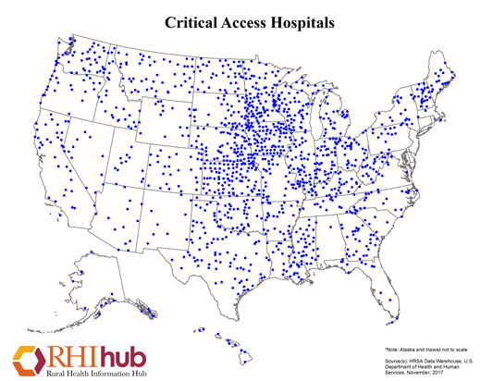
Critical Access Survival Tips

Slide 5
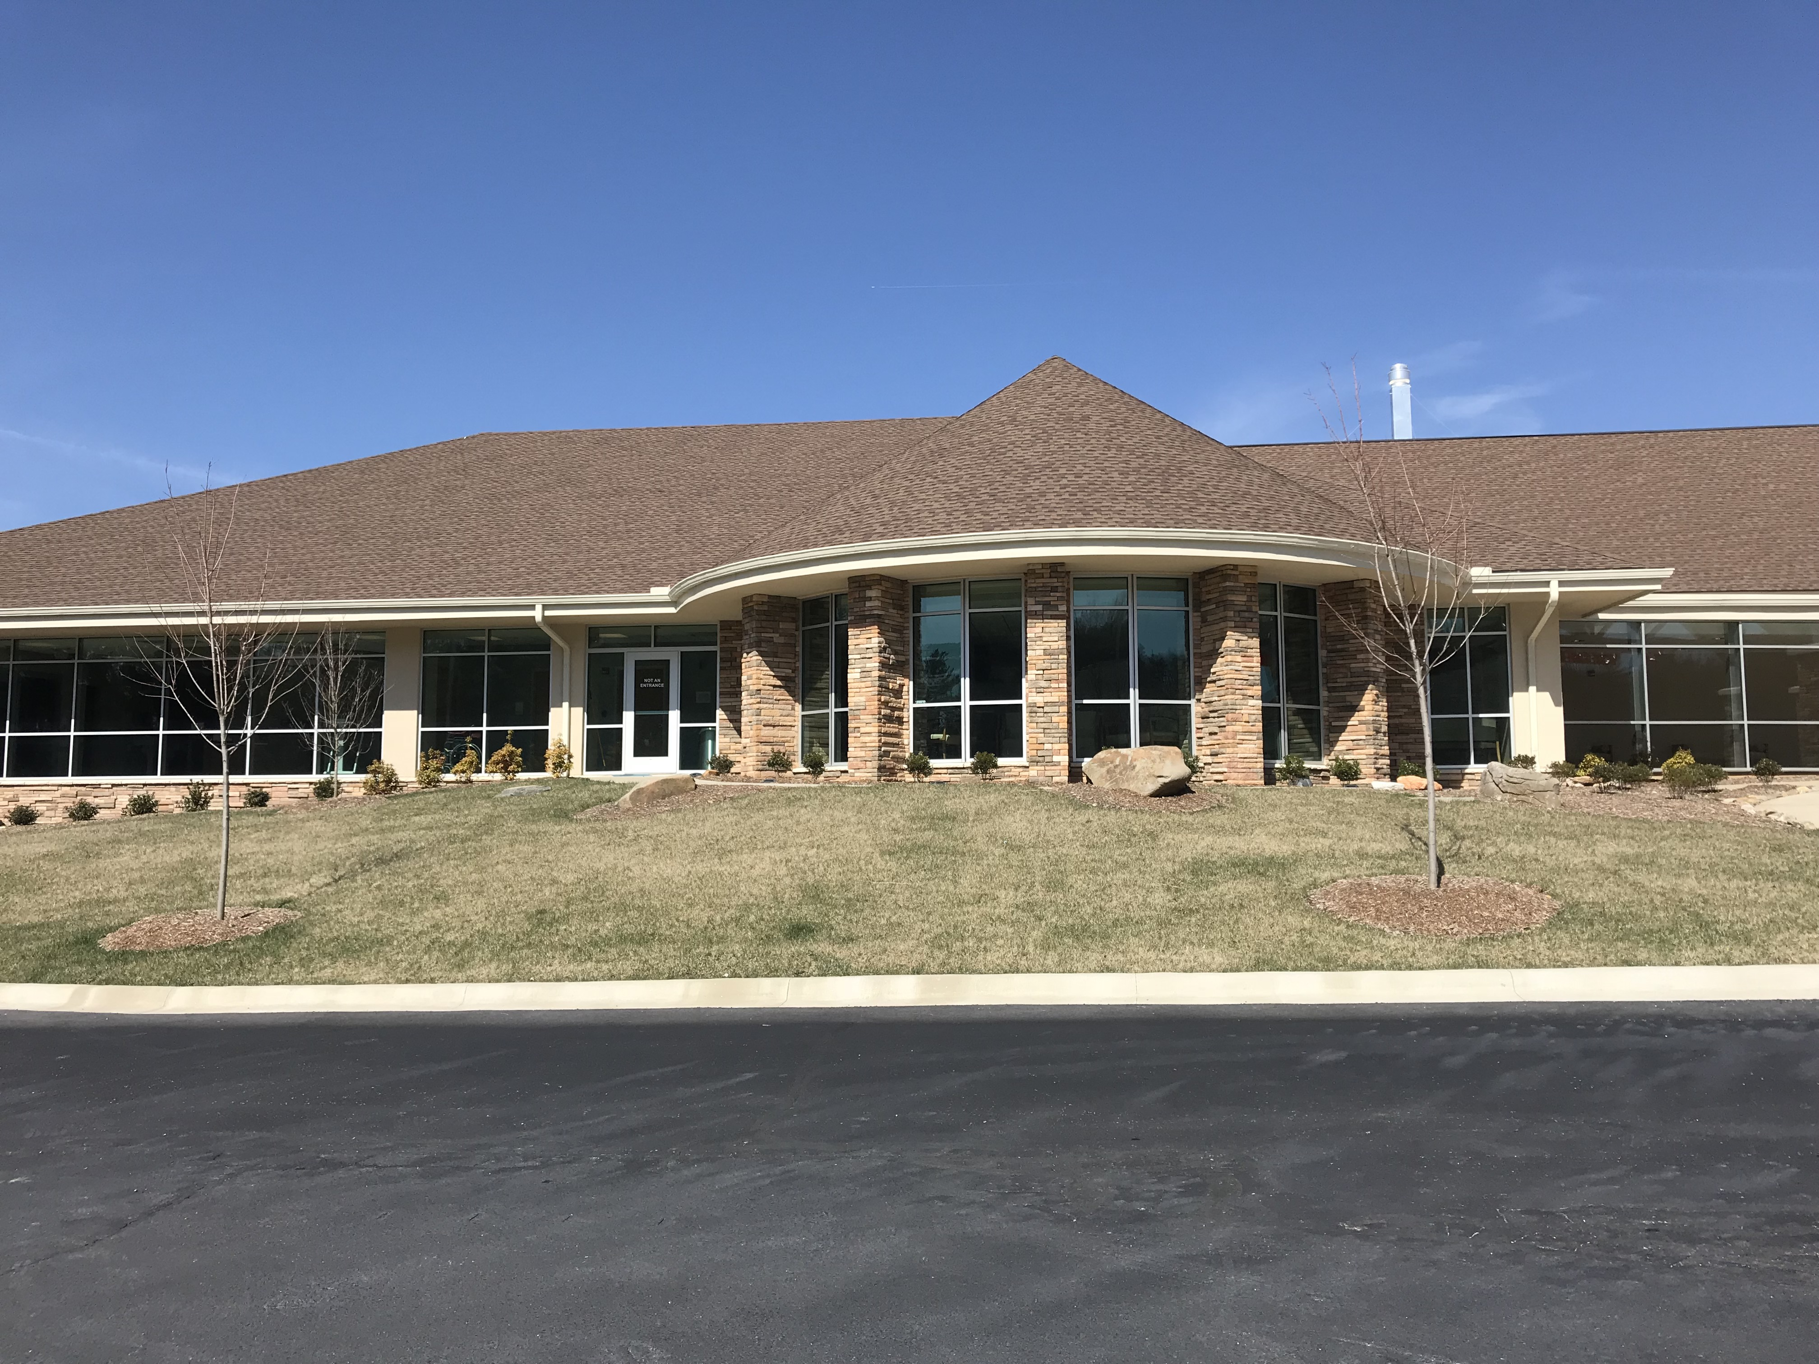
Critical Access Survival Tips
I have worked in a number of Critical Access Hospitals.

Slide 6
Critical Access Survival Tips
The Memorial Hospital, Craig, CO. Kremmling Memorial Hospital, Kremmling, CO. Crawford Memorial, Robinson, IL. Community Hospital of Bremen, Bremen, IN. Decatur County Memorial, Greensburg, IN. St. Vincents/Randolph, Winchester, IN. Highlands-Cashiers Hospital, Highlands, NC. New Horizons Medical Center, Owenton, KY.

Slide 7
Critical Access Survival Tips
After 20 years in a busy semi-rural hospital, it was a wonderful change.

Slide 8
Critical Access Survival tips
Why would I recommend it?

Slide 9
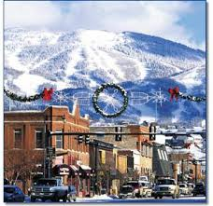
Critical Access Survival Tips
For one: Location, location, location

Slide 10
Critical Access Survival Tips
For another? Volume.
Four ED patients in 36 hours is easy money.
Even if the hourly rate is lower than in the city.

Slide 11
Critical Access Survival Tips
But perhaps best of all, the chance to take your incredible skills to a place where they are desired and desperately needed.
And frequently absent.
‘So that’s what intubation is supposed to look like!’

Slide 12
Critical Access Survival Tips
So what do you need to do to prepare for work in a CAH?

Slide 13
Critical Access Survival Tips
Before you go, talk to the director and/or CEO.
Ask about:

Slide 14
Critical Access Survival Tips
Geography. What are the limitations? Is the hospital on the coast and affected by hurricanes?
Is it on a mountain top and affected by snow, ice and fog?
Personal note: helicopters don’t fly if there’s lots of smoke from a forest fire!

Slide 15
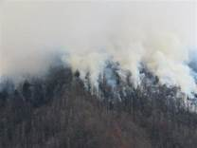
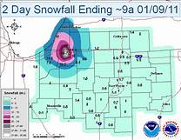
Critical Access Survival Tips
All of these affect transport of your patients

Slide 16
Critical Access Survival Tips
Ask about the nearest referral centers.
Is the hospital part of a larger organization?
This can make transfers much easier.

Slide 17
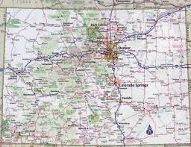
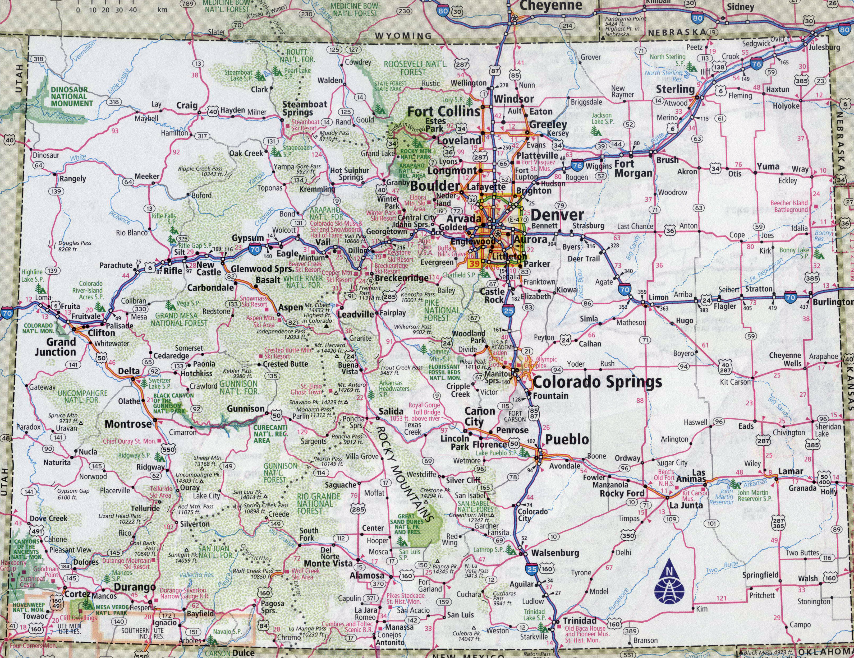
Critical Access Survival Tips

Slide 18
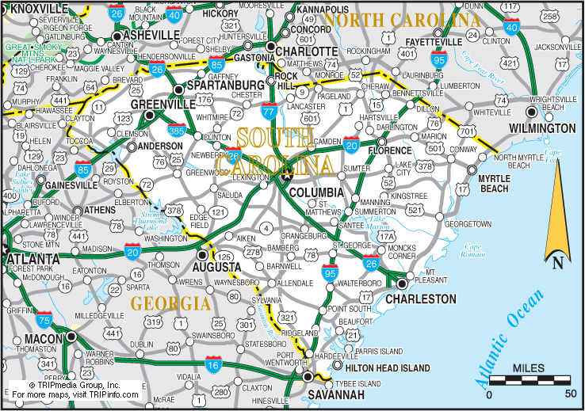
Critical Access Survival Tips

Slide 19
Critical Access Survival Tips
If you plan to work there a while, if your group is taking over, etc., go and meet the folks in the nearest referral center.
Explain to them what you need and especially what you don’t have.

Slide 20
Critical Access Survival Tips
As soon as you can (even if it’s your first day), find out what you have in terms of staff.
Is there a hospitalist? Sometimes there is.
Will YOU be the hospitalist? (Ask this before you ever go.)
Hospitals seem to assume a doctor is a doctor…

Slide 21
Critical Access Survival Tips
Being the hospitalist can be bearable when it’s slow.
It can be agony during vacation seasons in some areas.

Slide 22
Critical Access Survival Tips
You may simply have to round on patients on the weekend.
Or you may be expected to admit, manage and discharge.
Odds are you won’t make any more money for the trouble.

Slide 23
Critical Access Survival Tips
Is there a surgeon? Is there an OB? A family doctor who acts as an OB?
Are there other resources in the community, like orthopedics? A plastic surgeon?
Are there agreements with other sites?

Slide 24
Critical Access Survival Tips
What about stroke?

Slide 25
Critical Access Survival Tips
What about STEMI?

Slide 26
Critical Access Survival Tips
Many EMS services will go ahead and transport these patients to referral centers, knowing the delays in coming to the CAH first.
They still walk through the door.

Slide 27
Critical Access Survival Tips
You always wanted to be a cardiologist? Neurologist? Neurosurgeon? Congratulations? On the mountain-top, you are.
You may give tPA for STEMI. You may keep the SAH overnight due to snow and ice.

Slide 28
Critical Access Survival Tips
Your patient may fly in one of these if the distances are far enough. Say, from Craig, Colorado to Grand Junction.

Slide 29
Critical Access Survival Tips
Communication is key. Use all resources available as you’ll most likely be…

Slide 30
Critical Access Survival Tips
Sometimes the hardest part is explaining to other people (often residents) that you don’t have the things the patient needs.
An ICU. A pediatrician. Dialysis. A surgeon. An MRI. Even an ultrasound machine.
‘No, seriously, the lab can’t run spinal fluid. I can do the tap, they just can’t evaluate it. No, I’m not kidding.’ (Real conversation in rural KY, talking with UK)

Slide 31
Critical Access Survival Tips
Be firm and be realistic. You can’t do a plastic closure for two hours while the ED piles up and there are sick people on the floor and taking up your five other beds.

Slide 32
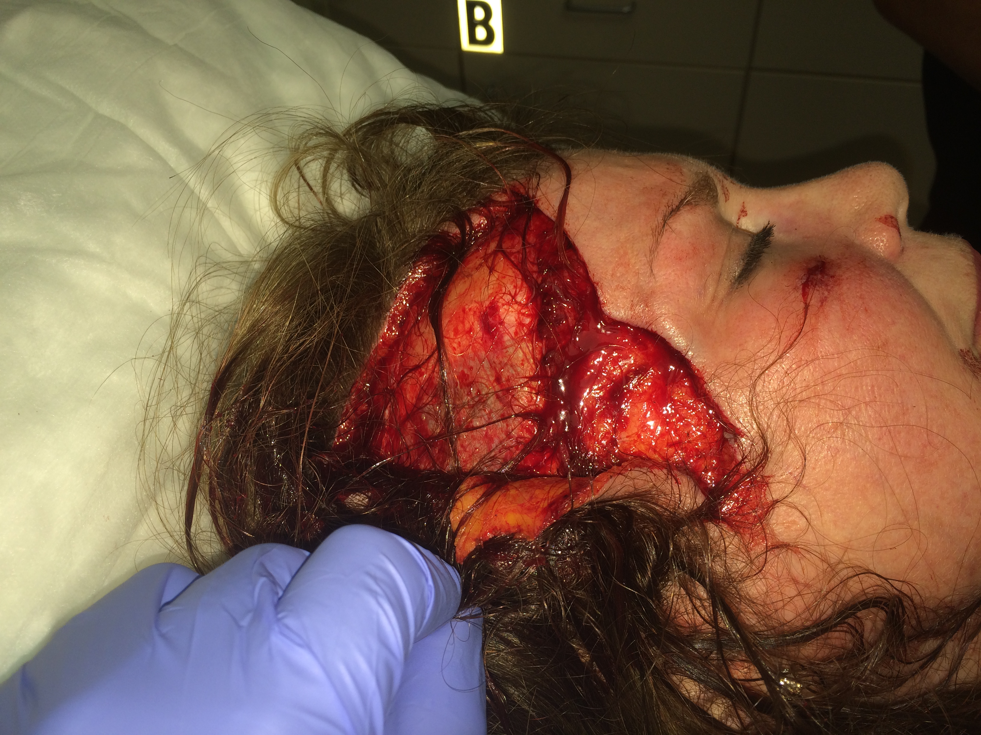
Critical Access Survival Tips

Slide 33
Critical Access Survival Tips
‘Well I guess, but I’ve never had someone send me a laceration from an ER. Why can’t you close it?’ Maxillofacial fellow at referral center.
To whom I sent the photo.

Slide 34
Critical Access Survival Tips
Remember that EMTALA aside, sometimes you can only make a patient so stable.
If you’re AAA is leaking and I have no surgeon, well a blood pressure of 60 may have to do…

Slide 35
Critical Access Survival Tips
Ask about nursing and ancillary staff. Is respiratory on site? Is lab on site? Is X-ray called in from home?
What about ultrasound?
‘Dr. Leap, I’ve never learned to do US on women.’
Uh, yeah.

Slide 36
Critical Access Survival Tips
Most sites use tele-radiology. Will you get real-time reads? Can you call for help if not?

Slide 37
Critical Access Survival Tips
When patients are seriously ill or injured, and you know they will need transport, call early and begin the process. Open fracture, sick infant, OB, stroke, etc.
Arranging transportation alone can be time consuming.
Get the ball rolling.

Slide 38
Critical Access Survival Tips
Check with multiple transport services.
In weather, helicopters may be able to come from another direction.

Slide 39
Critical Access Survival Tips
Two children ejected from buggy struck by F-250. Stable, no apparent injuries, normal VS. IV access. Awake and alert. C-collar, backboards.
Transported without labs or X-rays, within minute s of arrival and evaluation.

Slide 40
Critical Access Survival Tips
Other communications issues: will phones and Internet function?
Not always.
Connectivity may be poor due to weather or infrastructure.

Slide 41
Critical Access Survival Tips
First night as director in small rural hospital.
12 patients from bus crash.
Internet and phone services down due to another crash.
Nurse cell phones used to communicate with receiving hospitals and radiologists.
Innovate…

Slide 42
Critical Access Survival Tips
Your skills are uniquely suited.
Intubation is up to you.
No anesthesia backup so consider adjuncts.
There may or may not be video laryngoscopy.

Slide 43
Critical Access Survival Tips
Ultrasound? Can really help cut time to diagnosis.
If the hospital has one. This is not an absolute.

Slide 44
Critical Access Survival Tips
It’s heresy, I know. But sometimes, when you’re alone, CT is the better option. The accepting center will probably ask for it anyway.

Slide 45
Critical Access Survival Tips
IV access: Peripheral, EJ, central line.
Femoral lines are fast. Dirty? Sure.
But it does the job and gets you back to the patients.
If you have time? Do what you like.

Slide 46
Critical Access Survival Tips
The IO is AWESOME.
Don’t be proud, get access.
‘Say hello to my little friend!’

Slide 47
Critical Access Survival Tips
Brush up on your critical care skills.
Review your infusions and vent management.
You may find yourself running a Critical Access ICU until transportation is available.

Slide 48
Critical Access Survival Tips
Don’t assume the pharmacy has what the big center has.
Don’t assume you have much blood. You may only have two units.

Slide 49
Critical Care Survival Tips
Don’t feel like you’re ‘dumping’ the patient if you can’t offer what they need.
Remember, too, that if the ED physician is the only physician, there will be limited continuity when you leave in the morning.

Slide 50
Critical Care Survival Tips
Don’t be afraid to call and ask questions, even if not for transportation.

Slide 51
Critical Care Survival Tips
Keep resources at hand. Hopefully the site has reference books.
Don’t assume the Internet will work.
Hopefully your smart-phone has some things you need.

Slide 52
Critical Care Survival Tips

Slide 53
Critical Care Survival Tips
Simple things can stay: COPD flare, pneumonia, dehydration, UTI.
Complicated things: stabilize and ship asap.
Sepsis, stroke, STEMI, trauma, suspected trauma, etc. etc. etc.

Slide 54
Critical Access Survival Tips
Don’t waste effort. Once you identify the significant problem (eg, traumatic SAH), stabilize, call and start the transfer.
Too many films and labs don’t change anything and delay care.

Slide 55
Critical Access Survival Tips
‘Hello, this is Dr. Leap at Highlands Cashiers Hospital. I have a five-year-old Hispanic male who has been run over by a car.’
Trauma surgeon: ‘Well he needs to be at the trauma center!’
‘Uh, yeah, that’s why I’m calling you…’

Slide 56
Critical Access Survival Tips
‘What if I can’t do anything to help?’
Simply by being there with your skills, you’re giving the sickest patients a fighting chance.
If you weren’t there they’d certainly die. If you are they might not.

Slide 57
Critical Access Survival Tips
Lesser issues: Make sure they feed you. If not, bring your own food. 24-36 hours is a long time to eat crackers.
Some hospitals may let you go 20-30 minutes away. It’s within the law. They’ll just call you.
Some are partially staffed by PA’s and NP’s. For better or worse.

Slide 58
Critical Access Survival Tips
Some days you’ll do nothing.
Some days you’ll wonder why you ever came to the the middle of nowhere.
Good time to read, do CME, write, or just put up your feet and watch the snow fall.

Slide 59
Critical Access Survival Tips
Community Hospital of Bremen seriously has the greatest call room in the known universe.
And a hitching post for horse and buggy.

Slide 60
Critical Access Survival Tips
These are not places for the faint of heart, who have little to no experience.
If you feel ready, and comfortable, you give these communities a great gift.
Your knowledge, experience and calm will change lives and save lives that might otherwise be lost.

Slide 61
Critical Access Survival Tips
And what a great place to go when you’re older, tired of the rat race and want to slow down but still be useful!
You know, like security.

Slide 62
Critical Access Survival Tips
So in summary: You have limited resources; use them well
Communicate early
Transfer early
Don’t over-test or over-treat
Know your limitations and that of the staff/hospital
Stick to the essentials (airway, easy lines, necessary meds)

Slide 63
Critical Access Survival Tips
Check the weather
Check the food situation
Take a minute to talk to the patients (you’ll usually have time)
Enjoy the peace and quiet
Don’t feel guilty napping or watching Westerns
Know that you’re valued

Slide 64
Critical Access Survival Tips
Beware! If you are nice and do a good job they will ask you to come back.
And offer you a job.
Not the worst thing…

Slide 65
Critical Access Survival Tips
If you want to work in a CAH, you don’t need a locums company.
Call the hospital and contract with them directly if you like. It saves them money.

Slide 66
Critical Access Survival Tips
Rural hospitals are under enormous financial pressure.
Rural communities often struggle without medical care.
Please consider spending time at a small rural hospital or CAH.
You won’t regret it.

Slide 67
Critical Access Survival Tips
After all, they’re part of Emergistan too!

Slide 68
Critical Access Survival Tips
Thank you!
edwinleap@gmail.com
www.edwinleap.com

