Slide 1
Physician Satisfaction Scores

Slide 2
Patient Satisfaction Scores
I have no conflicts of interest to report
I have two sons in college and a daughter yet to go to college.
I’d love to have some conflicts to report.

Slide 3
Physician Satisfaction Scores
Long time doctor, second time as a director.

Slide 4
Patient Satisfaction Scores
Leading doctors is like herding cats…

Slide 6
Physician Satisfaction Scores
So part of being a director, as you know better than I, is pleasing people.
And insurers.
And the government, and administrators.
Satisfaction Scores are everywhere!

Slide 7
Patient Satisfaction Scores
It’s the battle eternal.

Slide 8
Physician Satisfaction Scores
I don’t work for you or with you. We all have unique challenges.
I certainly can’t tell you how to solve all of your patient satisfaction issues.

Slide 9
Patient Satisfaction Scores
Lots of layers to that discussion.
But I was thinking about Physician Satisfaction Scores.
Is there such a thing?
Could the two be connected?

Slide 10
Patient Satisfaction Scores
See, 23 years into practice, I have lots of theories.

Slide 11
Physician Satisfaction Scores
For instance, infants and toddlers are like wild animals and we mustn’t stare into their eyes or they freak out.

Slide 13
Physician Satisfaction Scores
The sodium necessary for admission is always ten less than the actual sodium.
‘What? 120? Unless it’s 110, they don’t meet criteria!’

Slide 14
Physician Satisfaction Scores
Severity of illness is inversely correlated with size of sunglasses.

Slide 15
Physician Satisfaction Scores
And I have a theory that satisfied physicians, perhaps, make satisfied patients.
Sorry, customers.

Slide 16
Physician Satisfaction Scores
We know what sort of things are involved in those patient satisfaction scores, right?

Slide 17
Physician Satisfaction Scores
Was the care timely?
Was the physician courteous?
Did the physician answer your questions?

Slide 18
Patient Satisfaction Scores
Was the facility clean?
Was your pain relieved?
Would you come back to the same physician again?

Slide 19
Physician Satisfaction Scores
Be nice, be fast, be clear, be careful.
I get it.

Slide 20
It’s not rocket science

Slide 21
Physician Satisfaction Scores
We all understand that:
Scores and metrics are tied to compensation
Scores and metrics are tied to continued employment
Scores and metrics are not always fair

Slide 22
Physician Satisfaction Scores
Of course, many of the problems we face are out of our control.
CT reads, admission times, consultations, EMR problems.
‘Call me when the workup is finished.’
We’re caught…

Slide 23
Physician Satisfaction Scores
Let me say this: Considering the conditions in which we work, our ability to generally please patients is almost miraculous.

Slide 24
Physician Satisfaction Scores
Few people on earth can manage to go from cardiac arrest to earache to airway nightmare in 30 minutes and still smile and care.

Slide 25
Physician Satisfaction Scores
I mean it. We see everyone, at anytime, for anything and are held to unimaginable standards, not only for patient care but patient and payer happiness.
No pressure…

Slide 26
Patient Satisfaction Scores
So how do we improve satisfaction in the current environment?

Slide 27
Physician Satisfaction Scores
Was Mick right?
Can’t we get no satisfaction?

Slide 28
Patient Satisfaction Scores
Actually, I think we can.

Slide 29
Physician Satisfaction Scores
I believe that if we’re happier physicians we’ll have happier patients.
At least to the extent we, in the ED, have ANY control of anything.

Slide 30
Patient Satisfaction Scores
Dear doctors, what about us?
Satisfaction starts with our lives
If we make bad decisions in our personal lives, we will have a harder time being kind and gracious.
Not finger pointing. I’ve seen it firsthand.
I’ve done it. Too much house at first!

Slide 31
Physician Satisfaction Scores
Unnecessary debt
Unnecessary personal drama
Neglect of health and family
Insufficient sleep
Substance abuse

Slide 32
Patient Satisfaction Scores
These lead us into stormy times.

Slide 33
Physician Satisfaction Scores
When we as physicians are personally miserable, it’s harder to be ‘super satisfaction’ guy with patients, coworkers and administrators.

Slide 34
Physician Satisfaction
Scores
Some of this also is hard to control. Illness, family crises, educational debt, all conspire to affect us in our jobs.

Slide 35
Physician Satisfaction Scores
Maybe, for various reasons, we can only work in one town, or in one hospital. That sometimes happens too.

Slide 36
Physician Satisfaction Scores
Oddly, some problems can make us better. I was very tuned in to my ‘customers’ when my wife had cancer.
I still have much more compassion for the families of those with cancer.
Trouble can be transformative.

Slide 37
Physician Satisfaction Scores
Other things, we can control. The amount of money we want, the amount we spend.
‘Live where you want, make what you want, work as much or as little as you want.’ Dr. Mike O.

Slide 38
Physician Satisfaction Scores
The amount of time we invest in family, or in non-medical activities that make us happier or better. The time we spend in professional development.

Slide 39
Patient Satisfaction Scores
Sometimes our loved ones help us change.
I was almost a zombie when my wife told me to stop nights.

Slide 40
Physician Satisfaction Scores
But, sometimes, doctors have enormous inertia.
Even when we’re unhappy, we won’t change.
Sunken cost fallacy.

Slide 41
Patient Satisfaction scores
Frequently physicians need help finding that lost ‘satisfaction.’
Burnout is a very real problem, especially in emergency medicine.
Nothing you don’t already know.

Slide 42
Patient Satisfaction Scores
So what can we do for each other?
How can we, directors and partners, friends, make more satisfied physicians?
Thus more satisfied patients?

Slide 43
Physician Satisfaction Scores
There are things we can do, or not do, as leaders to improve the ‘Physician Satisfaction Score.’

Slide 44
Physician Satisfaction Scores
Lead from the front.

Slide 45
Physician Satisfaction Scores
Work lousy shifts on lousy days. Experience the problems with that consultant.
Curse the EMR with everyone else. Advocate for customization, for scribes, for whatever…

Slide 46
Physician Satisfaction Scores
Remember that a physician represents a family.
Look after the whole unit if you can.
A distracted doctor is…distracted

Slide 47
Physician Satisfaction Scores
All too often, a physician is performing poorly because of personal problems.
Mental illness, sorrow over an error.
Having a teenager….if you have one, you understand.

Slide 48
Physician Satisfaction Scores
You want happy doctor who satisfies patients?
Have a meeting with spouses a couple times a year.
They have incredible insights and ideas…

Slide 49
Physician Satisfaction Scores

Slide 50
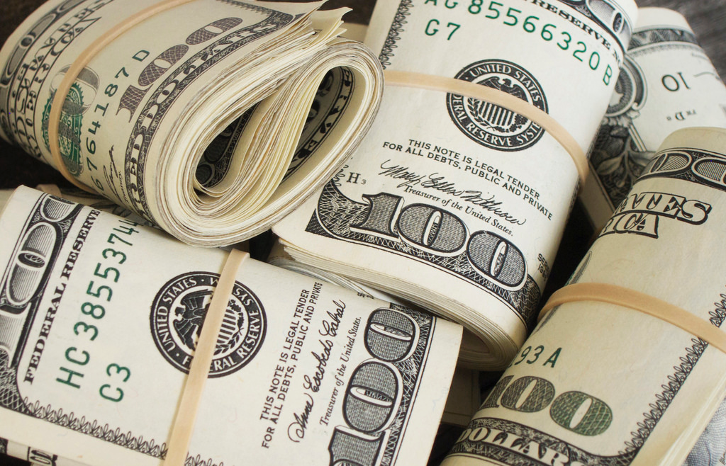
Patient Satisfaction Scores
And if you want help figuring out how to make money more effectively…
How to explain to your doctors what they need to do for billing…
Tell those spouses.
They usually write the checks.

Slide 51
Physician Satisfaction Scores
When physicians act out, or are confrontational, talk to them.
We sometimes call it ‘burnout’ but what a loaded term!

Slide 52
Physician Satisfaction Scores
Have they just had enough? Have they seen too much? PTSD?
When bad things happen, have a debrief.
When too many bad things happen, offer a break.

Slide 53
Physician Satisfaction Scores
Maybe we need to let them vent.
Or help them find counseling?
Maybe wounded healers don’t get good sat scores?
Or maybe they do?

Slide 54
Physician Satisfaction Scores
Have you considered a mandatory sabbatical?
Say, after five years, a one month paid sabbatical per year. Or whatever you see fit.
A time to travel, learn, recover.

Slide 55
Physician Satisfaction Scores
Our homeschool time spent traveling was restorative.

Slide 56
Patient Satisfaction scores
Sometimes a completely new venue is necessary.
In order to keep the expertise, move the frustrated doctor to a new location.
Slower with less stress, or busier with more backup!

Slide 57
Physician Satisfaction Scores
There can be friction due to a false dichotomy been admin/academia and those seeing patients full-time.
Everyone is important, we all have a roll.

Slide 58
physician Satisfaction scores
Value the expertise in the department.
Most shops have a wealth of experience and unique knowledge.

Slide 59
Physician Satisfaction Scores
Encourage other interests:
Fellowships, leadership, education
EMS, SWAT medic, disaster, etc.

Slide 60
Physician Satisfaction Scores
Encourage hobbies and non-medical interests.

Slide 61
Physician Satisfaction Scores
I always wished we had:
Taken smaller hospital contracts
Opened an urgent care
Bought a corporate beach house. Is it so crazy?

Slide 62
Physician Satisfaction Scores
Spend time together when possible.
Quarterly dinners, parties and picnics build unity.
When my group stopped, we fell apart.

Slide 63
Patient Satisfaction Scores
Praise lavishly!
Defend fiercely.

Slide 64
Physician Satisfaction Scores
With all of the top-down control, all the corporatization, the docs in the trenches can feel powerless.
Take their complaints seriously.
They have good ideas and legitimate issues with processes, problem patients and consultants.

Slide 65
Physician Satisfaction Scores
Nobody, but nobody wants to feel powerless.

Slide 66
The office of patient experience
The patient experience officer
These do not help the feeling of physician disempowerment

Slide 67
Physician Satisfaction Scores
Money? Of course money matters. But money is sometimes substituted for other things we don’t have.
Time, freedom, control. Respect.
If we lack these, we’ll try to make money fill the void.

Slide 68
Physician Satisfaction Scores
What would our ‘physician satisfaction’ survey ask?
Did the administration listen to your concerns?
Did the administration make you feel welcome?
Would you work for the facility again?
Did you feel safe and respected?

Slide 69
Physician Satisfaction Scores
Were the working conditions healthy?
Was there adequate back-up?
Was the EMR useful?
Was ancillary staff available to help?

Slide 70
Physician Satisfaction Scores
Were you paid in a timely manner?
Were you able to reach your incentives?
Was your contract stable?

Slide 71
Patient Satisfaction Scores
On the other hand, the ER in the age of insurance and corporations and federal involvement is complicated.
So what do directors need?
How can they (sorry ‘we’) be satisfied customers?

Slide 72
Director Satisfaction Scores
By physicians who are clinically solid
Do what they’re told
Play nice with others
Don’t cause drama

Slide 73
Director Satisfaction Scores
Well, it’s not that rare. But physicians, like all humans, aren’t easy.
I’ve been a worker longer than a director.
I know I was a pain at times.

Slide 74
Director Satisfaction Scores
I know my credentialing was always late…
My licenses nearly lapsed…
My charts often incomplete…
I was not the ideal employee.
I was, fortunately, competent and low-drama.

Slide 75
Director Satisfaction Scores
Directors need the help of the team.
We’re trying to help our docs to keep lucrative jobs with minimal trouble.

Slide 76
Director Satisfaction Scores
Directors don’t make all the stupid rules.
We just have to make sure that the necessary ones are followed so we do good work and get paid.
And the keep the ER open.
And keep the contract…

Slide 77
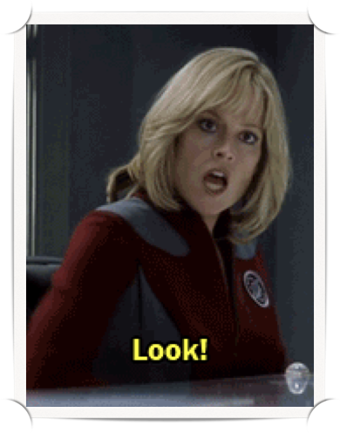
Director Satisfaction Scores
‘Look, I have one job on this lousy ship.’

Slide 78
Director Satisfaction Scores
Except of course, it isn’t really one job. It’s:
Manage, counsel, rehabilitate, encourage, guide, protect, negotiate, advocate, hire, fire and all the rest.
And: follow all new rules about treatment pathways, quality indicators, narcotics, admissions, time to this, time to that…

Slide 79
Director Satisfaction Scores
And cajole otherwise difficult physicians to do the same.

Slide 80
Director Satisfaction Scores
So what questions does the director’s survey have?

Slide 81
Director Satisfaction Survey
Did your physicians treat people nicely?
Were they courteous?
Did they throw tantrums?
Did they get involved in nurse drama?
Do they understand the EMR?

Slide 82
Director Satisfaction Scores
Did they keep their credentials up to date?
Did they keep their charts up to date?
Did they see patients in a timely manner?
Did they call in frequently?

Slide 83
Director Satisfaction Scores
The list could go on and on.
But frustration flows both ways.
We all need to remember that the other side has a set of ‘satisfaction’ criteria we can learn and respect as well.

Slide 84
Director Satisfaction Scores
Furthermore, those directors? They’re also physicians.
With the same issues as their docs:
Family, money, illness, burnout.
They just have to take care of everyone else also.

Slide 85
Patient Satisfaction Scores
What does this have to do with anything?

Slide 86
Patient Satisfaction Scores
Patient satisfaction can be improved if we all work together and treat one another nicely.
And if we take the lessons of what WE want, and apply it to what THEY want.

Slide 87
Patient Satisfaction Scores
Minus the narcotics, of course.
Especially that Dilo, dolo, whatever, it starts with a D!
I’m allergic to anything less than 5 milligrams…

Slide 88
Satisfaction Scores
Maybe there’s a template we can come up with for all ‘satisfaction’ scores?
Based on the fact that other than the outliers, we all want mostly the same things, from patient to clinician to director.

Slide 89
Satisfaction Score
Did they try their best?
Did they apply good science? Or listen to it?
Did they speak with kindness even in a hurry and communicate clearly?
Did they listen and take the problem seriously?

Slide 90
Satisfaction Scores
Did they look at the entire situation? Physical, emotional, social, before acting?
Was the time to ‘whatever’ reasonable given the situation?
Were the expectations also reasonable?

Slide 91
Satisfaction Score
Was the bill/payment appropriate?
Was the bill/payment timely?
Was the place pleasant?
Was the place safe?

Slide 92
Satisfaction Score
Did we try to avoid enforcing stupid rules?
Did we try to do away with any stupid rules?
Did we, in a (relatively professional manner) stand-in with the people who made stupid rules?

Slide 93
Satisfaction Score
Did they act as they would have for their own family?

Slide 94
Satisfaction Scores
Do unto others as you would have others do unto your children.

Slide 95
Satisfaction Scores
Connection is key. Offer patients blankets, explain why you are, or aren’t giving antibiotics or pain meds.
Compliment their babies, ask about their lives.
Ditto for colleagues. Try to help them and know them.

Slide 96
Satisfaction Scores
Like I said, I’m no expert. Our patients are sometimes dissatisfied no matter how hard we try.
This is the way of the world.

Slide 97
Satisfaction Scores
I know the deck can feel stacked.
I know sometimes, ‘it’s a trap.’

Slide 98
Satisfaction Scores
But I also know we can find ways to be happy
I know we can treat one another as valued friends and colleagues.

Slide 99
Satisfaction Scores
And that our physician,
director
and customer satisfaction
can all be improved.
With a little respect.

Slide 100
Physician Satisfaction Scores
And a little creative, outside the box thinking.

Slide 101
Satisfaction Scores
And of course, lots of political maneuvering, lobbying and frank discussions about how the whole satisfaction thing is a mess.
That’s all.

Slide 102
Satisfaction Scores
There are tons of patient advocates. That’s cool.
But we need more advocates for ourselves and our colleagues.
It’s happening, but slowly…

Slide 103
Satisfaction Scores
Hospitals look inward, add C-suite officer to boost staff wellness
Chief wellness officers are becoming more mainstream
By Meg Bryant • Feb. 20, 2018

Slide 104
Satisfaction Scores
There are too many unhappy physicians, resulting in unhappy families, patients and departments.
I think we can do more if we think as much about the physician satisfaction score as the patient satisfaction score.

Slide 105
Satisfaction Scores
Happy doctors. Creepy.
But I hope we see more.
Have a great day!

Slide 106
Satisfaction Scores
thank you for your time!

Slide 107
And I’m off to the land of smoke

