Slide 1
Cryptic Abdominal pain
(AKA, “My patient with a normal CT still has belly pain, now what!”)
Joseph P. Martinez, MD, FAAEM
Associate Professor of Emergency Medicine and Medicine
Assistant Dean for Student Affairs
Assistant Dean for Clinical Medical Education
University of Maryland School of Medicine
@JoeMartinezMD

Slide 2


Slide 3
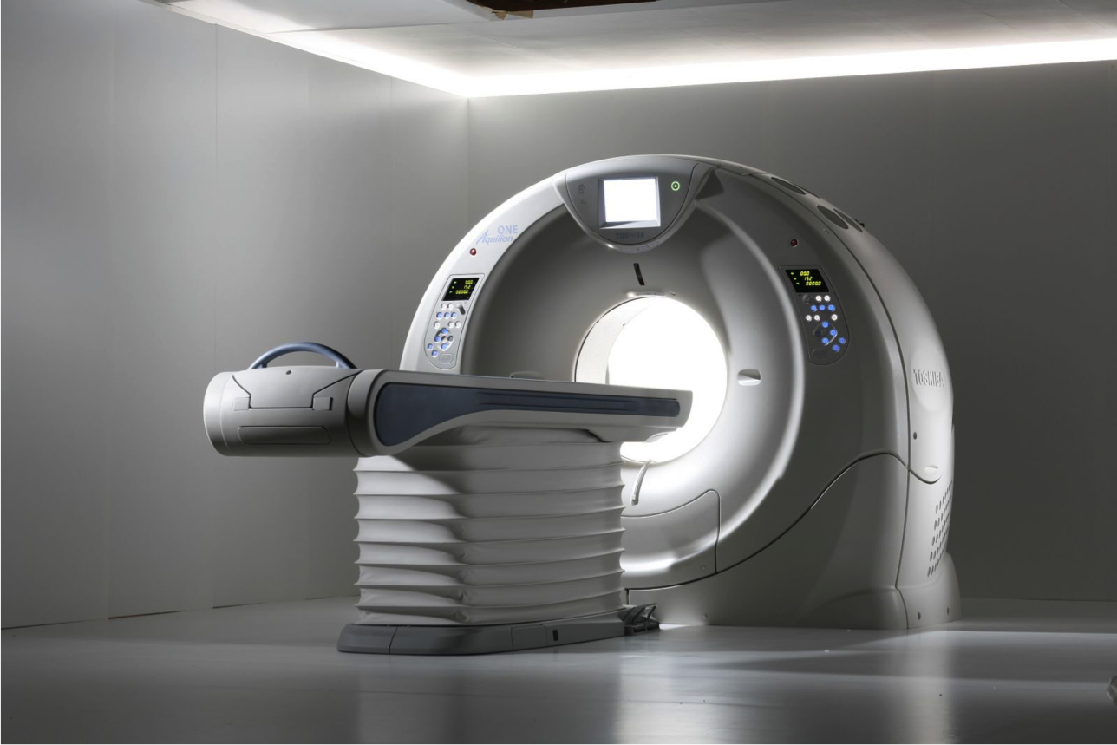

Slide 4
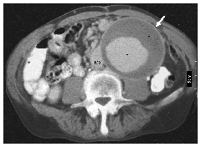
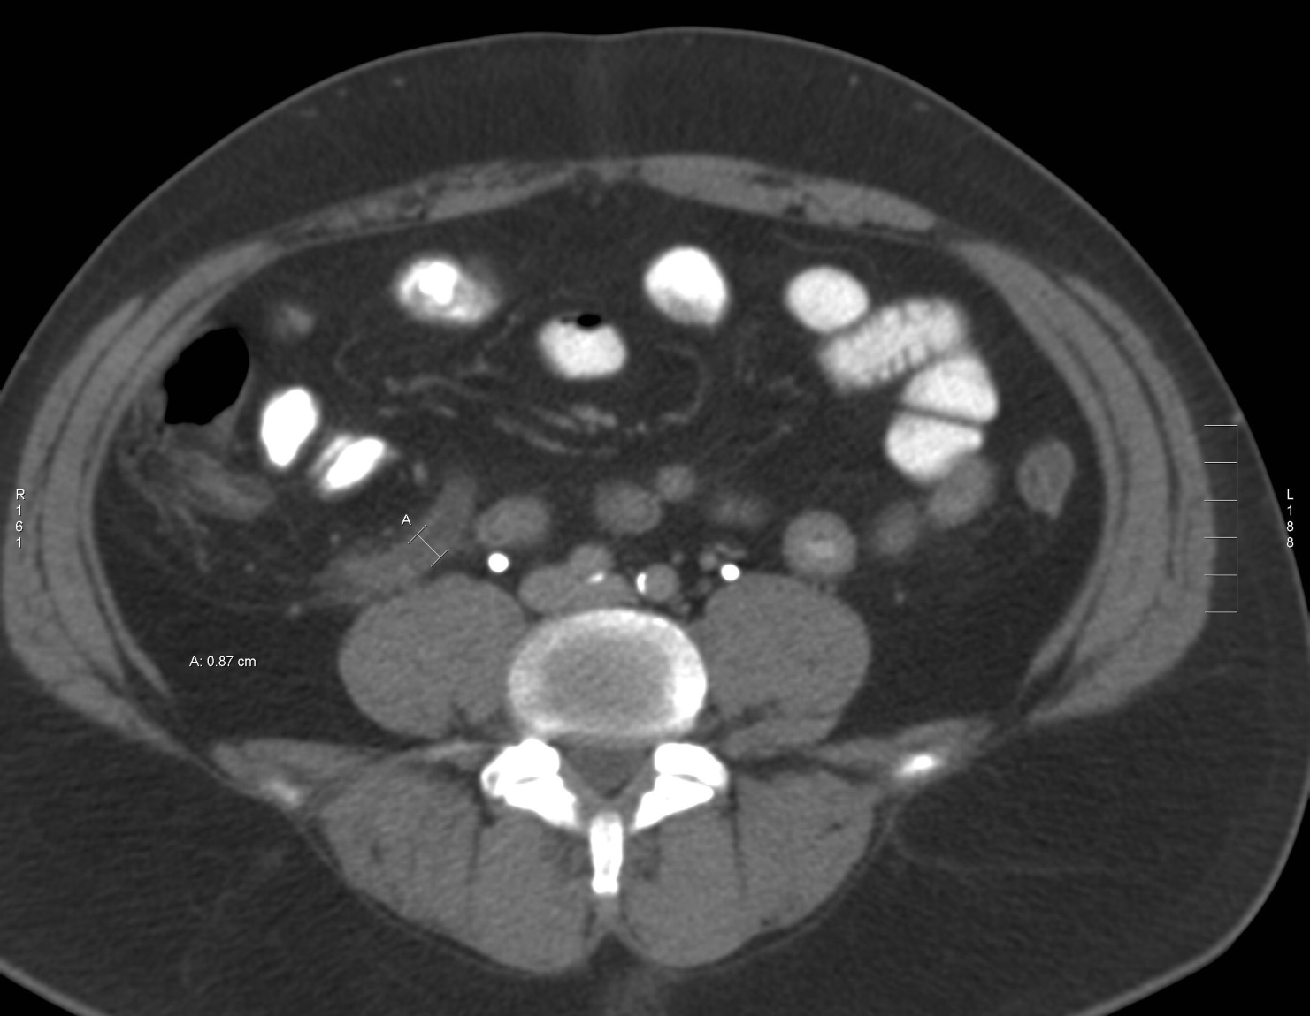
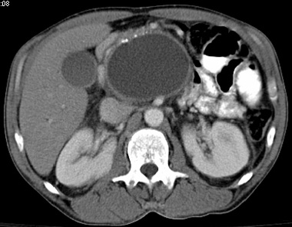
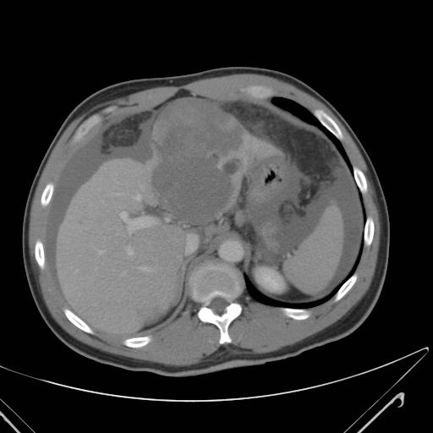
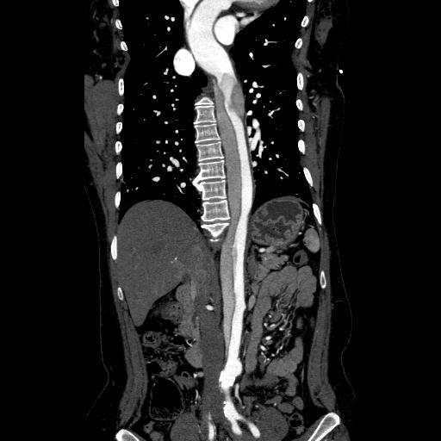

Slide 5
Now what?
“No findings in the abdomen to explain the patient’s symptoms”

Slide 6
Was something missed initially?
Notes:
23% had finding on follow-up CT – 73% of these were bowel pathology
70% of initially negative CTs were noncontrast
75% of follow-up CTs were with contrast

Slide 7
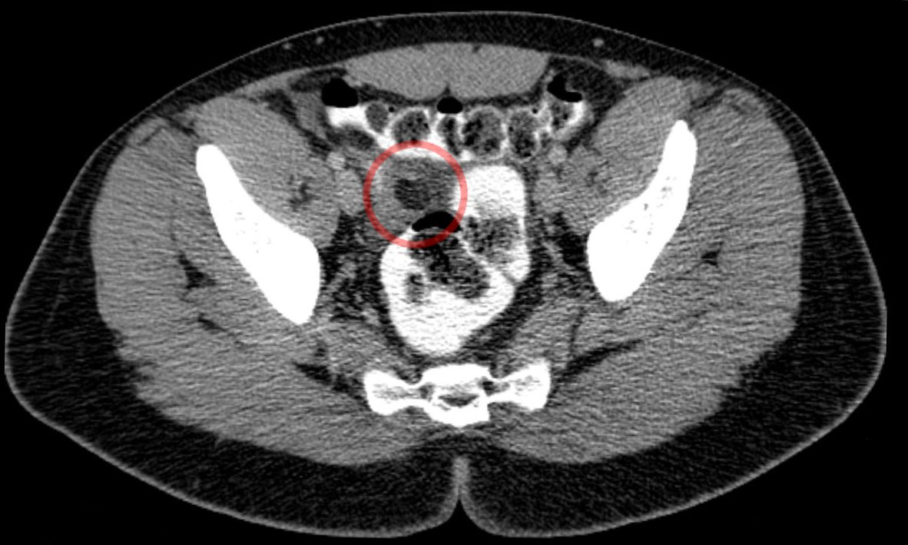
Was something unrecognized?

Slide 8
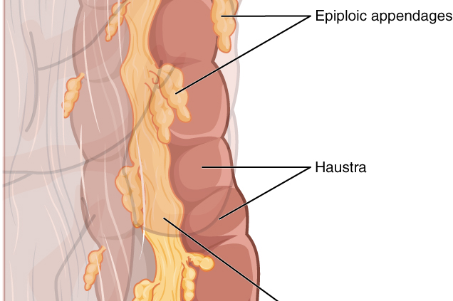
Epiploic Appendages

Slide 9
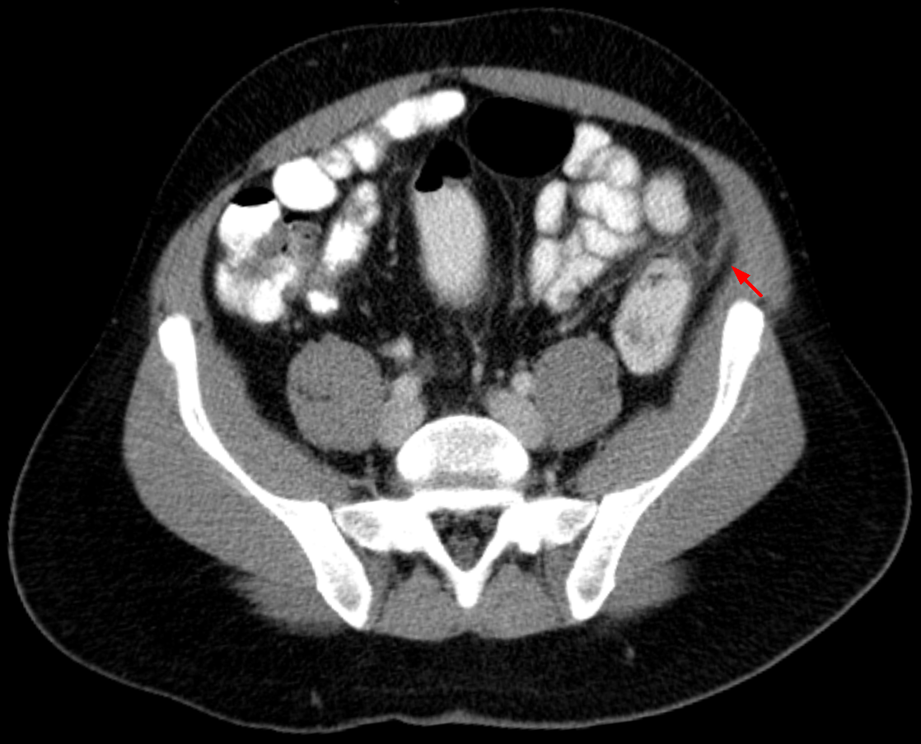

Slide 10
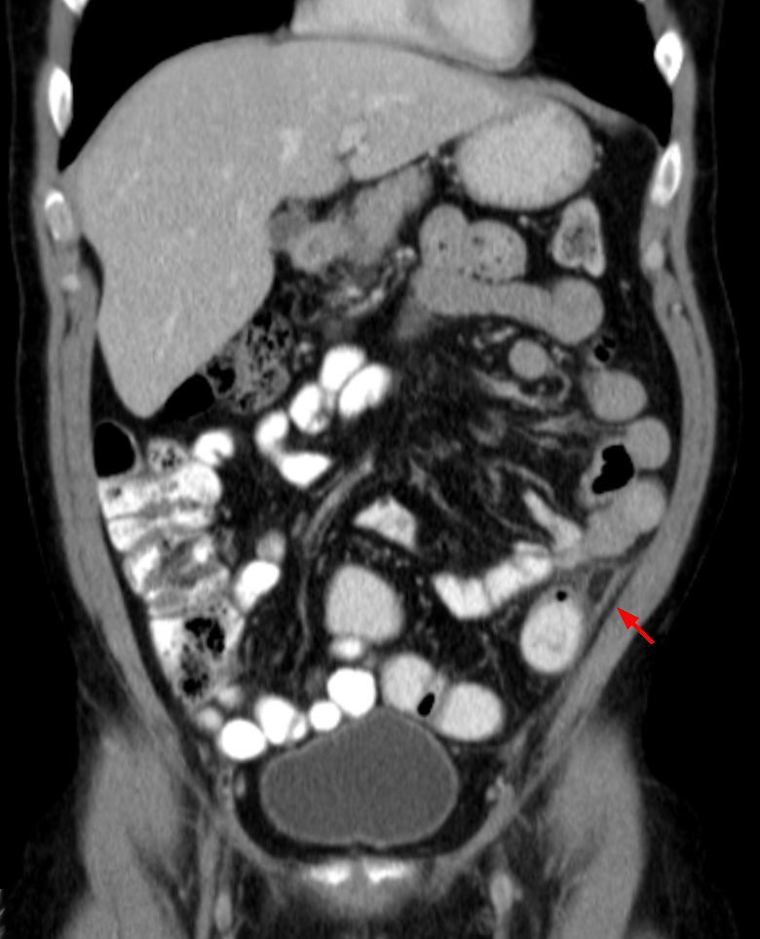

Slide 11
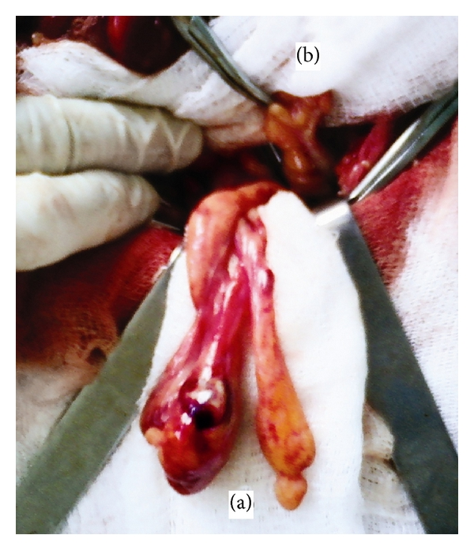

Slide 12
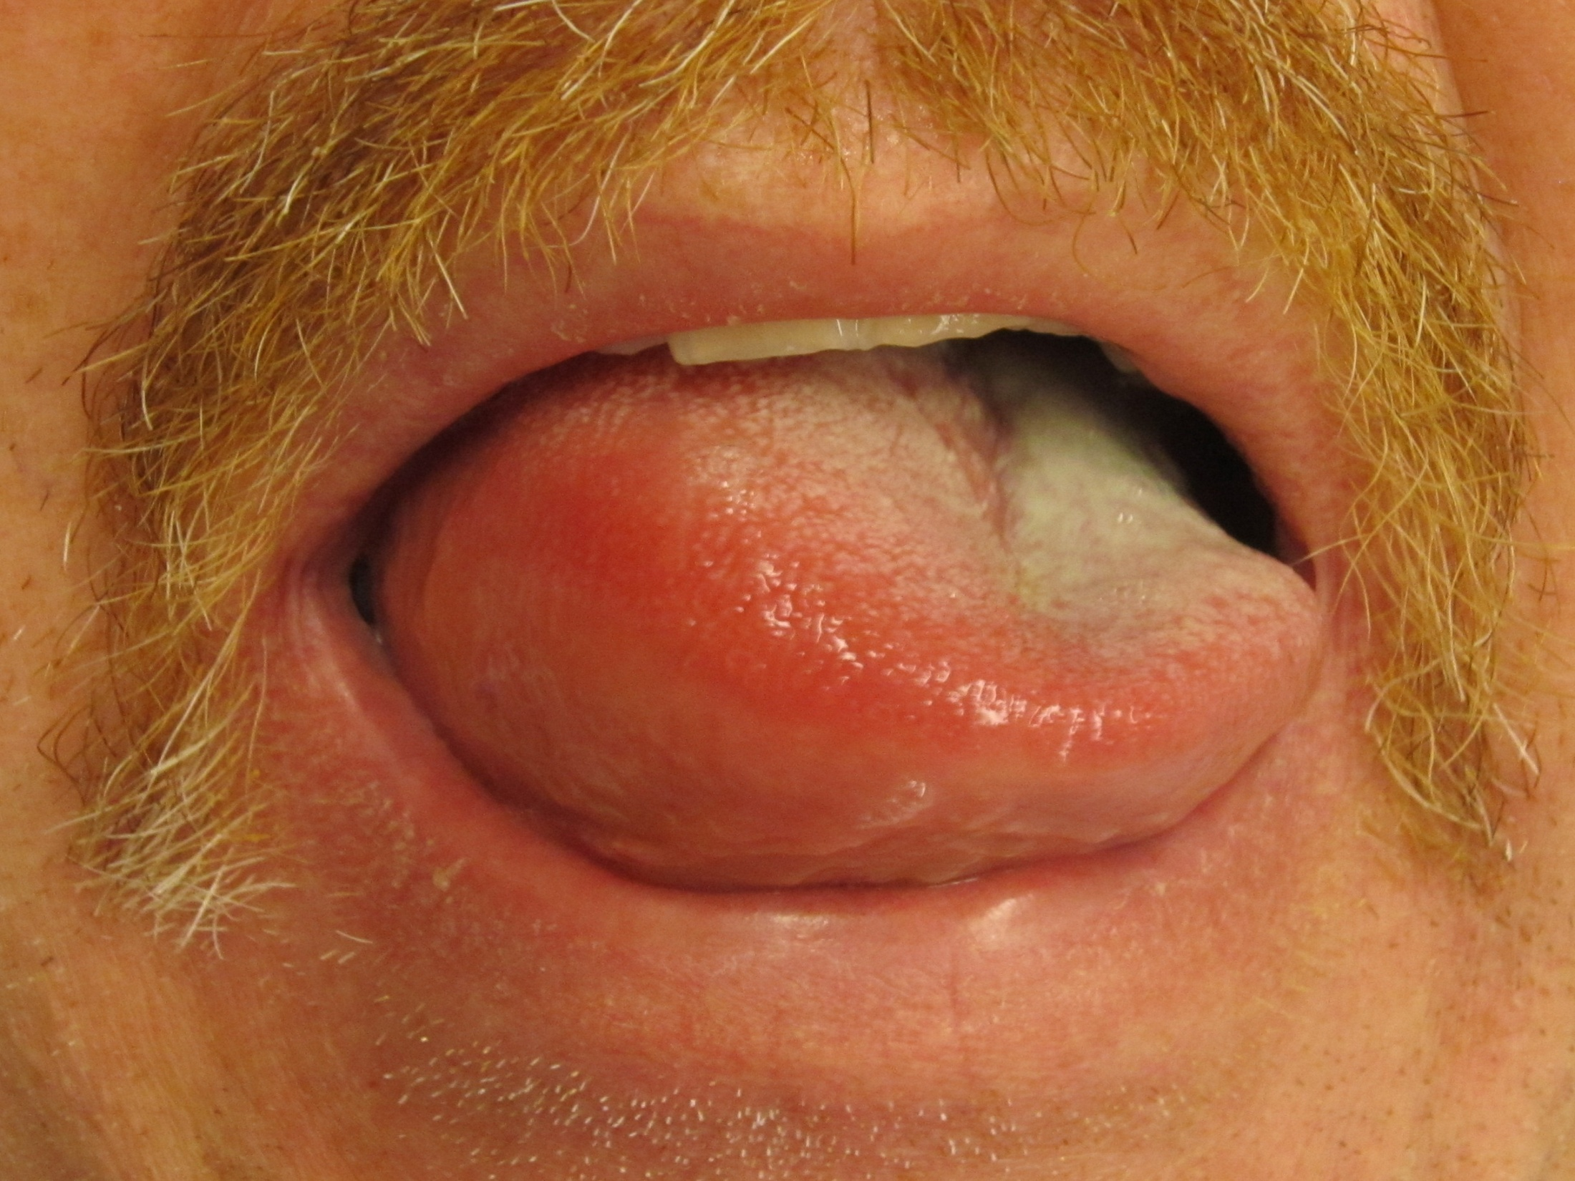
ANgioedema

Slide 13
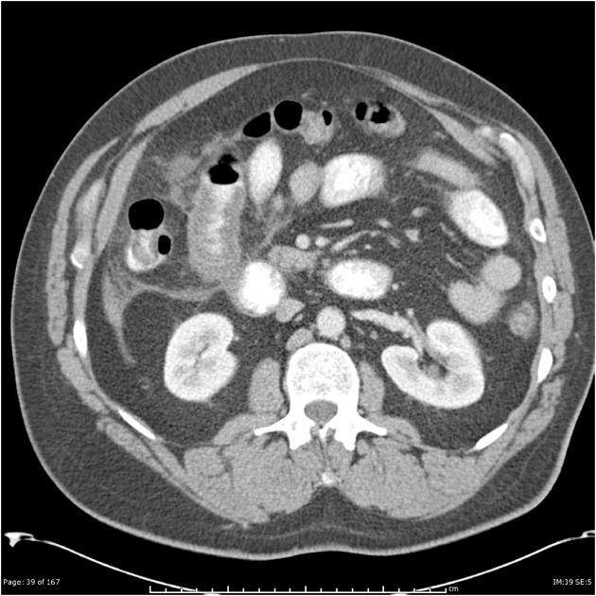

Slide 15


Is there something that ct doesn’t pick up?
Cyclic Vomiting Syndrome

Slide 16
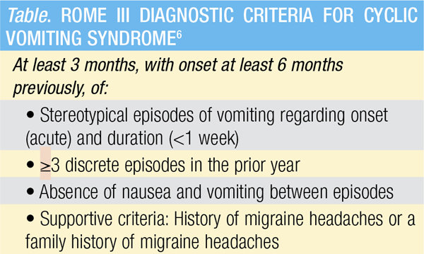
3/4

Slide 17


Slide 18


Slide 19
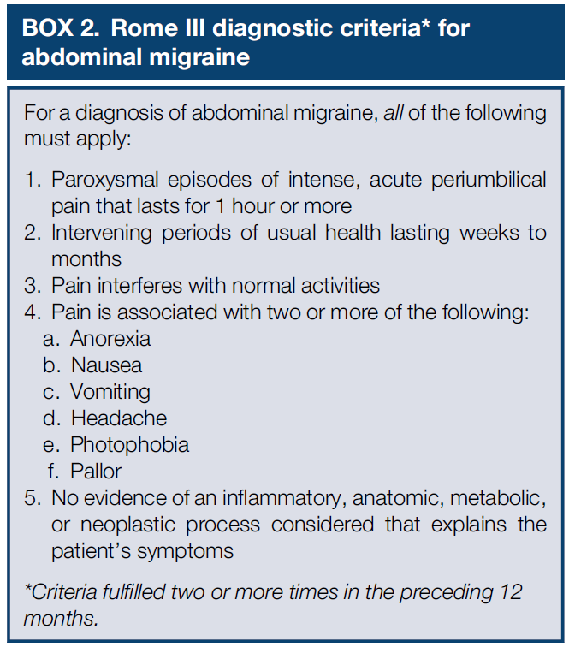

Slide 20

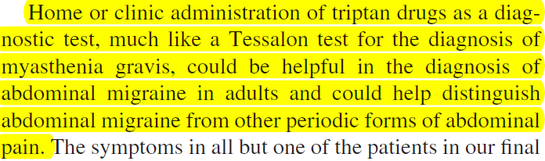

Slide 21
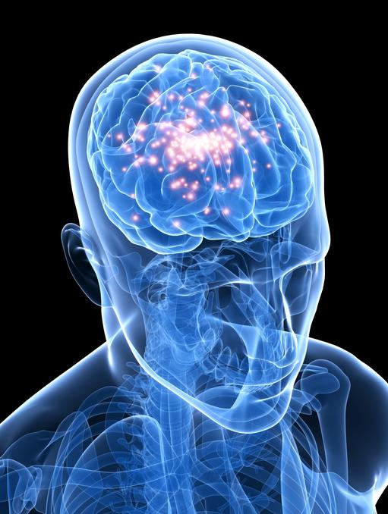
Epilepsy
ABDOMINAL
^

Slide 22
Abdominal Migraine | Abdominal Epilepsy
Duller pain | More severe pain
Longer lasting | Briefer
 | May have altered mental status

Slide 23
Porphyria

Slide 24


Slide 25


Slide 26
clues
Precipitants
Muscle cramps / paresthesias
Psychiatric symptoms

Slide 27

125
100
20
100
4
24
1.0

Slide 28
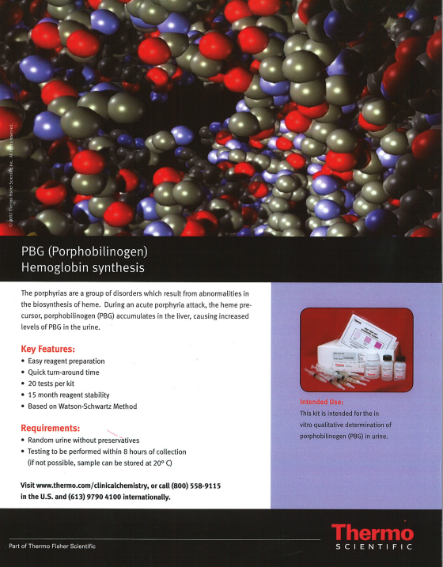

Slide 29
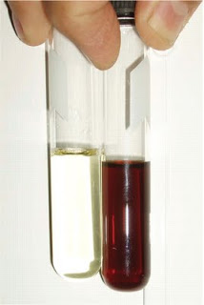

Slide 30
Treatment

Slide 31


Slide 32
Porphyria treatment
Glucose
Carbohydrates
Hematin

Slide 33
When the ct is negative, consider
Something missed?
Something unexplained?
Atypical disease presentation?
Exotic disease?

Slide 34
Attributions
http://commons.wikimedia.org/wiki/File%3AAppendicitis_epiploica_CT_coronar_2.png By Hellerhoff (Own work) [CC BY-SA 3.0 (http://creativecommons.org/licenses/by-sa/3.0)], via Wikimedia Commons from Wikimedia Commons
http://commons.wikimedia.org/wiki/File%3AAppendicitis_epiploica_CT_axial_5mm.png By Hellerhoff (Own work) [CC BY-SA 3.0 (http://creativecommons.org/licenses/by-sa/3.0)], via Wikimedia Commons
http://commons.wikimedia.org/wiki/File%3AAppendicitis_epiploica.jpg By Hellerhoff (Own work) [CC BY-SA 3.0 (http://creativecommons.org/licenses/by-sa/3.0)], via Wikimedia Commons
http://commons.wikimedia.org/wiki/File%3A2433_Teniae_Coli_Haustra_Epiploic_Appendage.jpg By OpenStax College [CC BY 3.0 (http://creativecommons.org/licenses/by/3.0)], via Wikimedia Commons
Yuri N. Shiryajev, Anna V. Glebova, and Marina V. Chalenko, “Strangulation and Necrosis of an Epiploic Appendage of the Sigmoid Colon in a Right Inguinal Hernia,” Case Reports in Surgery, vol. 2013, Article ID 890234, 4 pages, 2013. doi:10.1155/2013/890234 an open access article distributed under the Creative Commons Attribution License
http://commons.wikimedia.org/wiki/File%3AAngioedema2013.JPG By James Heilman, MD (Own work) [CC BY-SA 3.0 (http://creativecommons.org/licenses/by-sa/3.0)], via Wikimedia Commons
Angioedema: Case courtesy of Dr Frank Gaillard, Radiopaedia.org
http://commons.wikimedia.org/wiki/File%3AThrobbing_migraine_headache.gif By Sasha Wolf [CC BY 2.0 (http://creativecommons.org/licenses/by/2.0)], via Wikimedia Commons
HSTE Project - Epilepsy 5th Period : taken from http://healthsciencetechnology.wikispaces.com/Epilepsy+5th+Periodhttp://www.creativecommons.org/licenses/by-nc-sa/3.0

