Slide 1
Dying to lose:
Bariatric surgery and its complications
Joseph Martinez, MD, FACEP, FAAEM
Associate Professor of Emergency Medicine and Medicine
Assistant Dean for Student Affairs
Assistant Dean for Clinical Medical Education
University of Maryland School of Medicine
@JoeMartinezMD

Slide 2


Slide 3


Slide 4



BMI
Weight (kg)/Height (m)²
“Normal” (optimal): 18.5-24.9
Overweight: 25-29.9
Obese: ≥30

Slide 5
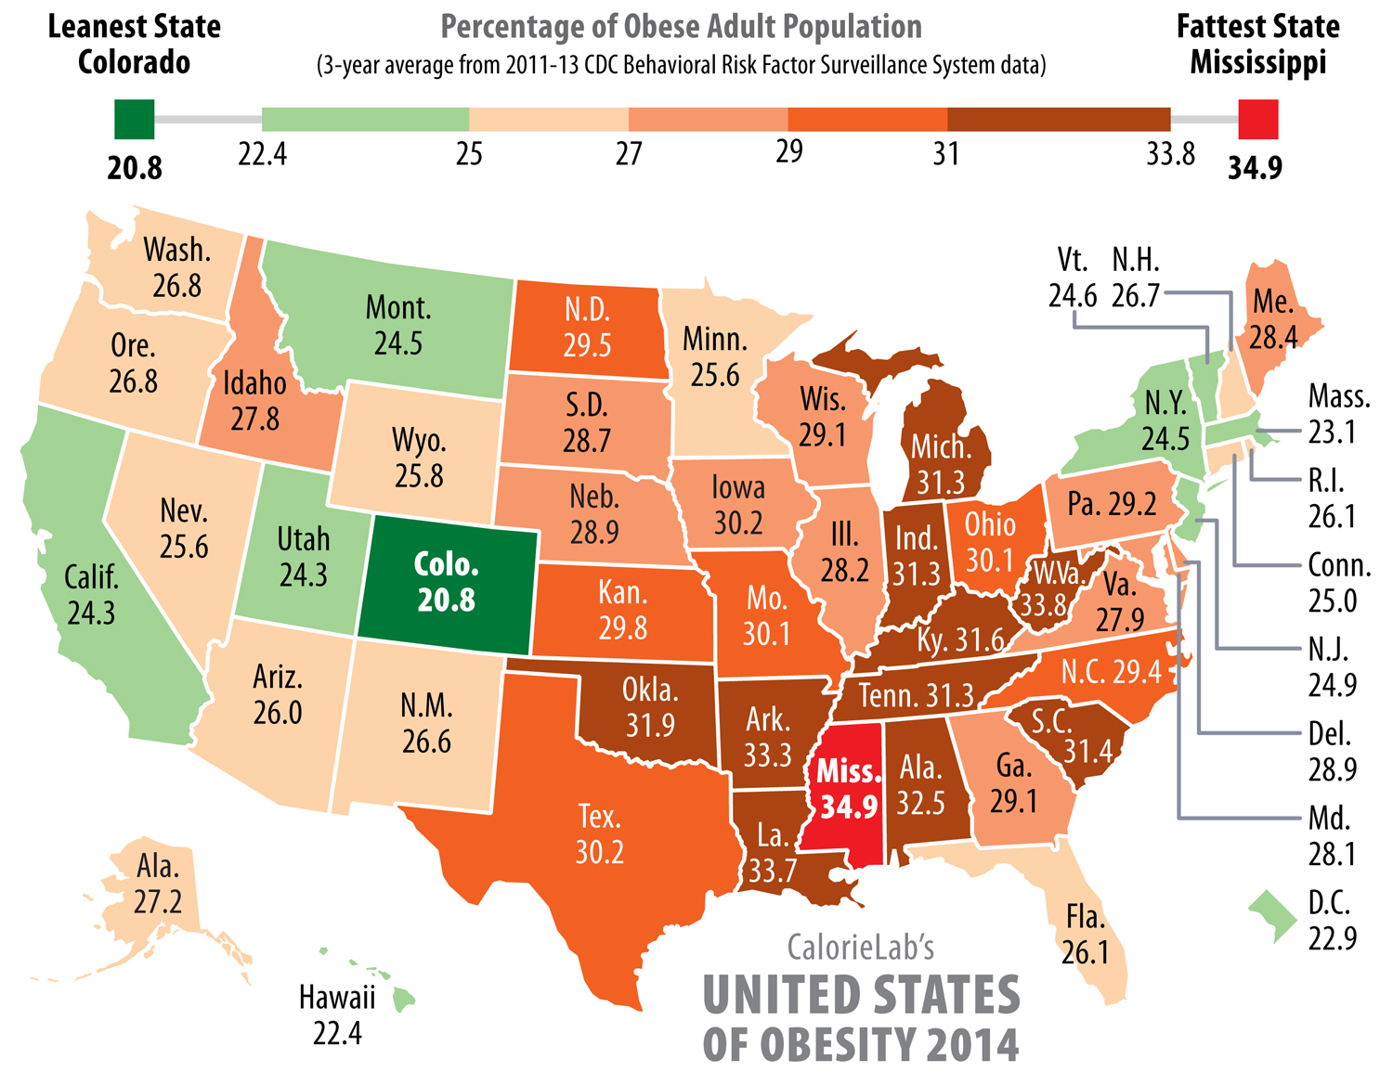

Slide 6


Slide 7
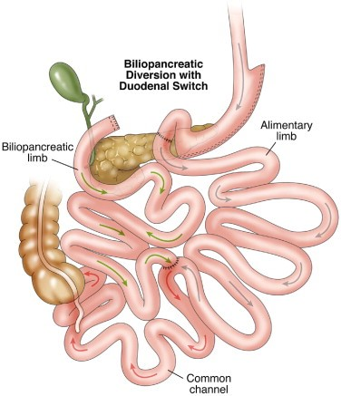

Slide 8


Slide 9
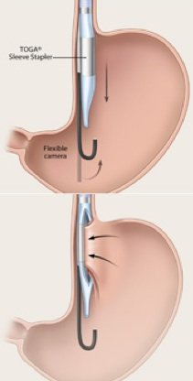
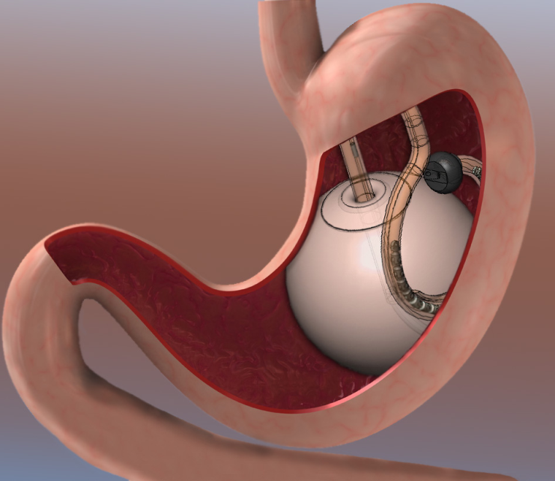

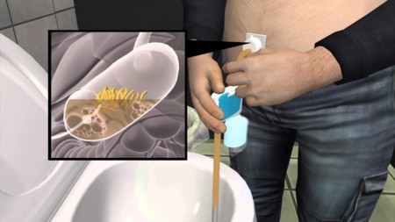
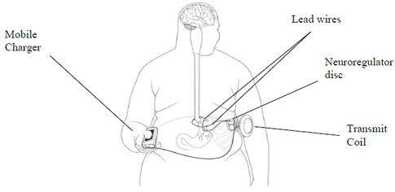

Slide 10
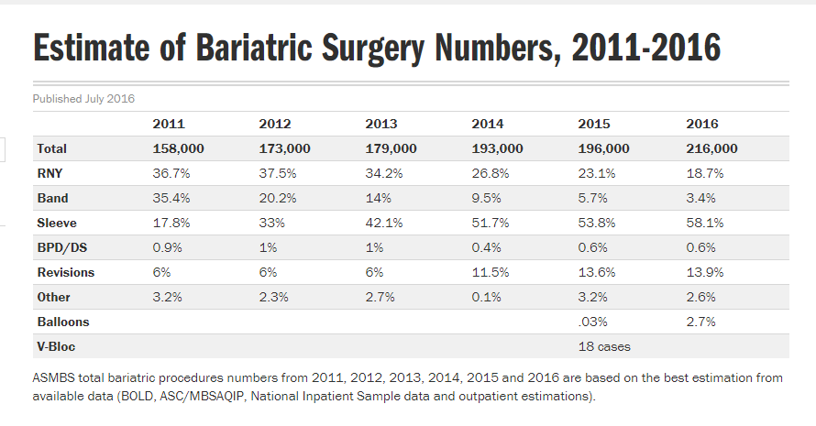

Slide 11


Slide 13
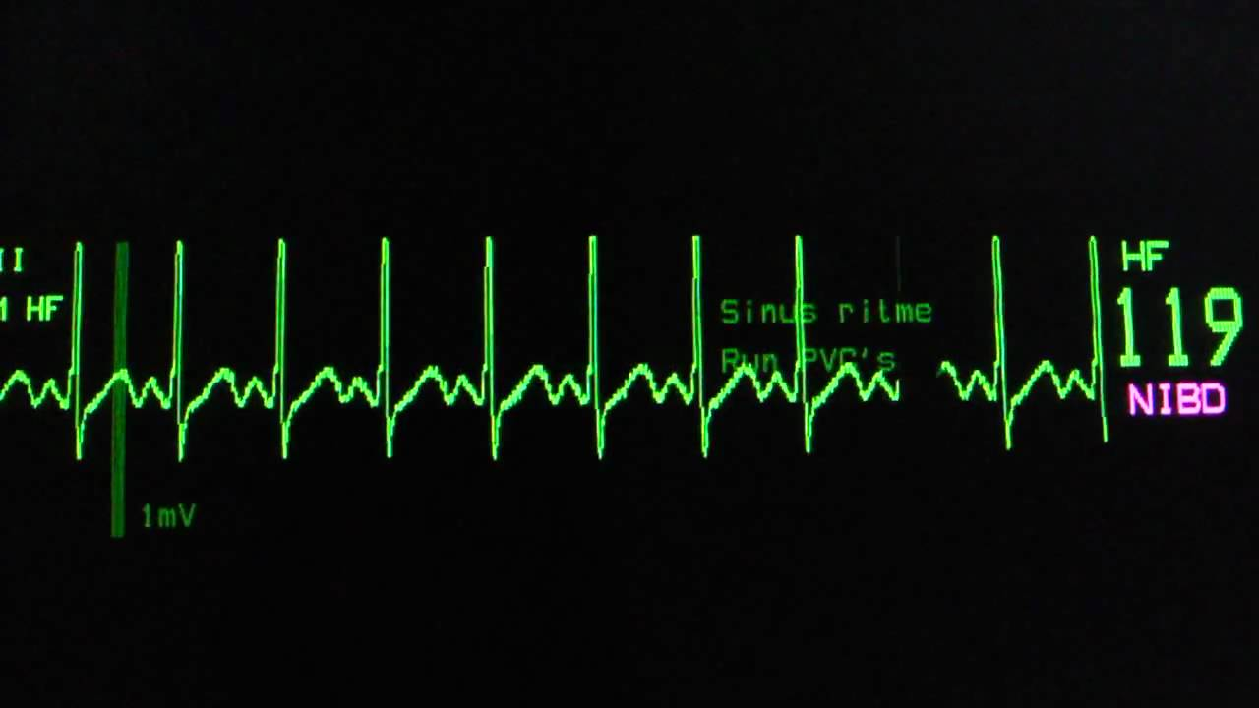

Slide 14
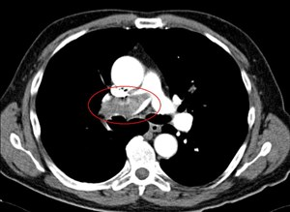

Slide 15
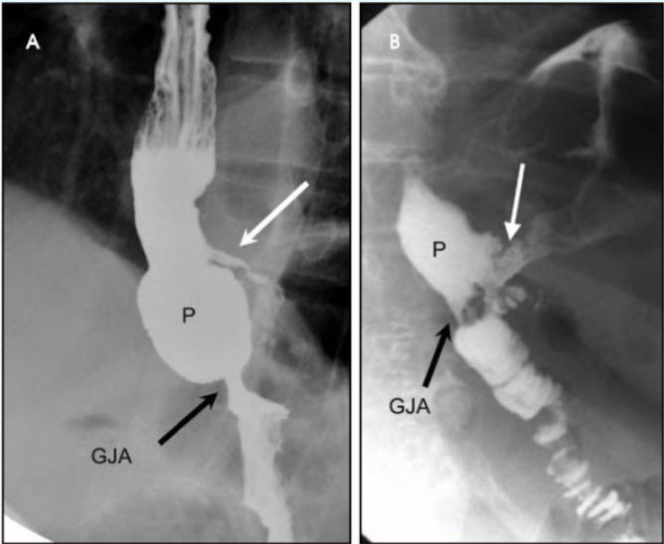

Slide 16
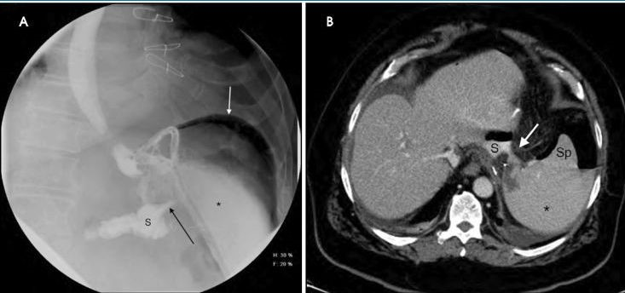

Slide 17


Slide 18
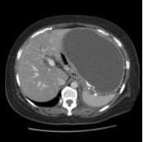

Slide 20
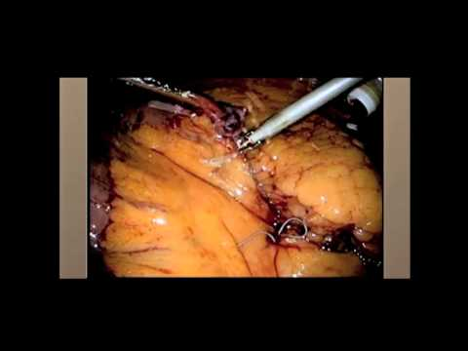

Slide 21


Slide 22
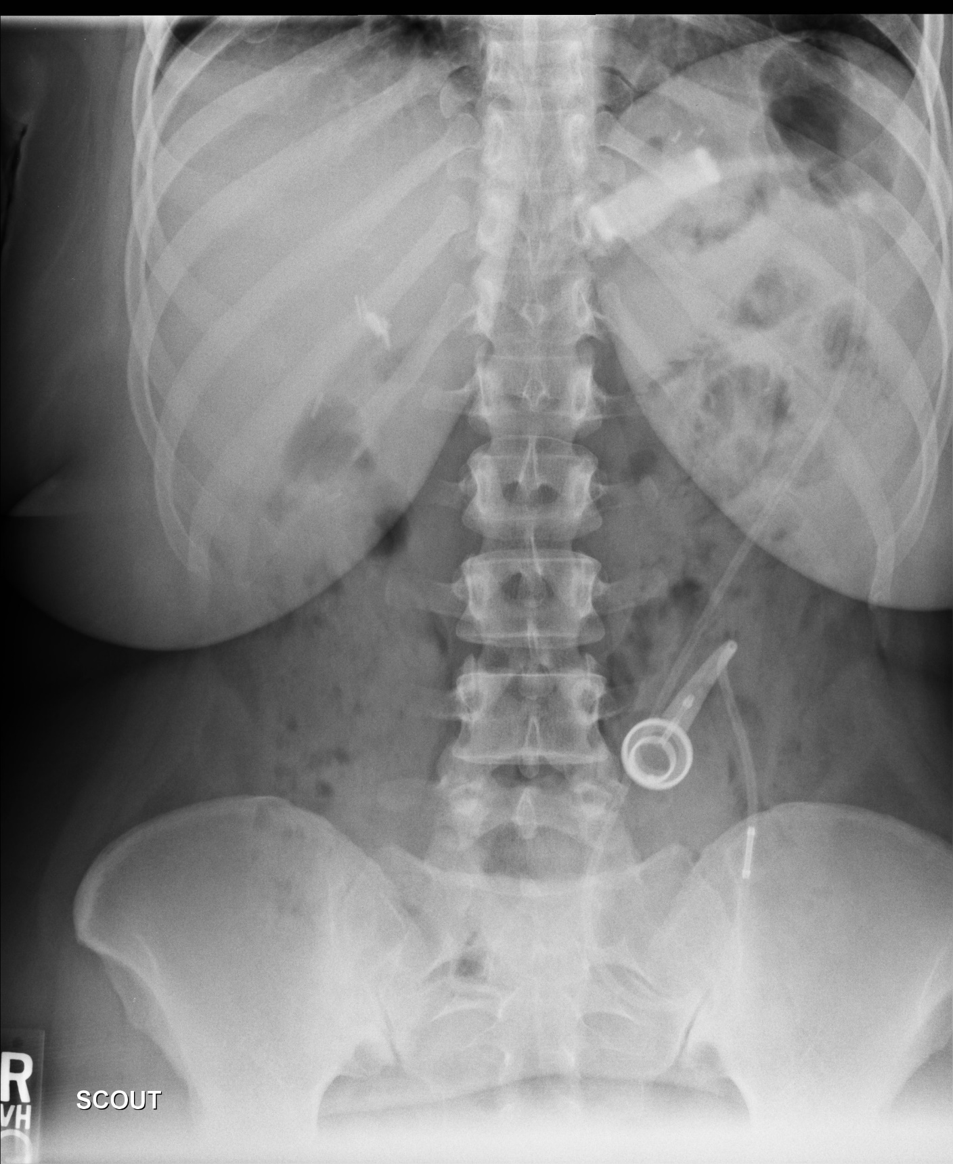

Slide 23
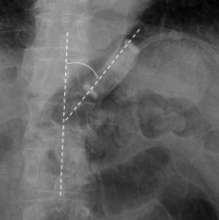

Slide 24
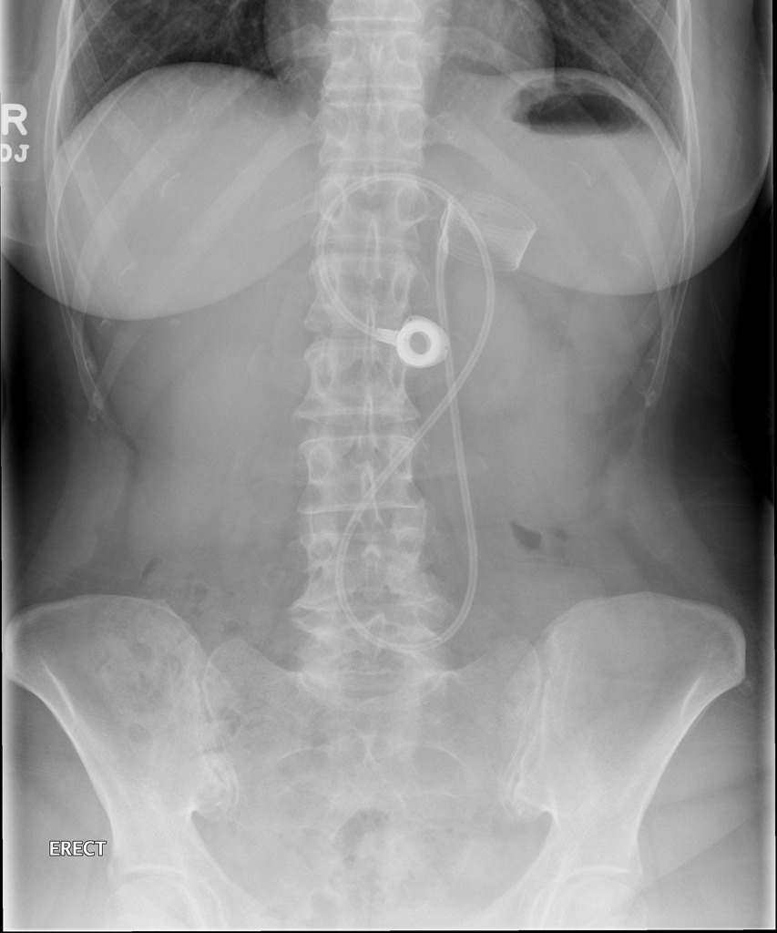

Slide 25
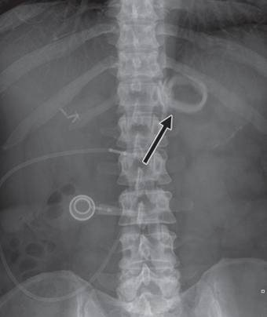

Slide 26
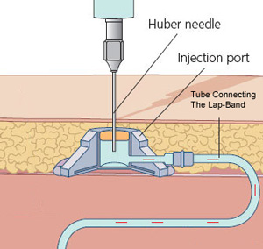

Slide 27
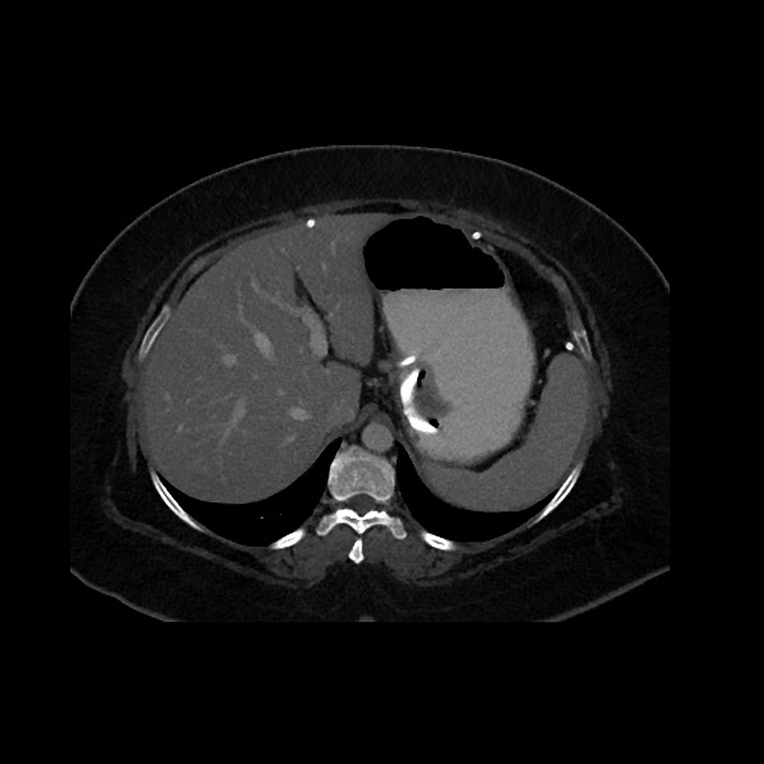
Case courtesy of Dr Michael P Hartung, Radiopaedia.org, rID: 57466

Slide 28
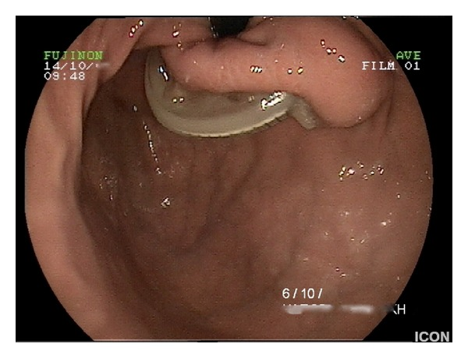

Slide 29
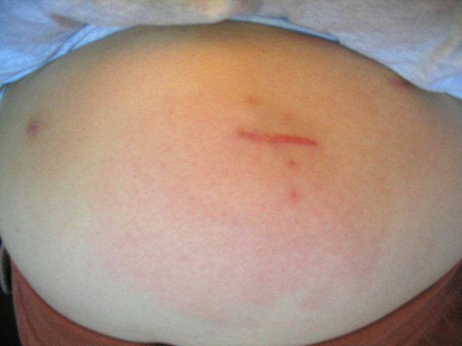

Slide 30
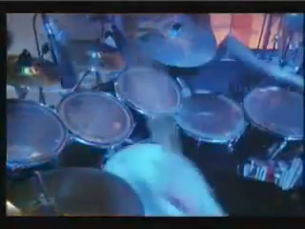

Slide 31
Unexplained tachycardia is bad
Hiccups are bad
Anastomotic leaks are bad
Lap Band erosion is bad

Slide 32

THANK YOU!

