Slide 1
PLEASE
Turn your cameras, phones, and electronic devices ON!!! Knowledge shared is knowledge earned! #INACEP18
Notes:
SMACC Story AV problems, imposter, quicksand

Slide 3
How to Swim in Quicksand: What Emergency Physicians Can Learn From Fighter Pilots, Marines, and the Architect of 'Shock and Awe’
Howie Mell, MD, MPH, FACEP
Reservist Emergency Physician
Vituity
Twitter: @drhowiemell #INACEP18

Slide 4
System 1 versus System 2
System 1
System 2
Kirk
Quick
“Lazy”
Go by feel
Realm of experts!
Spock
Thoughtful
Slow and Deliberative
Darling of the psych world
Taught not experienced
Notes:
Anti terrorism spotters – “What Cops Know”. “Sometimes you just have an instinct, the hair on the back of your neck goes up. We pulled up to a stop sign, and there was a woman on the sidewalk who had sunglasses on even though it was almost dark, and there was a guy who was clearly with her but pretending he wasn’t. There was just something wrong with how he was looming behind her. Me and my partner had the same sixth sense about this. So we stopped them, and he got all defensive: “You stopped me because I’m black.” She stood in the background but didn’t walk off. So while my partner was engaging him, I went over to her. I said, “Listen, do me a favor, take your sunglasses off.” She did, and her eyes were black-and-blue and her nose was busted. She motioned to me so that I’d keep her out of sight from him. She pulled her sleeves up, and she had cigarette burns. This woman had been tortured. Later, at the station, she showed us her back. She’d been hit with a chair and thrown down the stairs. This guy went to jail. And we could have easily just drove by.”

Slide 5
System 1 versus System 2
System 1
System 2
Kirk
Quick
“Lazy”
Go by feel
Realm of experts!
Spock
Thoughtful
Slow and Deliberative
Darling of the psych world
Taught not experienced
Notes:
Anti terrorism spotters – “What Cops Know”. Clipboard nurses and the Media love system 2 – because it can be measured! Task decomposition brings a system 1 problem down to system 2! SAR is system 1 Archeology is system 2!

Slide 6
System 1
Notes:
Anti terrorism spotters – “What Cops Know”. Clipboard nurses and the Media love system 2 – because it can be measured! Task decomposition brings a system 1 problem down to system 2! SAR is system 1 Archeology is system 2!

Slide 7
System 2
Notes:
Anti terrorism spotters – “What Cops Know”. Clipboard nurses and the Media love system 2 – because it can be measured! Task decomposition brings a system 1 problem down to system 2! SAR is system 1 Archeology is system 2!

Slide 8
Computer Versus Man Chess
Notes:
1997 – 2-1-3

Slide 9
Who is this?
Notes:
John Boyd fighter pilot

Slide 10
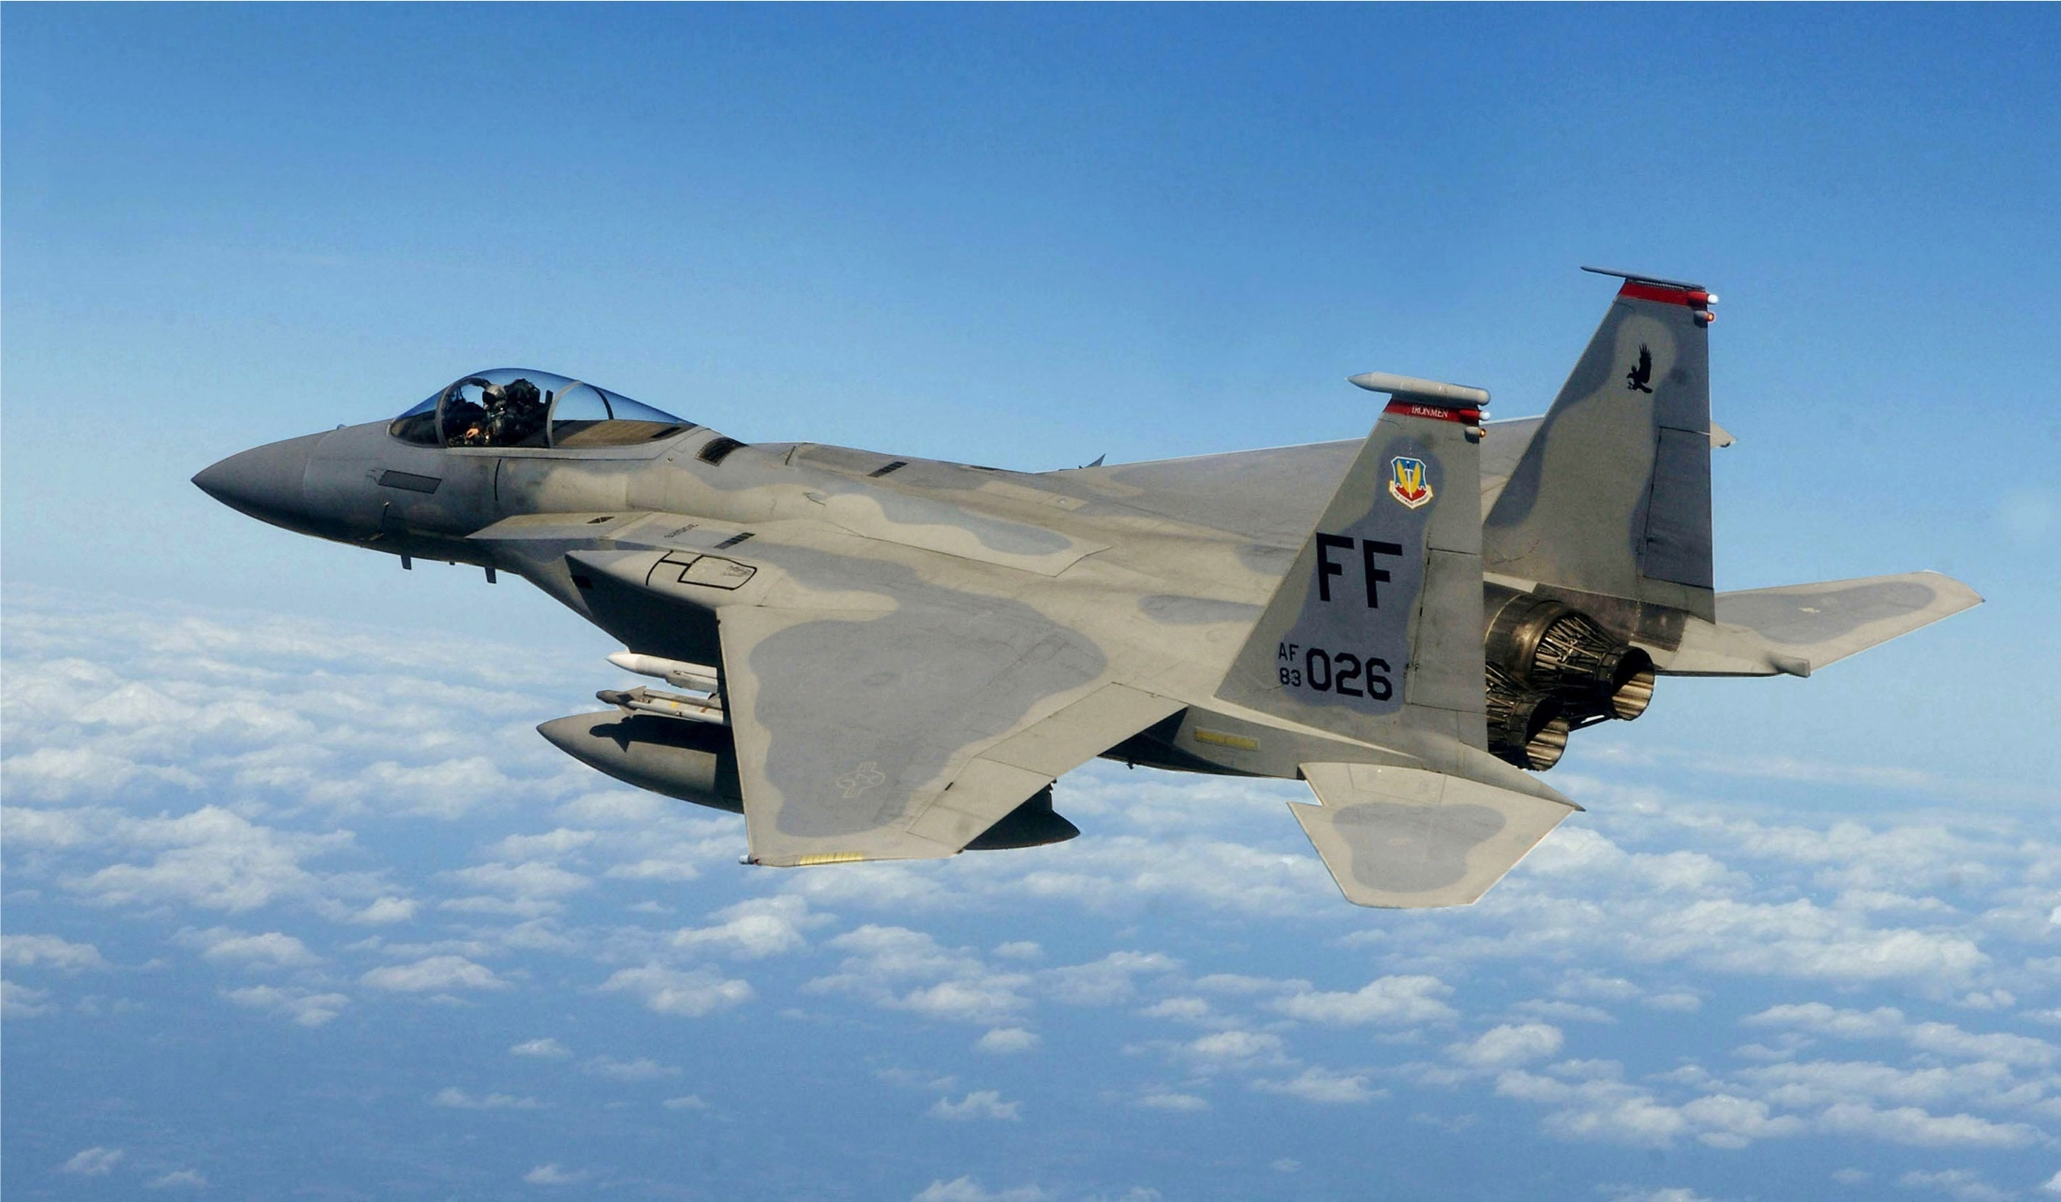
John Boyd

Slide 11
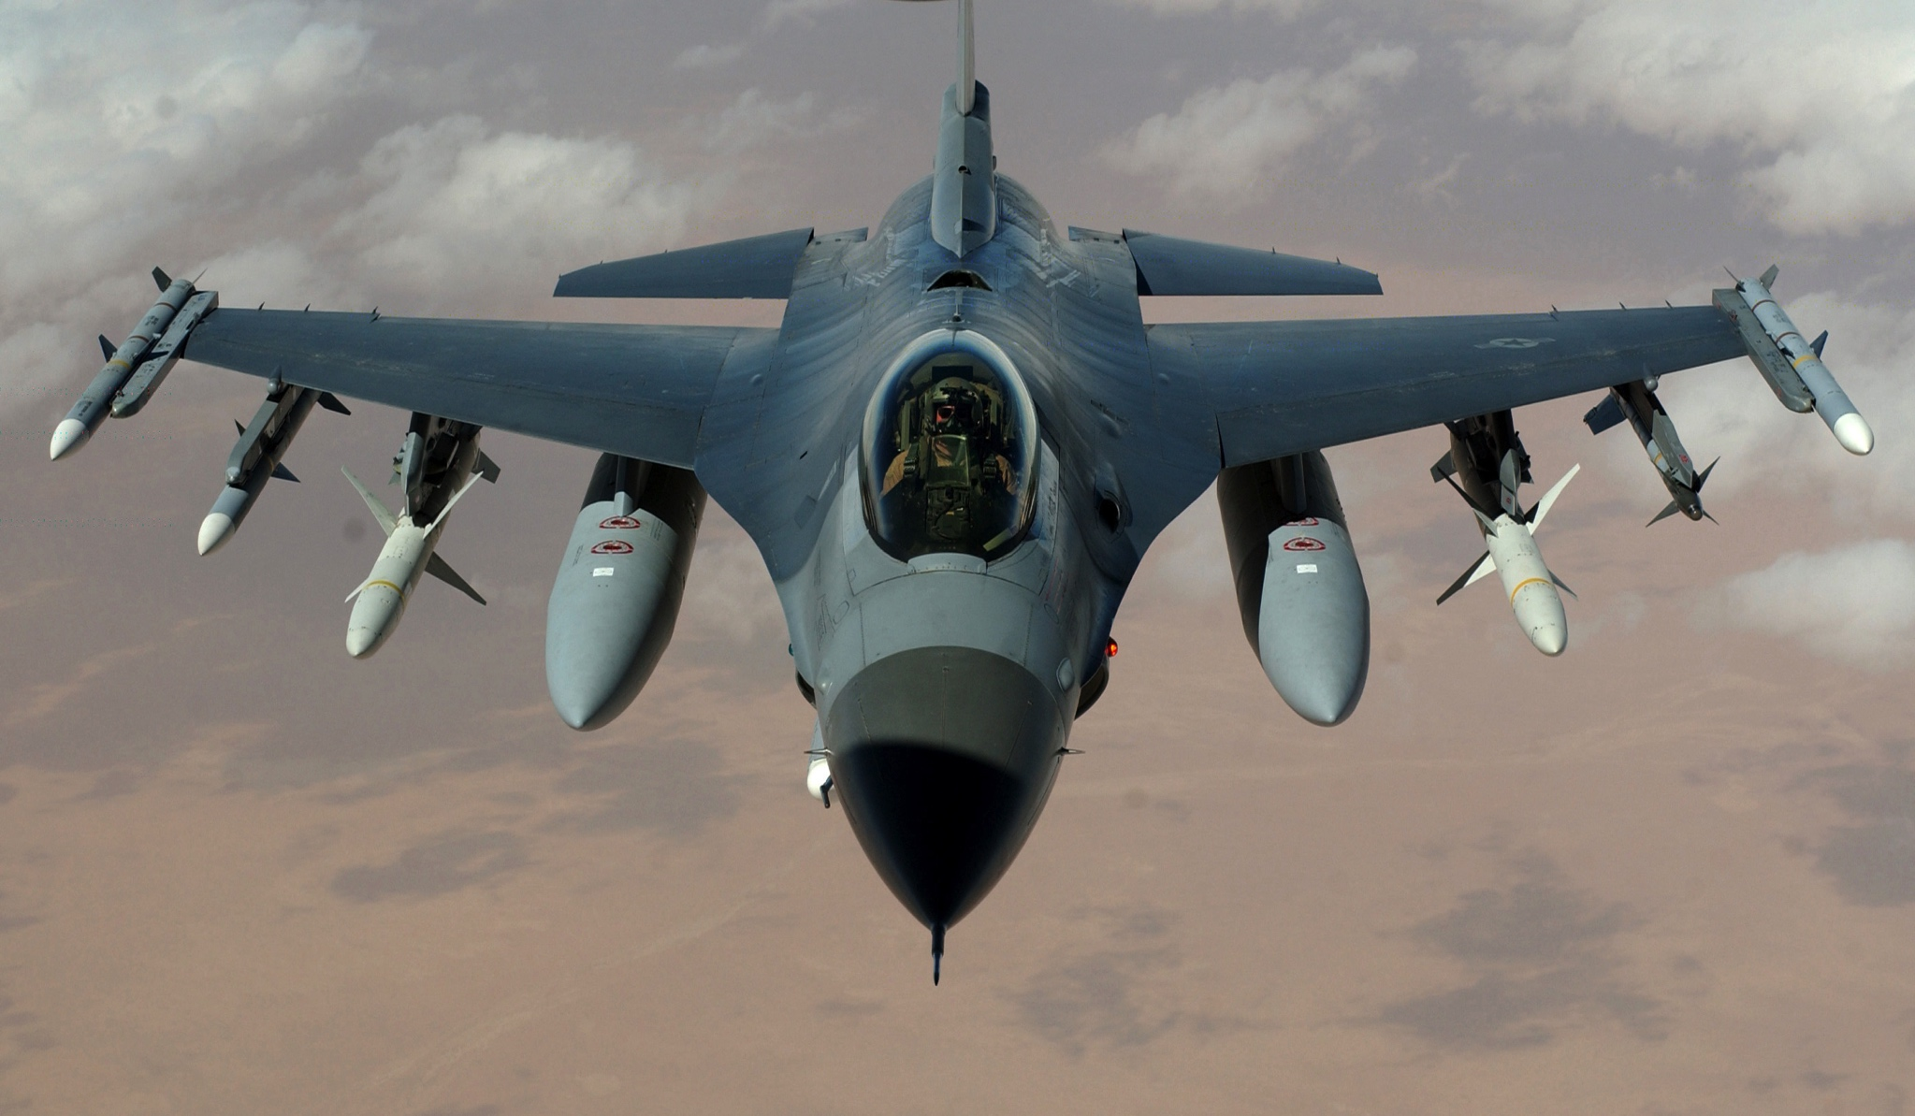
John Boyd

Slide 12
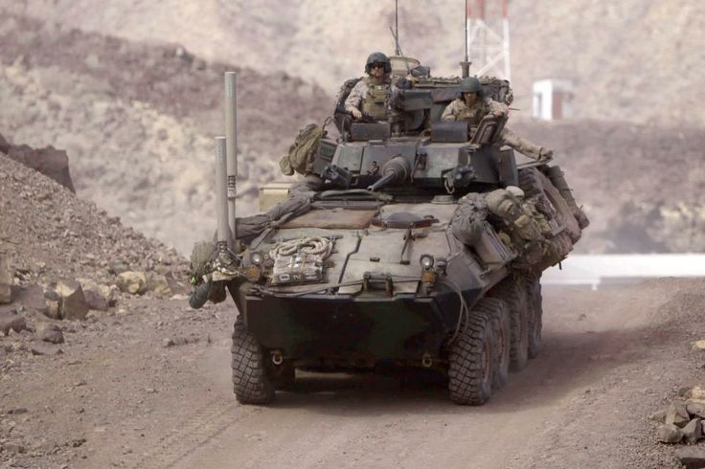
John Boyd

Slide 13
John Boyd

Slide 14
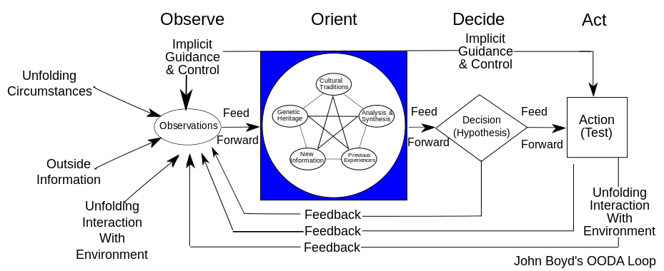
John Boyd

Slide 15
John Boyd
Notes:
ambiguity and uncertainty surround us. When our circumstances change, we often fail to shift our perspective and instead continue to try to see the world as we feel it should be.

Slide 16
Mental Models = Preconceived Notions…
… and preconceived notions are bad!
Notes:
Human behavior CAN be predicted

Slide 17
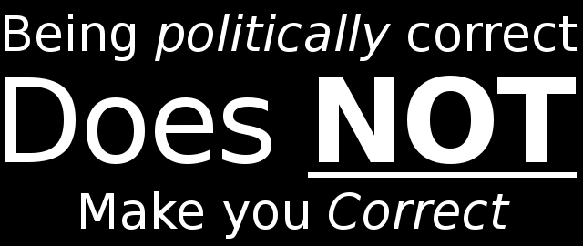
Mental Models = Preconceived Notions…
… and preconceived notions are bad!
Notes:
Human behavior CAN be predicted

Slide 18
Mental Models are OK, they help us predict!
Notes:
Human behavior CAN be predicted

Slide 19
OODA
Notes:
While our paradigms work and match up with reality most of the time, sometimes they don’t. Sometimes the universe pitches us a curveball that we never saw coming and the mental models we have to work with aren’t really useful.

Slide 20
OODA
Notes:
trying to understand a randomly changing universe with pre-existing mental models only results in confusion, ambiguity, and more uncertainty.
So Boyd combined 3 existing theorems to help.

Slide 21
Gödel’s Incompleteness Theorems
Notes:
any logical model of reality is incomplete (and possibly inconsistent) and must be continuously refined/adapted in the face of new observations. “This sentence is false”

Slide 22
Heisenberg’s Uncertainty Principle
Notes:
However, as our observations about the world become more and more precise and subtle, a second principle kicks in which limits our ability to observe reality correctly: Heisenberg’s Uncertainty Principle. In a nutshell, this principle shows that we cannot simultaneously fix or determine the velocity and position of a particle or body. We can measure coordinates or movements of those particles, but not both. As we get a more and more precise measure of one value (velocity or positions), our measurement of the other value becomes more and more uncertain. The uncertainty of one variable is created simply by the act of observation.

Slide 23
2nd Law of Thermodynamics
Notes:
individuals or organizations that don’t communicate with the outside world by getting new information about the environment or by creating new mental models act like a “closed system.” And just as a closed system in nature will have increasing entropy, or disorder, so too will a person or organization experience mental entropy or disorder if they’re cut off from the outside world and new information. Ask your paramedics!

Slide 24
From the Book of Boyd
“Taken together, these three notions support the idea that any inward-oriented and continued effort to improve the match concept with observed reality will only increase the degree of mismatch.”
Notes:
When these old mental models don’t work, they will often keep trying to make them work — maybe if they just use an old strategy with more gusto, things will pan out. But they don’t. Business magnate Charlie Munger calls this tendency to use the familiar even in the face of a changing reality the “man with a hammer syndrome.” You know the old saying: “to the man with only a hammer, everything is a nail.”

Slide 25
The OODA Loop

Slide 26
The OODA Loop

Slide 27
Observe
Notes:
“If we don’t communicate with the outside world–to gain information for knowledge and understanding–we die out to become a non-discerning and uninteresting part of that world.” –John Boyd By observing and taking into account new information about our changing environment, our minds become an open system rather than a closed one, and we are able to gain the knowledge and understanding that’s crucial in forming new mental models.

Slide 28
Observe
Notes:
This is what we do best – break it down to stem question! In his presentations, Boyd notes that we’ll encounter two problems in the Observation phase: We often observe imperfect or incomplete information (thanks to Heisenberg’s Uncertainty Principle)
We can be inundated with so much information that separating the signal from the noise becomes difficult. But pattern recognition WINS – and that is what we do. Reject calls to do otherwise! It is not necessarily the one with more information who will come out victorious, it is the one with better judgment, the one who is better at discerning patterns

Slide 29
Orient
Notes:
The reason Orient is the schwerpunkt (Shh fer punked) of the OODA Loop is because that’s where our mental models exist, and it is our mental models that shape how everything in the OODA Loop works.

Slide 30
Orient
Destructive Deduction
Creative Induction
Analyze and pull apart mental concepts into discrete parts or constitutive elements
using the old fragments to form new mental concepts that more closely align with what is observed to be really happening.
Notes:
“Imagine that you are on a ski slope with other skiers…that you are in Florida riding in an outboard motorboat, maybe even towing water-skiers. Imagine that you are riding a bicycle on a nice spring day. Imagine that you are a parent taking your son to a department store and that you notice he is fascinated by the toy tractors or tanks with rubber caterpillar treads.
Now imagine that you pull the skis off but you are still on the ski slope. Imagine also that you remove the outboard motor from the motorboat, and you are no longer in Florida. And from the bicycle you remove the handle-bar and discard the rest of the bike. Finally, you take off the rubber treads from the toy tractor or tanks. This leaves only the following separate pieces: skis, outboard motor, handlebars and rubber treads.”

Slide 31
Orient
Notes:
Orienting, in a nutshell, is the ability to make figurative mental snowmobiles on the fly and in the face of uncertainty. “A loser is someone (individual or group) who cannot build snowmobiles when facing uncertainty and unpredictable change; whereas a winner is someone (individual or group) who can build snowmobiles, and employ them in an appropriate fashion, when facing uncertainty and unpredictable change.”

Slide 32
Orient
Notes:
It’s important to point out that deductive destruction and creative induction of mental models isn’t a one-time event. For Boyd, it’s a continual process; as soon as you create that new mental concept, it will quickly become outdated as the environment around you changes.

Slide 33
How to Orient
Build a robust toolbox of mental models.
Notes:
Run to trouble. Avoid doctrine, it becomes dogma. Boyd – “If you got one doctrine, you’re a dinosaur. Period.” This is the problem with ACLS, ATLS, etc., etc.! So you’ve got to have multiple models. And the models have to come from multiple disciplines — because all the wisdom of the world is not to be found in one little academic department

Slide 34
How to Orient
Build a robust toolbox of mental models.
Start destroying and creating mental models.
Notes:
As you practice destroying and creating mental models, you’ll find that it will become easier and easier to do on the fly. It will become almost intuitive. In Mastery, Robert Greene described the great military strategists from history as having a “fingertip feel” for knowing how to proceed on the battlefield. These great strategists simply were effective and efficient at orienting.

Slide 35
How to Orient
Build a robust toolbox of mental models.
Start destroying and creating mental models.
Never stop orienting.
Notes:
Because the world around you is constantly changing, orientation is something you can never stop doing. “ABO = Always Be Orienting” should become your mantra. Make it a goal to add to your toolbox of mental models every day, and then immediately start atomizing those models and fashioning new ones.

Slide 36
How to Orient
Build a robust toolbox of mental models.
Start destroying and creating mental models.
Never stop orienting.
Try to validate mental models before operation.
Notes:
How do you validate mental models before operation? You study what mental concepts have and haven’t worked in similar situations and then practice, train, and visualize using those mental concepts. Think of the situation where a basketball team is losing the game by one basket, there’s just seconds left on the clock, and they’re inbounding the ball. – Eric DeLasalle’s character in ER

Slide 37
Decide (Hypothesis)
Notes:
“component in which actors decide among action alternatives generated in the Orientation phase.” For Boyd, it’s impossible to select a perfectly matching mental model because: We often have imperfect information of our environment Even if we had perfect information, Heisenberg’s Uncertainty Principle prevents us from attaining a perfect match-up between our environment and our mental model
Consequently, when we decide which mental model(s) to use, we’re forced to settle for ones that aren’t perfect, but good enough.

Slide 38
Decide (Hypothesis)
Notes:
When we decide, we’re essentially moving forward with our best hypothesis — our best “educated guess” — about which mental model will work.

Slide 39
Act (Test)
Notes:
In his final sketch of the OODA Loop, Boyd has “Test” next to “Act,” again indicating that the OODA Loop is not only a decision process, but a learning system; we are all like scientists perpetually testing our new hypotheses in the real world.
Howie’s 4th basic rule of EM “4. If it’s stupid, but it works, then it ain't stupid.” THEN FEED IT BACK ALWAYS BE ORIENTING!

Slide 40
Act (Test)
Notes:
“We gotta get an image or picture in our head, which we call orientation. Then we have to make a decision as to what we’re going to do, and then implement the decision….Then we look at the [resulting] action, plus our observation, and we drag in new data, new orientation, new decision, new action, ad infinitum…” –John Boyd

Slide 41
A word about Tempo
Notes:
The individual or organization that can go through successful, consecutive OODA Loops faster than their opponent will win the conflict.
Second, rapid OODA Looping on your part “resets” your opponent’s OODA Loop by causing confusion – it sends them back to square one
Our speed comes from preparedness! “The body can’t go where the brain hasn’t been,”

Slide 42
So lets take this to the real world…

Slide 43
The Case
The patient is a 60ish year old Cambodian male
He is cyanotic, tachypneic, tachycardic and hypertensive

Slide 44
The Case
He was brought in by paramedics who state that he had been in some respiratory distress
received an albuterol via nebulizer en route.

Slide 45
The Case
HPI
Sudden onset of respiratory distress after direct inhalation of some gas that was produced after mixing household cleaning products that included sodium hydroxide, chloride and bleach.

Slide 46
The Case
HPI
He was cleaning a drain in the bathroom when this happened
The patient spent a significant amount of time in the bathroom trying to open up a vent
He fell off a stool and struck his shoulder, unknown LOC. He was not immobilized by EMS.
Notes:
Pivot 1

Slide 47
The Case
The Trauma Team was activated and primary assessment, eFAST, and secondary assessment performed. The patient was immobilized due to the fall (hey, this was 2006 after all)!

Slide 48
The Case
“He was in severe respiratory distress, and given his history and symptoms, we did feel he would benefit from endotracheal intubation.”
He was successfully intubated on the first attempt

Slide 49
The case…
Patient has been intubated and is on a vent.
What tests would you order now?

Slide 50
The case…
History
1. Left thalamic CVA November 2005 with hemisensory and dyscoordination deficits.
2. Cirrhosis secondary to Hep B
3. Grade 1 esophageal varices secondary to cirrhosis.
4. Hepatoma status post radiofrequency ablation in March 2003.

Slide 51
The case…
History
5. GERD
6. Loeffler's pneumonia due to Strongyloides infection
7. Diverticulitis
8. Chronic gastritis with recurrent H. pylori infection

Slide 52
The case…
History
9. Chronic mild eosinophilia and neutropenia dating back to 1997.
10. Mild intermittent asthma.
11. Left bicipital tendonitis status post injection May 2004.
12. Tobacco addiction.

Slide 53
The case…
Meds
Tylenol, Aspirin,Calcium Polycarbophil (Fiber), Colace, Glipizide, Lisinopril, Pantoprazole, Simvastatin, Senna, and Tramadol

Slide 54
The case…

Slide 55
The case…
Emergency coronary angiography was performed which demonstrated a severe left main artery stenosis and severe proximal LAD stenosis.
There was TIMI 3 flow in all vessels and there was over 50%, spontaneous, ST elevation resolution.

Slide 56
The case…
Emergency revascularization was not performed, but an intra-aortic balloon pump was inserted.
He was hemodynamically unstable with atrial fibrillation.
This was treated successfully with DC cardioversion and intravenous amiodarone.

Slide 57
The case…
In the setting of his cardiogenic shock, ACE inhibitors as well as beta blockers were held.
Cardiothoracic surgery was consulted.
Cardiothoracic surgery reviewed the patient and agreed to proceed with urgent CABG.

Slide 58
The case…
The patient died of MSOF during recovery from his CABG.

Slide 59
The OODA Loop
Notes:
Always be orienting

Slide 60
Closing Words
If you can keep your head when all about you
Are losing theirs and blaming it on you…
…If neither foes nor loving friends can hurt you,
If all men count with you, but none too much;
If you can fill the unforgiving minute
With sixty seconds’ worth of distance run,
Yours is the Earth and everything that’s in it…
Notes:
If you can keep your head when all about you * Are losing theirs and blaming it on you,
If you can trust yourself when all men doubt you, * But make allowance for their doubting too;
If you can wait and not be tired by waiting,* Or being lied about, don’t deal in lies,
Or being hated, don’t give way to hating, * And yet don’t look too good, nor talk too wise:
If you can dream—and not make dreams your master; * If you can think—and not make thoughts your aim;
If you can meet with Triumph and Disaster * And treat those two impostors just the same;
If you can bear to hear the truth you’ve spoken * Twisted by knaves to make a trap for fools,
Or watch the things you gave your life to, broken, * And stoop and build ’em up with worn-out tools:
If you can make one heap of all your winnings * And risk it on one turn of pitch-and-toss,
And lose, and start again at your beginnings * And never breathe a word about your loss;
If you can force your heart and nerve and sinew * To serve your turn long after they are gone,
And so hold on when there is nothing in you * Except the Will which says to them: ‘Hold on!’
If you can talk with crowds and keep your virtue, * Or walk with Kings—nor lose the common touch,
If neither foes nor loving friends can hurt you, * If all men count with you, but none too much;
If you can fill the unforgiving minute * With sixty seconds’ worth of distance run,
Yours is the Earth and everything that’s in it, * And—which is more—you’ll be a Man, my son!

Slide 61
Closing Words
If you can keep your head when all about you
Are losing theirs and blaming it on you…
…If neither foes nor loving friends can hurt you,
If all men count with you, but none too much;
If you can fill the unforgiving minute
With sixty seconds’ worth of distance run,
Yours is the Earth and everything that’s in it…
And—which is more—you’ll be a Emergency Physician my friend!
Notes:
RUDYARD KIPLING
IF

Slide 62
Thank You!

