Slide 1
Unconscious Bias
Katie Pettit, MD
INACEP 2018

Slide 2
Disclosures
No financial disclosures
Not an expert on topic
Going to ask for interaction
Cook Ross Inc – some slides from training workshop

Slide 3


Slide 4
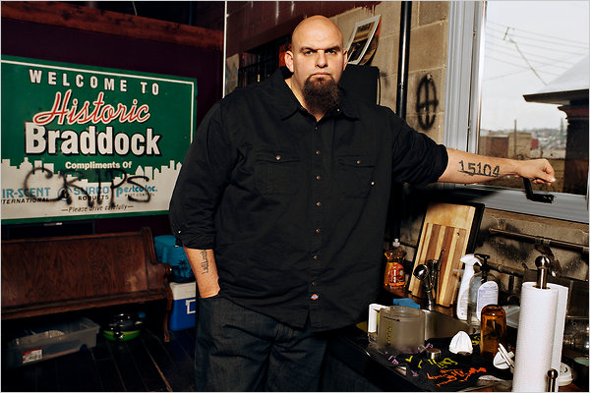

Notes:
TIME: 15 sec
Cook Ross Inc. © 2015
May be used only with express permission.

Slide 5
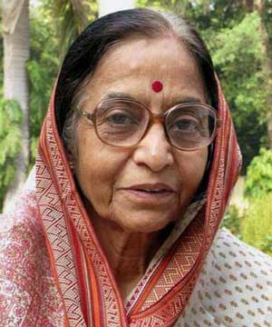
Notes:
TIME: 15 sec
Cook Ross Inc. © 2015
May be used only with express permission.

Slide 6
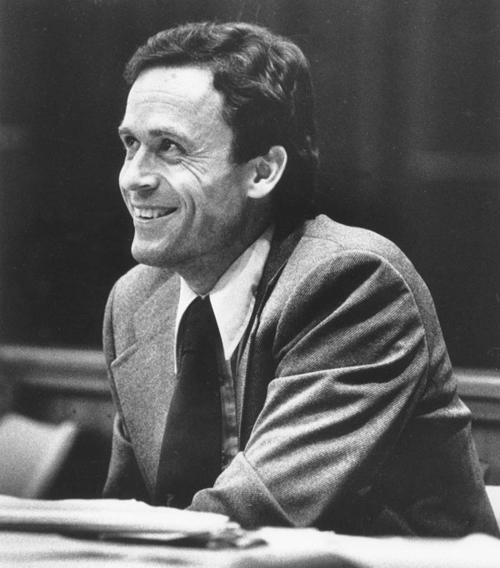
Notes:
TIME: 15 sec
Cook Ross Inc. © 2015
May be used only with express permission.

Slide 7
Gender
Ethnicity
Skin tone
Age
Setting
What patterns do you notice?
Facial expression
Body posture
Body type
Clothing
Notes:
Participant Guide reference p.6
TIME: 2min
DO: Click to reveal the different cues.
SAY: What patterns did you notice when you were watching your own perceptions?
DO: Ask 3-4 participants to share what they reacted to when they saw the pictures, and comment appropriately.
SAY: Now I’m going to share with you a little bit about who each of these individuals are.

Slide 8
John Fetterman
Mayor of Braddock, PA (a suburb of Pittsburgh) – the tattoo on his arm is the zip code!
Has a Master’s degree in Public Policy from Harvard
Served in the Americorps
Received international media attention for the economic revitalization programming he started in his community
Notes:
DO: Introduce each individual using some of the key points about them on each slide. Know that some of them may provoke strong reactions from the audience!
DO: Ask the group every now and then: did you perceive them to be warm? competent? Why or why not? What other feelings or assumptions did you have about them?
John Fetterman
Mayor of Braddock, PA (a suburb of Pittsburgh) – the tattoo on his arm is the zip code!
Has a Master’s degree in Public Policy from Harvard
Served in the Americorps
Received international media attention for the economic revitalization programming he started in his community
Cook Ross Inc. © 2015
May be used only with express permission.

Slide 9
Pratibha Patil
Economist
Attorney
First female president of India, 2007-2012
Notes:
Pratibha Patil
President of India from 2007-2012
First female president of India

Slide 10
Ted Bundy
American serial killer and rapist
Confessed to killing 30 women
Notes:
Ted Bundy
American serial killer and rapist
Confessed to killing 30 women
Cook Ross Inc. © 2015
May be used only with express permission.

Slide 11
Learning Objectives
Explore and acknowledge unconscious bias
Discuss the impact of bias on healthcare and daily interactions
Review recent literature regarding gender bias in Emergency Medicine
Discuss ways to mitigate bias

Slide 12
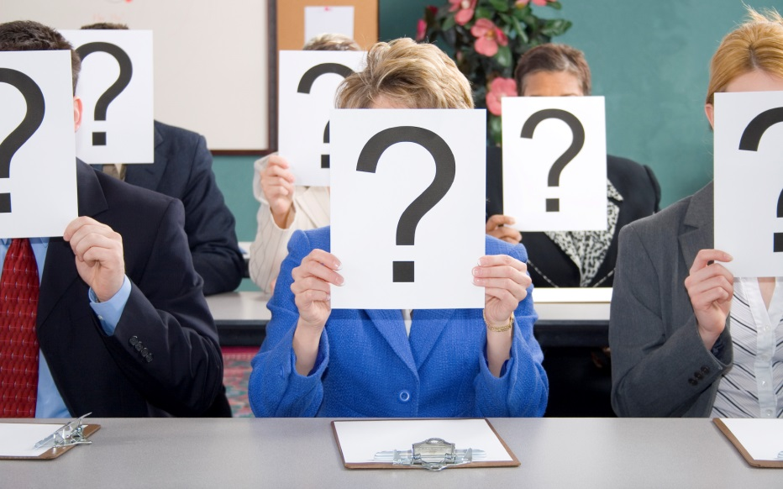
What are your associations with “bias” and “unconscious bias”?
Notes:
Participant Guide reference p.4
TIME: 3 min
ASK: So when you hear the terms “bias” or “unconscious bias”, what are your associations with them? (If needed, prompt participants with asking: Do you feel like it is positive or negative? Are you excited about this training topic, or maybe a little cautious? etc.)
DO: Solicit 2-3 responses and thank people for sharing.
SAY: During this training, we talk about unconscious bias not as necessarily good or bad, but as a natural function of the human mind that can potentially impact diversity and inclusion in our organizations. Recognizing unconscious bias helps us to get more insight into our interpretations and evaluations, and to make more conscious decisions.
DO: Share a personal example of a moment in which you had bias, were aware of it, mitigated it, and the positive impact this had.
SAY: I am sharing this with you to illustrate the universal nature of bias; we all have bias, and we’re not necessarily trying to get rid of it. The key is practicing conscious awareness, which is the overall purpose of this workshop.
TRANSITION: Now that we’ve begun to discuss the what, let’s discuss the why. What makes it important for us to explore unconscious bias and blind spots?
Cook Ross Inc. © 2015
May be used only with express permission.

Slide 13

What is bias?
A tendency or inclination that results in judgment without question.
A shortcut to interact with our world
An automatic response
Notes:
Participant Guide reference p.7 for definitions
TIME: 1 min
SAY: Bias refers quite simply to the mechanism of the brain that operates on associations; it is an automatic response. Our brain operates with short-cuts that allow us to quickly interpret and respond to the world around us. Bias is a decision we make so quickly that it simply occurs to us as data; we don’t know that we’ve actually taken them in (data points), interpreted them, and made meaning out of them. It all happens so fast that judgments such as ‘He’s stand-offish’ or ‘She’s charming’ in a first impression simply appear as though they were facts. However, we’re really just associating this new person with someone or something we’ve experienced before and creating a judgment based on that. This is a normal human function, but often it has consequences that are unintended.
TRANSITION: Some of our biases are conscious. For instance, you might be aware that you have a preference for working with people from your own culture or with people your age, rather than younger employees. Most of our biases, however, are unconscious to us.
Cook Ross Inc. © 2015
May be used only with express permission.

Slide 14
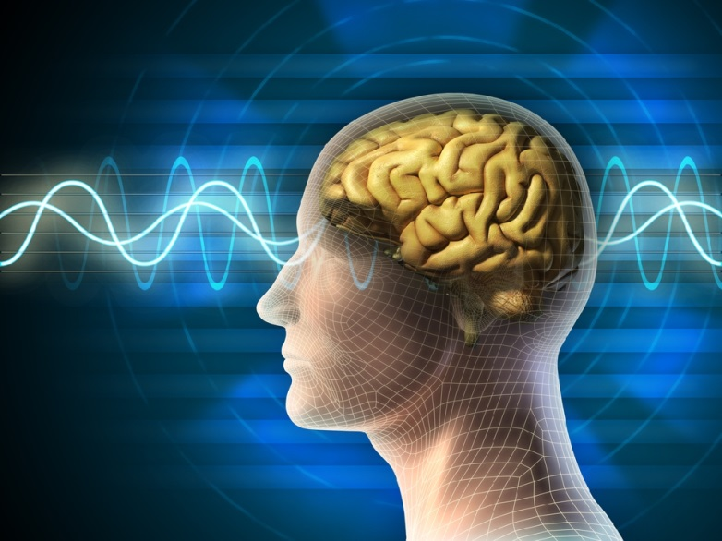

What is Unconscious Bias?
        Mental associations
        without:
          Awareness
          Intention
          Control
        These often conflict with our conscious
        attitudes, behaviors, and intentions.
Notes:
Participant Guide reference p.7 for definitions
TIME: 2 min
SAY: So what is unconscious bias?
DO: Read what is on the slide.
SAY: My assumption from being with you is that everyone has an intention to be inclusive, and yet, when we look at our results we don’t always see the fruits of our labor.
DO: Click to reveal “These often conflict with our conscious attitudes and intentions”.
SAY: Unconscious bias often conflicts with our conscious attitudes, behaviors, and intentions. This explains the fact that even though we have consciously worked on increasing diversity and inclusion, we have not been as successful as we hoped we would be, like we discussed earlier.
NOTE: If you have time, ask people in large group (popcorn style) or in pairs, to see if they can identify some of these discrepancies between intention and outcome.
Cook Ross Inc. © 2015
May be used only with express permission.

Slide 15

The road to unconscious bias is paved with good intentions!
Notes:
TIME: 30 sec
DO: Read what is on the slide.
Cook Ross Inc. © 2015
May be used only with express permission.

Slide 16

What function does bias serve?
Notes:
Participant Guide reference p.7 for definitions
TIME: 3 min
SAY: So why do we have bias; what function does it serve? The most primary purpose of the mind is to ensure our survival. Our identities are shaped by this desire to survive, and, if possible, to thrive. It makes sense that we would be more sensitized to danger than to attraction, because if we miss something positive, it’s just a missed opportunity. If we miss something dangerous, we could die! Part of this automatic survival tendency is to evaluate in every circumstance whether others are a “friend,” or a “foe.” Friend is people like us, where we immediately feel comfortable. Foe is someone different than me on first blush. Once we unconsciously label someone as “foe”, it takes 20% more glucose to process a “foe” as “friend”. We have a natural tendency to feel more comfortable with people who are like us. Bias becomes our internal “danger detector.” If you think back to our ancestors living in caves…someone was either part of the tribe, or they weren’t. If they weren’t, they were likely a threat. Although we don’t need this level of scrutiny in today’s world, the natural tendency is there and we still very much live in an “us” versus “them” world. Again, the purpose of this mechanism is to keep us safe.
DO: Provide an example, like:
If someone with a knife comes towards you, looking like they are going to attack, what do you do? That’s right, you respond, you run away or defend yourself, but you probably don’t just stand there wondering what this person might be doing with that steel object. Your immediate response/behavior is directly related to the bias you have towards a person coming your way with a knife.
If you’re about to cross the street and a car comes your way, you quickly jump back onto the sidewalk or run across the street, right? You are not asking yourself why this big metal object is speeding your way and what you should do. Your immediate response/behavior is directly related to the bias you have towards a speeding car coming your way.
Think about who you are most drawn to talk to or feel comfortable around at a public function? Right, when it comes to a room full of relative strangers, most people are drawn to those who look or act similarly as they do. This is due to our bias towards “friends” as opposed to “foes”.
Imagine you are in an unfamiliar wooded area (a park or on a hike) with your 4 year-old and it’s getting dark. You hear a noise coming from behind thick bushes. How do you respond? You take your child’s hand and quickly get as far away as possible. Your immediate bias is related to flight from unknown danger.
TRANSITION: Let’s review a couple of studies that demonstrate how unconscious bias has shown up in healthcare with respect to different dimensions of diversity.
Cook Ross Inc. © 2015
May be used only with express permission.

Slide 17

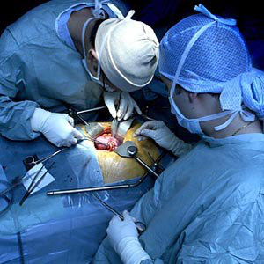
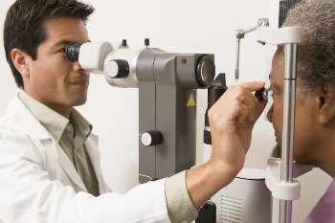
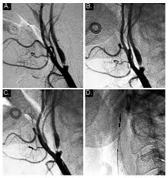

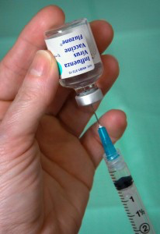
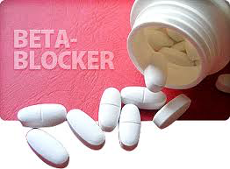
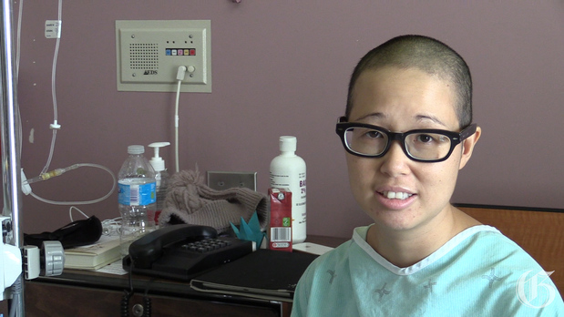
People of Color Receive Fewer/Less…
Breast Cancer Screenings
Kidney Transplants
Eye Exams
Revascularization Procedures
Cancer Pain Meds
Mental Health Treatment
Vaccinations
Cardiac Care
Notes:
TIME: 30 sec
SAY: Research shows that people of color receive fewer breast cancer screenings, kidney transplants, eye exams, vaccinations, and revascularization procedures, and less cardiac care, pain medication, and mental health treatment.
NOTE: Authors and abstracts for relevant studies are provided in the Additional Resources/Bibliography section of your Facilitator Guide. It is recommended that you review these completely before facilitating this session. You won’t use all of the information in the facilitation, but knowing the content will allow you to more easily respond to learners’ questions.
Cook Ross Inc. © 2015
May be used only with express permission.

Slide 18
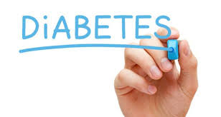
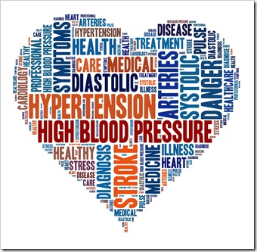
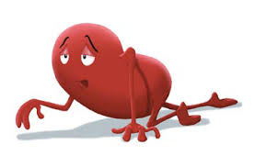

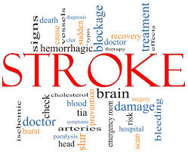
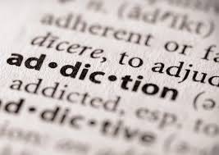
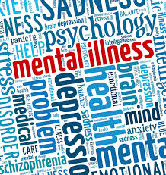
Significant Health Disparities Exist In…
Kidney Disease
Notes:
TIME: 30 sec
SAY: The research has shown us that health disparities exist across many chronic illnesses and conditions.
NOTE: Authors and abstracts for key health disparities research are provided in the Additional Resources/Bibliography section of your Facilitator Guide. It is recommended that you review these completely before facilitating this session. You won’t use all of the information in the facilitation, but knowing the content will allow you to more easily respond to learners’ questions.
Cook Ross Inc. © 2015
May be used only with express permission.

Slide 19
The Effect of Race and Sex on Physicians' Recommendations for Cardiac Catheterization
“Men and whites were significantly more likely to be referred than women and blacks.”
Kevin Schulman, MD, et. al, NEJM, February, 1999
Notes:
TIME: 1 min
SAY: For example, let’s examine one study. In 1999, researchers explored how race and sex impact whether patients are recommended for cardiac catheterization. What they found in their experiment was that both men and whites were significantly more likely to be referred for the procedure than women and blacks. What might be causing the discrepancy? In recent years, a considerable amount of research has revealed that unconscious bias on the part of medical professionals may be actively contributing to health disparities.
NOTE (Reference Study): Schulman KA, Berlinj A, Harless W, et al. (1999). “The effect of race and sex on physicians' recommendations for cardiac catheterization.” NEngFJ Med, 340:618-626.
Abstract available in Additional Resources section.
Cook Ross Inc. © 2015
May be used only with express permission.

Slide 20
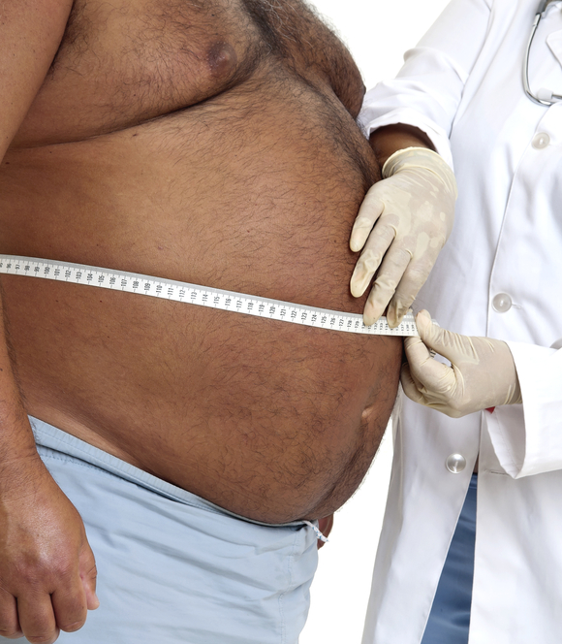
Weight
Research testing 2284 medical doctors found that overall doctors show a strong implicit bias against overweight people.
Men’s bias was stronger than women’s, and bias was strongest among those tested who were the thinnest.
Janice A. Sabin, Maddalena Marini, and Brian A. Nosek, 2012
Notes:
Participant Guide reference p.8
TIME: 1 min
SAY: Overweight patients report experiencing discrimination in health care settings. This often leads to avoidance of routine preventive health care. This 2012 study investigated the pervasiveness of negative attitudes about weight among health care professionals using the Implicit Association Test. The 2,284 medical doctors who voluntarily took the test revealed a strong implicit anti-fat bias. This bias was stronger among men, and the thinnest test-takers.
NOTE (Reference Study): Sabin, J.A., Marini, M., and B. Nosek (2012). “Implicit and Explicit Anti-Fat Bias among a Large Sample of Medical Doctors by BMI, Race/Ethnicity and Gender.” PLoS One, 7(11): e48448. Abstract available in Additional Resources section.
Cook Ross Inc. © 2015
May be used only with express permission.

Slide 21
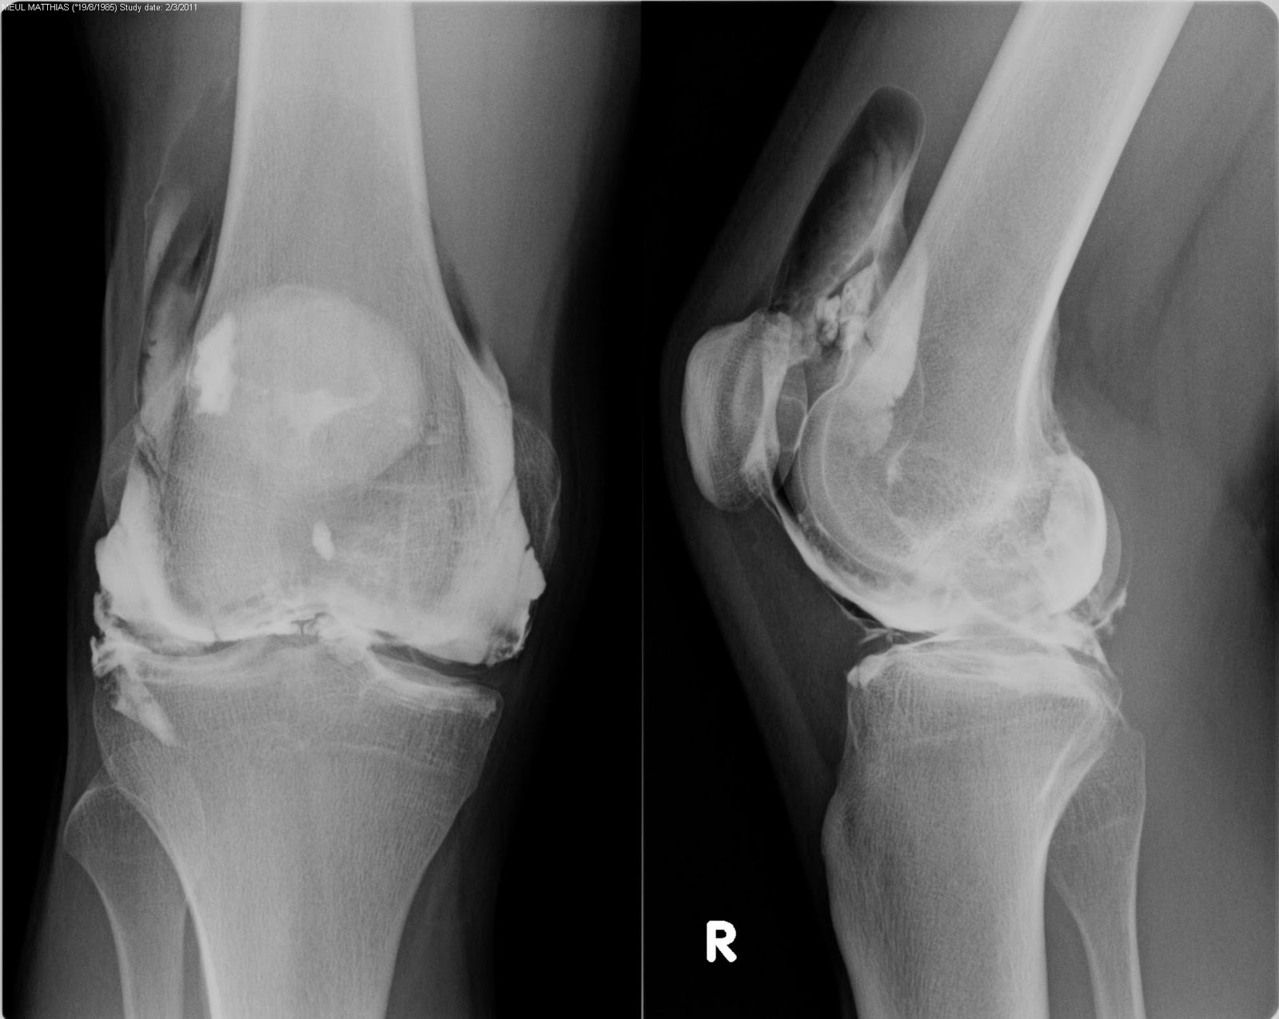
Gender
50% more men than women were recommended for knee replacement surgery with the same presenting medical evidence.
Borkhoff, Hawker, Kreder, Glazier, Mahomed, Wright, University of Ontario, Canadian Medical Assn.
Notes:
Participant Guide reference p.8
TIME: 1 min
SAY: Rates of use of total joint arthroplasty among appropriate and willing candidates are lower in women than in men. This disparity is explained by several factors, among them gender bias that impacts physician’s clinical decision making: 50% more men than women were recommended for knee replacement surgery with the same presenting medical evidence.
NOTE: Reference study: Borkhoff, C. M., G. A. Hawker, et al. (2011). "Patient Gender Affects the Referral and Recommendation for Total Joint Arthroplasty." Clinical Orthopaedics and Related Research, 469(7): 1829-1837. Abstract available in Additional Resources section of this Facilitator Guide.
Cook Ross Inc. © 2015
May be used only with express permission.

Slide 22
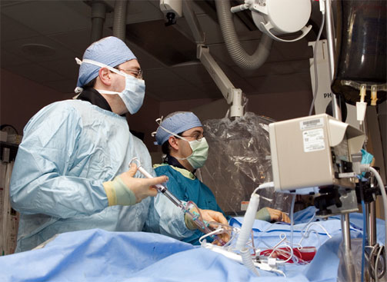
Alexander R. Green, MD, MPH; Dana R. Carney, PhD; Daniel J. Pallin, MD, MPH; Long H. Ngo, PhD; Kristal L. Raymond, MPH; Lisa I. Iezzoni, MD, MSc; Mahzarin R. Banaji, PhD
Race
Notes:
Participant Guide reference p.8
TIME: 1 min
SAY: We’ve already seen one example of bias about race and gender as it impacts cardiac catheterization. Here’s another, which illustrates how unconscious bias can play out with respect to race and thrombolysis. Physicians were given 3 items: 1) a clinical vignette of a patient with acute coronary syndrome who was randomly assigned as either black or white, 2) a post-questionnaire, and 3) three Implicit Association Tests. While all physicians explicitly reported themselves on the questionnaire as equitable and un-biased, through the IAT implicit preference was revealed in favor of the white patients, who were more frequently recommended for the treatments than the black patients.
NOTE: Reference study: Green, A. R., D. R. Carney, et al. (2007). "Implicit bias among physicians and its prediction of thrombolysis decisions for black and white patients." Journal of General Internal Medicine, 22(9): 1231-1238.
Abstract available in Additional Resources section of this Facilitator Guide.
Cook Ross Inc. © 2015
May be used only with express permission.

Slide 23
Book of Rules
Schema
Background
Notes:
Participant Guide reference p.8 for taking notes
TIME: 30 sec
DO: Show “Background.”
SAY: Our schema contributes to forming the background through which we see the world. Simultaneously, our background contributes to and reinforces our Book of Rules, in a continuous cycle. Let’s take a moment to experience the impact of schema and background on our interpretation.
Cook Ross Inc. © 2015
May be used only with express permission.

Slide 24
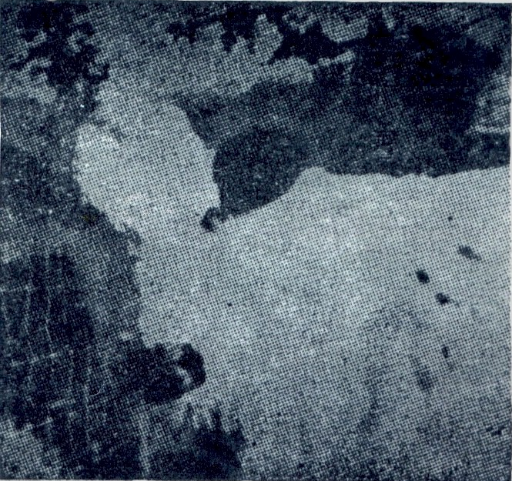
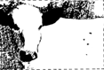
Karl Dallenbach
Notes:
TIME: 4 min
SAY: One of the things that our schema and background do is to organize our minds to see things in particular ways that we might not otherwise see. Consider this picture.
ASK: What do you see?
NOTE: Gather 3-4 different views on the image.
DO: Click to reveal the fixed image of the cow.
ASK: What do you see now?
SAY: Karl Dallenbach is a psychologist interested in perceptual organization. This is one of his images, in which he demonstrates how quickly we groove a pathway that will have you forever see a cow when you see the original image.
DO: Click through to show the original image.
SAY: Now how many of you see a cow? Now that you know the schema—the context—all shapes in this image all of a sudden make perfect sense. Our schema gives us a framework through which we see the world, and through which we make sense of the world around us. This example demonstrates how immediately we are influenced by our schema as we interpret our surroundings, people and places. When something is particularly meaningful, it will convert to long term memory, and will be one of the neuronal threads that we call on when we make associations. When we experience a change of context and something is revealed to us, the paradigm shifts, and it becomes difficult to un-see it after that. One of the intentions of the course is to experience a new paradigm that will help us look at the same thing (diversity & inclusion) with a different lens in order to see and approach it differently.
TRANSITION: Now, let’s discuss the concept of background.
NOTE: The theoretical explanation of perceptual organization is: “...the process by which particular relationships among potentially separate elements (including parts, features, and dimensions) are perceived (selected from alternative relationships) and guide the interpretation of those elements... in sum, how we process sensory information in context.” - Pomerantz & Kubovy, 1986
Cook Ross Inc. © 2015
May be used only with express permission.

Slide 25
We see the world as we are, rather than the way that it is.
Notes:
TRANSITION: Click and read what is on the slide.
Cook Ross Inc. © 2015
May be used only with express permission.

Slide 26
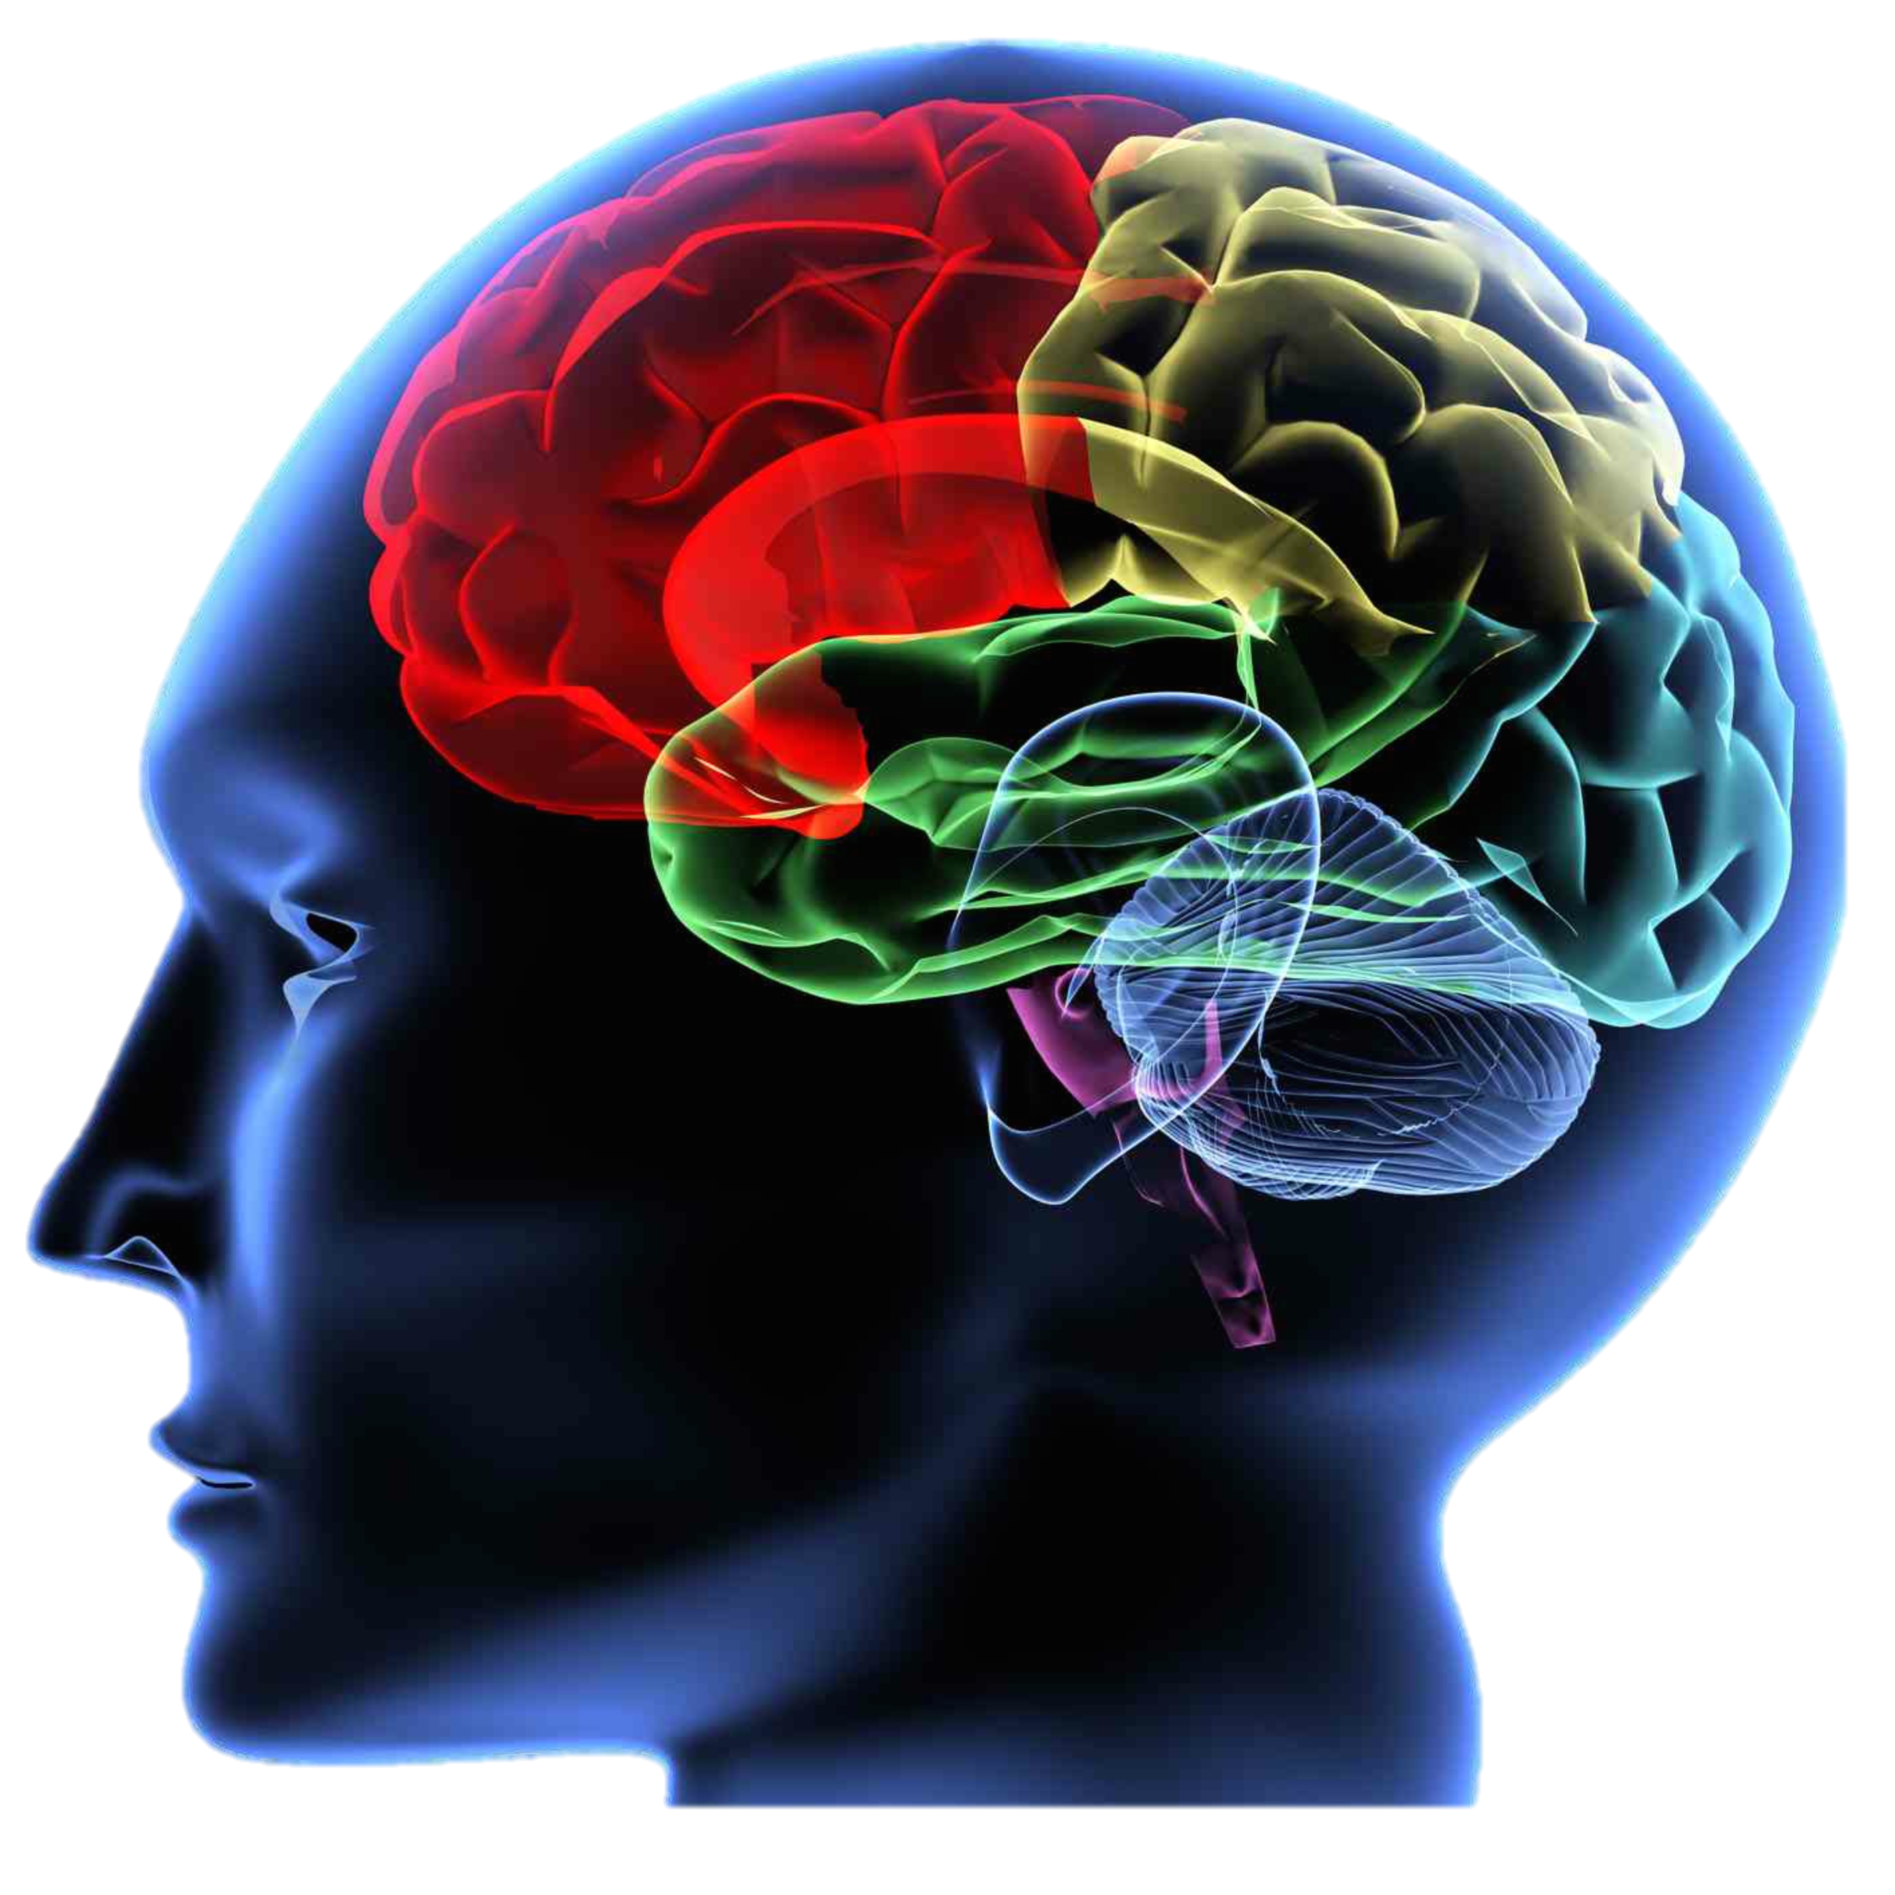
Fast (Emotional) Brain
Slow (Thinking) Brain
Background
Catalyzing person or circumstance
Notes:
Participant Guide reference p.10 for taking notes
TIME: 3 min
SAY: The majority of our brain is designed for fast-thinking. The fast brain allows us to quickly process people and circumstances, and translate the stimuli directly into reactions. This function of the human mind is critical for our survival, but also causes us to rely on our emotions and biases much more than if we would slow down our thinking. Our “slow brain” lives in our pre-frontal neocortex. Information processing is slower in this part of the brain. This is where awareness and consciousness have the potential to not just think, but to reflect on our thinking process. We call this meta-cognition: our brain’s ability to watch ourselves think. Training our meta-cognition skills allows us to become aware of our biases, and intervene and change direction if we notice that those biases do not serve ourselves, our interpersonal interactions and team dynamics, and our work and organization. Instead of our biases making decisions and running the show when we rely on our fast brain default, meta-cognition helps us to practice a more conscious awareness in our everyday functioning.
Cook Ross Inc. © 2015
May be used only with express permission.

Slide 27
John Ridley Stroop, 1935
SLB | CFLTK | CFLTK
SPRND | HLMG | CFLTK
SLB | SPRND | SLB
SPRND | HLMG | CFLTK
HLMG | SPRND | CFLTK
Notes:
TIME: 1 min
SAY: Let’s look at an example that allows us to experience the difference between fast brain and slow brain. This experiment was done by American psychologist John Ridley Stroop in 1935.
DO: Ask participants to all together call out loud the color of the letters in each box, as you click through them steady pace. This will be easy for participants and they will get all of them right.
SAY: Pretty easy, wasn’t it? Let’s try it one more time.
27
Cook Ross Inc. © 2015
May be used only with express permission.

Slide 28
John Ridley Stroop, 1935
RED | GREEN | YELLOW
BLUE | GREEN | BROWN
PURPLE | YELLOW | BLUE
BROWN | BROWN | BLUE
YELLOW | GREEN | RED
Notes:
TIME: 1 min
DO: Click through them in the same steady pace as the set before.
NOTE: Because the words and the colors of the letters are not the same, participants will have trouble quickly calling out the right color of the letters, and might get confused between the words and the colors. This often leads to a little bit of chaos and laughter, but keep clicking until you’ve gone through all the boxes.
SAY: This was a bit harder, wasn’t it? Why was that? That’s right, because the letters formed a word that indicated a different color than the colors of the letters themselves. It confuses our fast brains, which either causes us to give the wrong answer or forces us to move the analysis/interpretation to the slow brain. It takes us longer to process this information when we do that, causing a delay in our answers.
Cook Ross Inc. © 2015
May be used only with express permission.

Slide 29
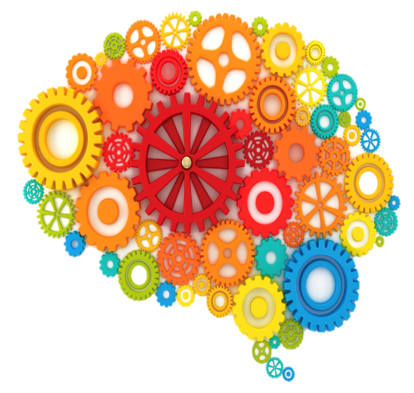
Perceptions
Source: T. Norretranders, The User Illusion. Trans. J. Sydenham (New York: Viking, 1998), cited in Timothy Wilson, Strangers to Ourselves: Discovering the Adaptive Unconscious (Cambridge, Mass.: Belknap Press of Harvard University Press, 2002), 24.
Interpretations
Preferences
Selective Attention
11 million pieces of information at any one time
40-50 pieces
of information get absorbed
Notes:
Participant Guide reference p.10 for taking notes
TIME: 2 min
SAY: How does this work? We’re exposed to 11 million pieces of information at any one time, and our brains can only manage 40-50. We are bombarded with stimuli and we simply can’t process all of it. Our perceptions, interpretations, preferences, and selective attention filter the information to a manageable number of pieces of information, about 40-50. Remember when we talked about how our background is similar to wearing colored contact lenses that shade the world a certain way? The filters are like lenses. What we see and how we see it, is thus a partial and colored view on the world based on our background and biases. We therefore often see what we expect to see, what is of interest to us, or what we’re looking for, rather than everything in front of us. It can prevent us from seeing the full picture, and we can therefore overlook people, information, risks, opportunities, etc. for no other reasons than our own perspective. Our biases are one form of these perspectives. Understanding our own background, identity, and biases can help us be more aware of what we are missing. Yet another motivation for increasing diversity & inclusion: more variety in viewpoints can help us see more than a single person or a homogeneous crowd.
NOTE: Reference study: T. Norretranders, The User Illusion. Trans. J. Sydenham (New York: Viking, 1998), cited in Timothy Wilson, Strangers to Ourselves: Discovering the Adaptive Unconscious (Cambridge, Mass.: Belknap Press of Harvard University Press, 2002), 24.
(study mentioned on page 87 in ReInventing Diversity by Howard Ross. )
Cook Ross Inc. © 2015
May be used only with express permission.

Slide 30
Name
Height
Sexual Orientation
Appearance
Education
Race
Which biases are ours?
Gender
Disability
Accent
Hand Dominance
Skin Tone
Weight
Religion
Communication Style
Age
Notes:
TIME: 1 min
SAY: Let’s return to this model.
DO: Click to reveal the different biases while you speak.
SAY: Thus far, we’ve discussed various functions of our unconscious mind: the fast brain, selective attention, subliminal messages, and social primacy. We’ve seen how each of us is influenced by factors often that occur outside of our control. Ultimately, the question is not whether or not we have unconscious biases ourselves, because ALL humans do. The question really is, “Which ones do we have?” and “How might they impact myself, others, and our organizations?”
Cook Ross Inc. © 2015
May be used only with express permission.

Slide 31
A Network of Relationships
Patient to Provider
Nurse to Patient
Faculty to Learner
Provider to Provider
Administration to Provider
Nurse to Provider
Notes:
Participant Guide reference p.11 for taking notes
TIME: 10-15 min
SAY: We are going to spend a few minutes brainstorming where and how unconscious bias shows up in healthcare and academic medicine. Our natural inclination in this field is to see how bias can impact the patient-provider relationship. Certainly this is one important place in which we must be conscious of the role of unconscious bias in order to mitigate its impact. However, there are many other relationships that define academic medicine in which it is important to recognize the impact of bias.
DO: Divide the room into small groups of 4-5 learners, depending on the size of the group and how much time there is. Assign each group two of the relationships from the slide. Make adjustments if necessary based on size of learner group. If there are fewer participants, consider having each group take on 3 or more relationships.
SAY: Take 5-7 minutes in your small group to brainstorm how the dynamics of unconscious bias impact this particular domain/relationship. This might include micro-behaviors, decision-making processes, and systems and structures. Note them on your wall chart. After 5-7 minutes, we’ll share with the large group.
DO: Execute large group debrief for an additional 3-5 minutes. Have each group share 1-2 ways that unconscious bias can impact each process.
NOTE: Coach participants as needed to identify specific biases in these areas.
Cook Ross Inc. © 2015
May be used only with express permission.

Slide 32

Dr. Paid Less: An Old Title Still Fits Female Physicians
Women make $20,000 less annually than comparable male physicians.
Jena AB, Olenski AR, Blumenthal DM. Sex Differences in Physician Salary in US Public Medical Schools.
JAMA Intern Med. 2016;176(9):1294–1304. doi:10.1001/jamainternmed.2016.3284
Notes:
Data from 10,000 faculty physicians at 24 medical schools…adjusting for factors such as number of patient seen, number of publications etc. 51,000/year before adjustment
Article in NYT, July 16

Slide 33
Gender bias towards EM residents?
Comparison of male vs female resident milestone evaluations by faculty during emergency medicine residency training
Dayal A, O’Connor DM, Qadri U, et al. Comparison of male vs female resident milestone evaluations by faculty during emergency medicine residency training. JAMA Intern Med. 2017;177(5):651–657.
Notes:
8 training programs over 2 years – milestone attainment the same for intern year, and then gap started between male and female. By graduation, male residents had attained 0.15 milestone levels highter (equiv of 3-4 months training.) 12.7% higher

Slide 34
Nursing Evaluations
Standout
Ability
Grindstone
Interpersonal
Brucker K, Whitaker N, Morgan Z, Pettit K, Thinnes E, Banta A, Palmer M. “Gender bias in nursing evaluations of Emergency Medicine residents
Notes:
Three years worth of evals, coded as positive or negative after pronouns removed.
Give example of words
Ability – 51% neg for female, 20% neg for male
Grindstone – 57% neg for female, 24% neg for male
Faculty evals and ITE scores unchanged

Slide 35
Faculty Evaluations
Standout
Ability
Grindstone
Interpersonal
Pettit K, Morgan Z, Lommel J, Banta A, Palmer M, Besinger B. “Gender Bias in Faculty Evaluations of Emergency Medicine Residents
Notes:
Also three years. In the process of coding, but first just looked at types of words used. Same categories as before.
This was a 4/4 grid. Female faculty write longer comments.
Female residents were more likely to have comment re: IP language
Female faculty less likely to use standout and ability language.

Slide 36
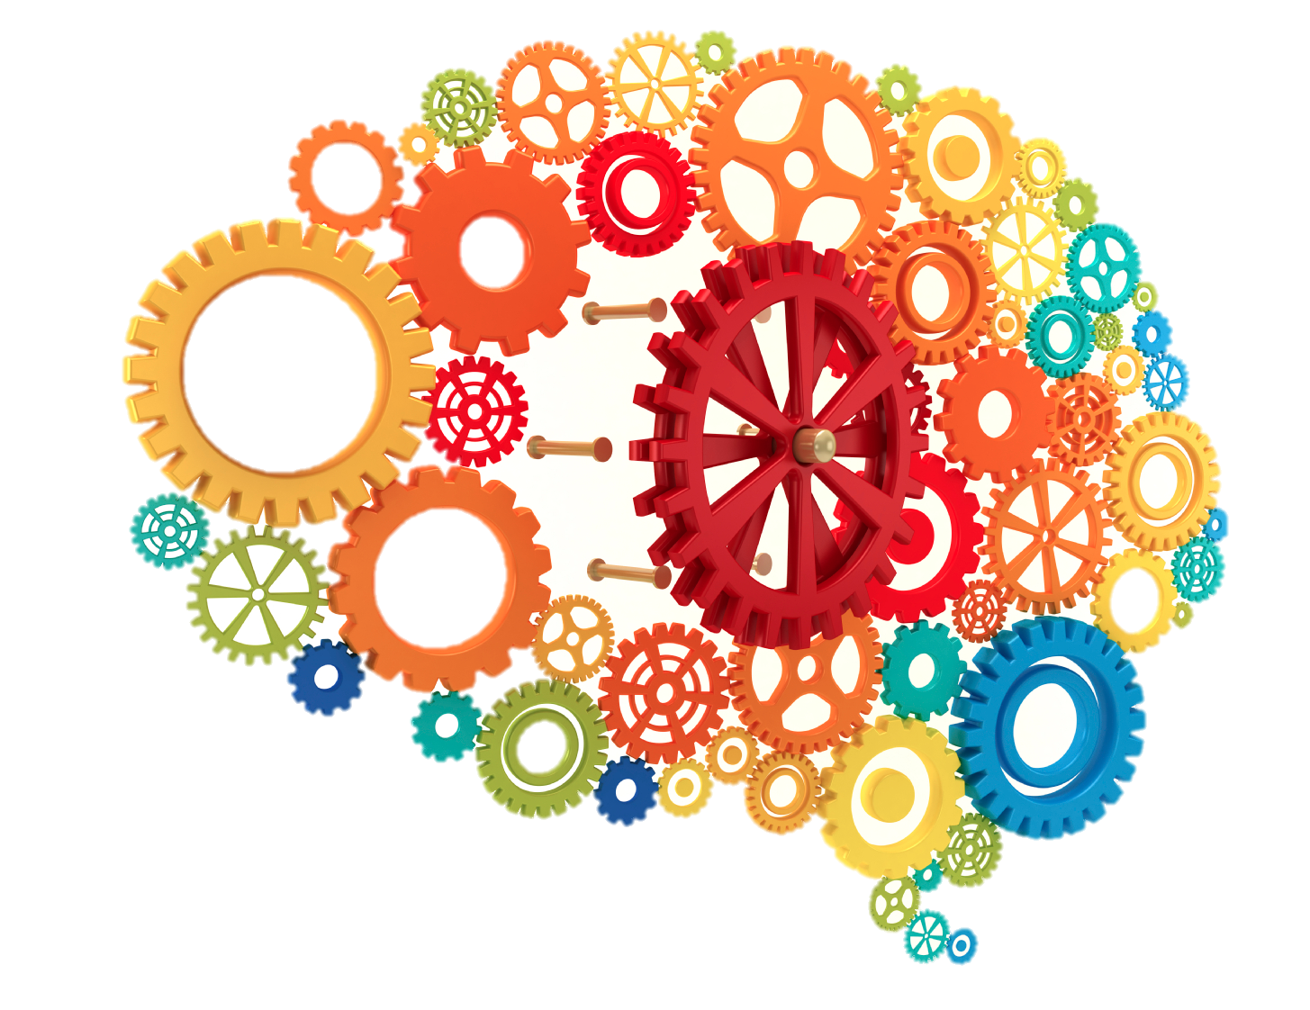
The Unconscious is Malleable
Notes:
TIME: 1 min
SAY: One of the more important learnings that we’ve had from the research is that the unconscious is malleable; we can work with it. The brain has a high level of plasticity and flexibility, which means that it constantly makes new connections and re-wires itself. We can also re-wire and redefine our relationship to bias. I’ll talk about some of the strategies now.
Cook Ross Inc. © 2015
May be used only with express permission.

Slide 37
6 Ways to Mitigate Your Biases
Recognize and accept that you have bias
Notes:
Participant Guide reference p.12 for taking notes
TIME: 1 min
SAY: The first step in mitigating the impact of your biases is both the simplest and, often, the most difficult: to recognize that you have biases – just like everybody else. To have bias is to be human. It is a primal survival instinct, combined with social conditioning (social messages) about different groups of people, behaviors, values, etc. As we’ve talked about earlier, it is not necessarily a bad thing to have biases, but we do have to become aware of them in order to anticipate their impact on ourselves and others, and be able to intervene when we recognize the potential negative impact. When we realize where our biases come from, we might realize how they are not based in a rational reality, but rather a social or emotional construction created somewhere in your past.
Cook Ross Inc. © 2015
May be used only with express permission.

Slide 38
6 Ways to Mitigate Your Biases
Develop the capacity to use a flashlight on yourself
Notes:
Participant Guide reference p.12 for taking notes
TIME: 1 min
SAY: Humans have far more capacity (3 times more) to think about their own thinking than other high level primates. Yet, we often take this gift for granted. Develop the capacity to shine a flashlight on yourself. Continue to engage in the self-explorations we have doing in the training so far. Be able to take an honest look at how you are who you are, and which messages and biases govern your everyday life. Remember to do this without self-judgment, but rather from a place of curious inquiry.
TRANSITION: Recognizing our own biases by shining the flashlight on ourselves creates a short pause in our thinking and acting/reacting.
Cook Ross Inc. © 2015
May be used only with express permission.

Slide 39
6 Ways to Mitigate Your Biases
Practice “Constructive Uncertainty”
Notes:
Participant Guide reference p.12 for taking notes
TIME: 1 min
SAY: Develop and practice “Constructive Uncertainty.” This is especially helpful when you’re “certainly certain that you’re certain.” In other words, change your exclamation points into question marks. Check your assumptions and “truths” you have about yourself and others, and ask questions from a non-judgmental place.
Cook Ross Inc. © 2015
May be used only with express permission.

Slide 40
6 Ways to Mitigate Your Biases
Explore awkwardness, and discomfort
Notes:
Participant Guide reference p.14 for taking notes
TIME: 1 min
SAY: Explore awkwardness or discomfort. It’s okay to feel outside of your comfort-zone sometimes or unsure what feel, do, or say. Lean into this, and remember the first two ways to impact the unconscious.
Cook Ross Inc. © 2015
May be used only with express permission.

Slide 41
6 Ways to Mitigate Your Biases
Engage with people you consider “others” and expose yourself to positive role models in that group
Notes:
Participant Guide reference p.14 for taking notes
TIME: 1 min
SAY: Engage with people you consider “others,” and expose yourself to positive role models in that group. It helps to develop a multi-dimensional, diverse view of others and the groups they belong to. This has also been found to be one of the most powerful ways to “soften” our negative biases about particular groups. The pictures on the walls around you; stories about exemplars from the group in question; learning more about their culture, all can contribute to this “rewiring.”
Cook Ross Inc. © 2015
May be used only with express permission.

Slide 42
6 Ways to Mitigate Your Biases
Get feedback
Notes:
Participant Guide reference p.14 for taking notes
TIME: 1 min
SAY: Get feedback and data. Invite feedback from others as well as metrics, no matter how basic they are, so they can help you see your patterns and blind spots, and in that way your biases and their impact.
DO: Provide some examples on how to solicit this information effectively, as “Am I biased?” might be perceived as a loaded question. For instance, “Is there anything that I’ve missed?” is a friendly invitation for others to fill you in on what might be a blind spot for you.
Cook Ross Inc. © 2015
May be used only with express permission.

Slide 43
6 Ways to Mitigate Your Biases
Recognize and accept that you have bias
Develop the capacity to use a flashlight on yourself
Practice “Constructive Uncertainty”
Explore awkwardness, and discomfort
Engage with people you consider “others” and expose yourself to positive role models in that group
Get feedback
Notes:
TIME: 30 sec
TRANSITION: Let’s transition from reviewing these strategies to creating an action plan for mitigating bias.
Cook Ross Inc. © 2015
May be used only with express permission.

Slide 44
Questions??

