Slide 1
EMS 2018 Updates
INACEP
4.25.17

Slide 2
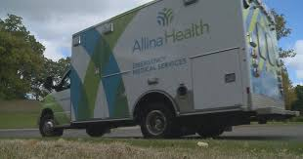
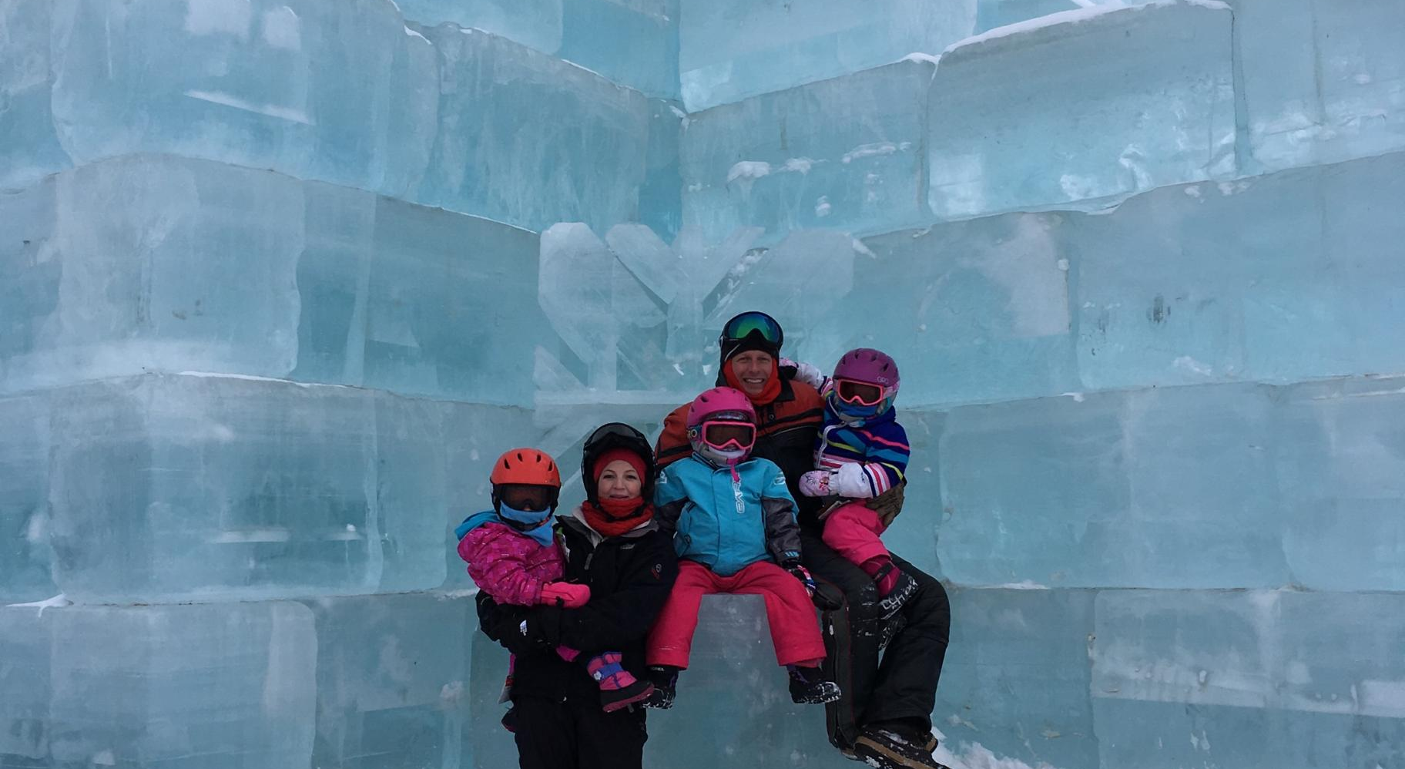


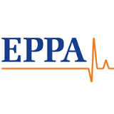
Still Enjoying Home
2

Slide 3
Update Points
Stroke (LVO, Door to CT)
Trauma (Stop the bleed, Endovascular aortic occlusion, C Collar)
Cardiac Arrest (Public expectation CPR, ACCESS, ECMO, Airports, Upright CPR)

Slide 4
Stroke Guidelines & Recommendations
Alteplase for stroke: money and optimistic claims buttress the “brain attack” campaign
  BMJ VOLUME 324 23 MARCH 2002 bmj.com
  Bottom Line- $11million to AHA and 6/9 Panelist had COI
Underreporting of conflicts of interest in clinical practice guidelines: cross sectional study
  BMC Medical Ethics201314:19 DOI: 10.1186/1472-6939-14-19
  Bottom Line-Forty-five guidelines from 14 specialty societies were included. Of 254 authors, 135 (53%) had conflicts of interest, corresponding to 43 of the 45 guidelines (96%) having one or more authors with a conflict of interest. Only one of the 45 guidelines (2%) disclosed author conflicts of interest.

Slide 6
Observational Multicenter Study of a Direct-to-CT Protocol for EMS-transported Patients with Suspected Stroke.
Prehospital Emergency Care Jan 2018
Some hospitals have begun taking stable EMS patients with suspected stroke directly from the ambulance to the CT scanner
Seven hospitals contributed data on 1040 patients (529 "before" and 511 "after"); and 627 had final diagnoses of ischemic stroke, 275 received tPA.
Median door-to-CT-ordered time for all patients was 7 minutes in the before phase, and 4 minutes after. median door-to-CT-started time was 6 minutes before and 10 minutes after. The median door-to-needle time for all patients given tPA was 42 minutes before, and 44 minutes after (p = 0.78).

Slide 7
Systematic review of the literature on prehospital stroke scales used to identify LVOs
Prehospital Emergency Care March 2018
Sensitivity, specificity, and predictive values.
Goal was to determine if emergency medical services (EMS) are able to accurately identify LVO in the field
Eight studies, 6787 patients were included in our systematic review. 6 were retrospective studies, 1 was a prospective cohort, and 1 was a prospective observational study. Sensitivities of the studies ranged from 49% to 91% while specificity of the studies varied from 40% to 94%.
  For comparison Cincinnati PSS>2, 87% sens 94% spec
Equivocal for LVO, need more studies
Probably last seen normal most important*

Slide 8
March 2018 Report Update
The Stop the Bleed Program® was born in the aftermath of
the active shooter disaster on December 14, 2012, at Sandy Hook Elementary School in Newtown, CT. Goal was to decrease death 20% by 2020.

Slide 10
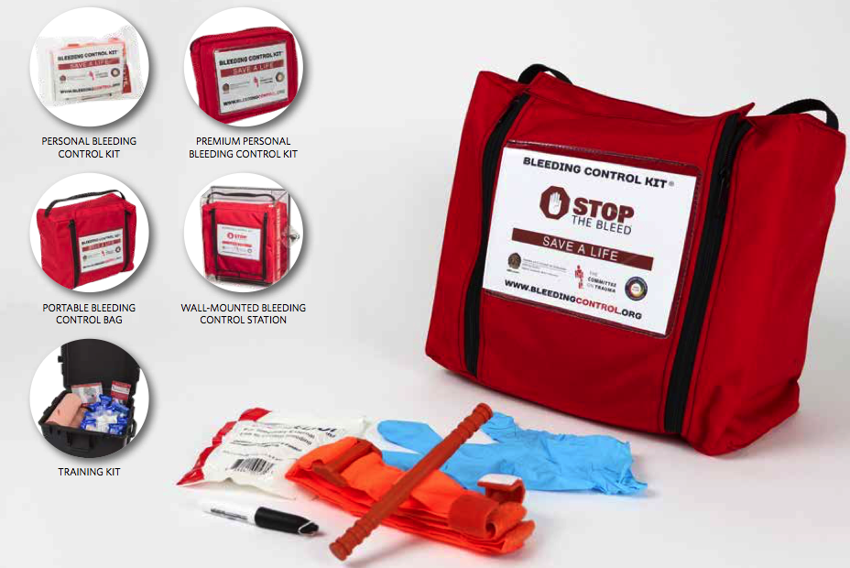

Slide 11
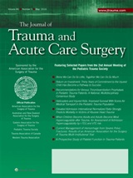
So what to do?
The profile of wounding in civilian public mass shooting fatalities
E. Reed Smith, MD, Geoff Shapiro, EMT-P, Babak Sarani, MD
Journal of Trauma and Acute Care Surgery, Publish Ahead of Print Feb 16, 2016 DOI: 10.1097/TA.0000000000001031

Slide 12
Tourniquets
A total 139 fatalities consisting of 371 wounds from 12 CPMS events were reviewed
58% of victims had gunshots to the head and chest
Only 7% of victims had potentially survivable wounds
There were no deaths due to exsanguination from an extremity
        Combat does NOT equal Civilian
        BUT this was prior to Las Vegas and Orlando

Slide 13
Resuscitative Endovascular Balloon Occlusion of the Aorta in trauma: a systematic review of the literature
World Journal of Emergency Surgery Aug 2017
Sixty-one articles, case report/series & retro
1355 treated with aortic endovascular balloon occlusion, and 883 (65%) patients died after the procedure
Almost all had shock state
One placed by London Air Ambulance in Zone III

Slide 14
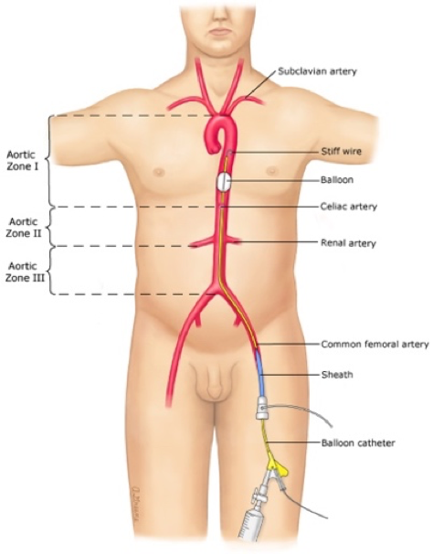
Competency in ER with 3-5 placements

Slide 15
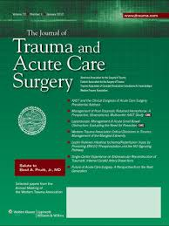
Nexus Failure…
Asymptomatic cervical spine fractures: Current guidelines can fail older patients
Healey, Christopher D. MD; Spilman, Sarah K. MA; King, Bradley D. DO; Sherrill, Joseph E. II MD; Pelaez, Carlos A. MD
Journal of Trauma and Acute Care Surgery: July 2017 - Volume 83 - Issue 1 - p 119–125
A retrospective review was performed for patients 55 years or older with a c-spine fracture during a 4-year study period. All GCS 15, no pain/tenderness.
173 fractures, 22% percent of the symptomatic group and 19% of the asymptomatic group required halo, fusion, or other surgical intervention.

Slide 16
Public knowledge and perceptions about cardiopulmonary resuscitation (CPR): Results of a multicenter survey
AJEM Feb 2018
Cross-sectional prospective surveys were conducted at four academic medical centers (including a children's hospital) during a two-month study period
In one CPR vignette, participants consistently overestimated the success rate of CPR (72% predicted postcardiac survival) as well as long-term outcome (65% predicted a complete neurological recovery) in a 54-year-old who suffered a heart attack at home and required CPR by paramedics.
Reality 10%
Personal medical training concerning CPR (68%), followed by television (39%), personal experience (21%), internet (9%), and friends or family with medical training (7%)
Worries for ceasing resuscitation

Slide 17
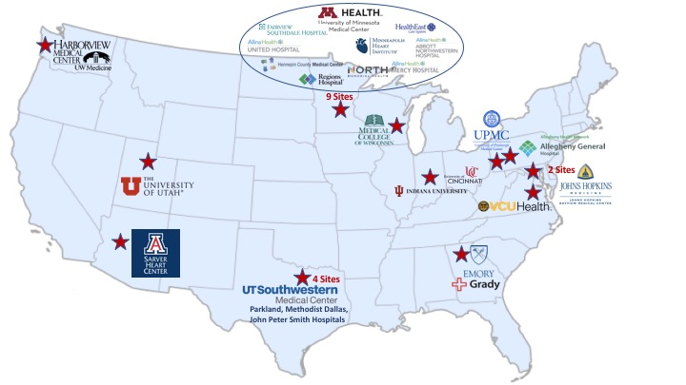
Maybe we are getting closer

Slide 18
Early Access to the Cardiac Catheterization Laboratory for Patients Resuscitated From Cardiac Arrest Due to a Shockable Rhythm: The Minnesota Resuscitation Consortium Twin Cities Unified Protocol
J Am Heart Assoc Jan 2016
Overall, 197 (63%) patients survived to hospital discharge with good neurological outcome (cerebral performance category of 1 or 2). Of the patients who followed the Minnesota Resuscitation Consortium protocol, 121 (52%) underwent percutaneous coronary intervention, and 15 (7%) underwent coronary artery bypass graft. In this group, 151 (65%) survived with good neurological outcome, whereas in the group that did not follow the Minnesota Resuscitation Consortium protocol, 46 (55%) survived with good neurological outcome (adjusted odds ratio: 1.99; [1.07–3.72], P=0.03).

Slide 19

Shock Refractory VF VT
Inclusion Criteria:
Age 18-75
Presumed Cardiac Origin
First recorded rhythm VF/VT or AED shock was given before arrival of EMS
MUST be on LUCAS CPR
No Trauma
No DNR/DNI
EMS Transport Time <30 min

Slide 20
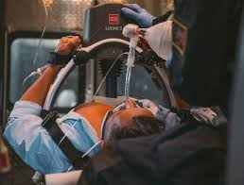

Slide 21
Shock Refractory VF VT
3 Shocks then go
U of Minn Cath Lab
  ECMO
  Cath
  ICU
Results: 26/72 survival 38%!!!
  26/72 good neuro 36%
CARES MINN – 8%, Allina 15%

Slide 22
Out-of-hospital cardiac arrest survival in international airports.
Masterson S, et al. Resuscitation. 2018.
30-day survival after cardiac arrest among cases at 70 international airports in nine countries from 2013 through 2015. During this period, 3.3 billion persons passed through these airports.
Among 800 cases, 74% were witnessed, 42% had an initial shockable rhythm, median emergency medical services (EMS) response time was 8 minutes, and 32% survived.
Witnessed, bystander CPR, early defib appear to be very important.

Slide 23
Upright Intubation
Am J Emerg Med. 2017 Feb 5. pii: S0735-6757(17)30100-6. doi: 10.1016/j.ajem.2017.02.011. [Epub ahead of print]
Feasibility of upright patient positioning and intubation success rates at two academic emergency departments.
Turner JS¹, Ellender TJ², Okonkwo ER³, Stepsis TM⁴, Stevens AC⁵, Sembroski EG⁶, Eddy CS⁷, Perkins AJ⁸, Cooper DD⁹.
RESULTS: A total of 231 intubations performed by 58 residents were analyzed. First pass success was 65.8% for the supine group, 77.9% for the inclined group, and 85.6% for the upright group (p=0.024). For every 5 degree increase in angle, there was increased likelihood of first pass success (AOR=1.11; 95% CI=1.01-1.22, p=0.043).

Slide 24
“Concussion with Every Compression”

Slide 25
Evolution of Head Up CPR
A
B
Unique Benefits of D
Lower ICP
Lower RA pressure
Higher CerPP
Higher CorPP
Preserves central blood volume
Lower PVR?
C
D

Slide 26
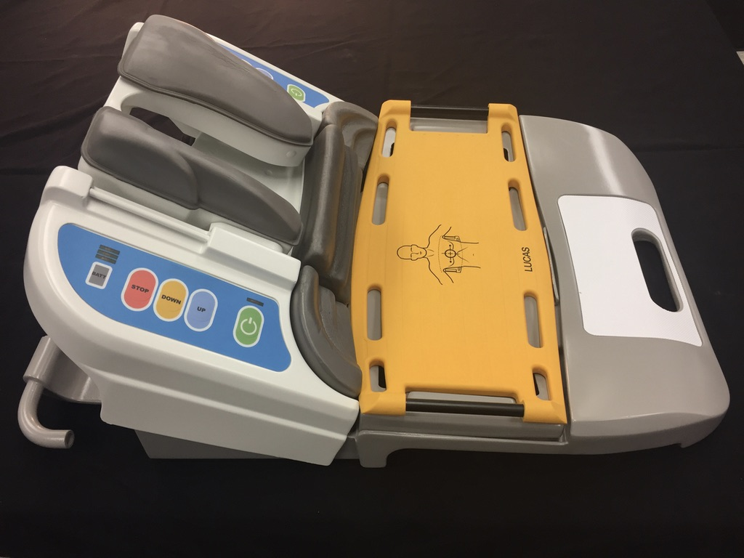
Current Prototype:
Weight without LUCAS backplate: 15 lbs

Slide 27
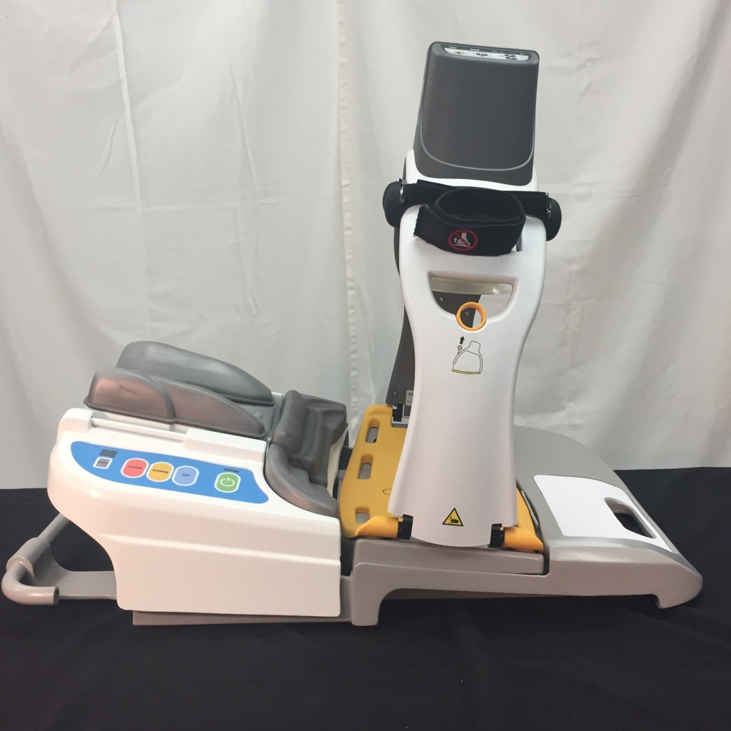
MRS 525™ Patient Placement System in Supine Position with LUCAS 3 Attached

Slide 28
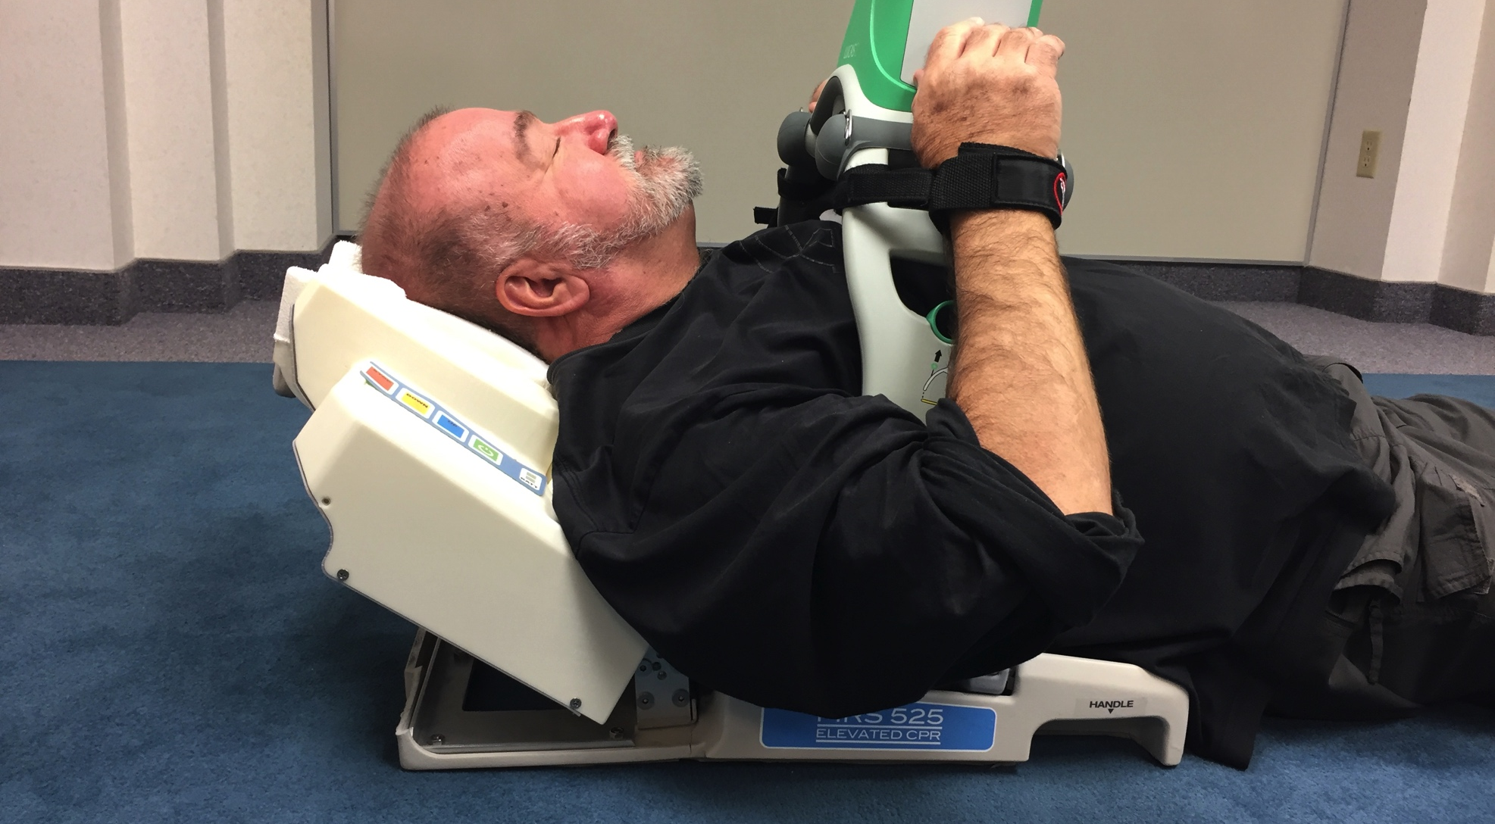
There’s hope yet

Slide 29
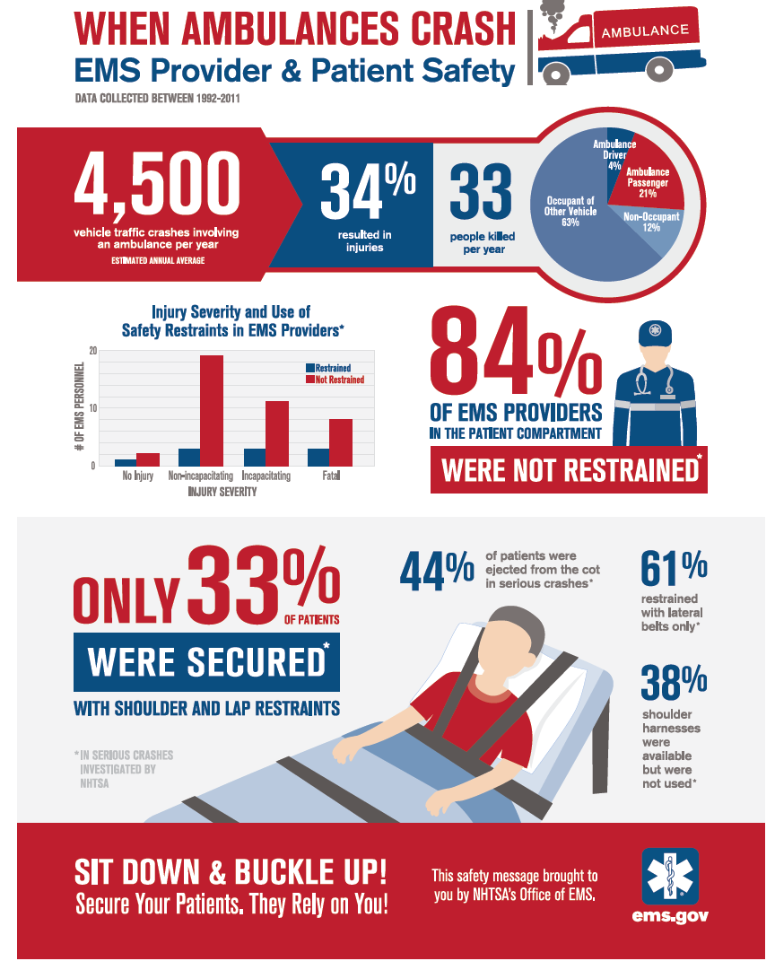
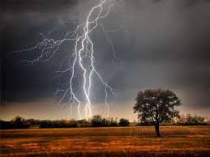
36 million 911 EMS Responses Per Year

Slide 30
Summary EMS Updates 2018
Stroke TPA always skeptical, EVR is the future, Hard to find prehospital
Hemorrhage control is going public & REBOA
Cardiac Arrest is going to be procedural
Upright Intubation, Upright CPR
Drive fast again, but safe

Slide 31

Thank You

Slide 32
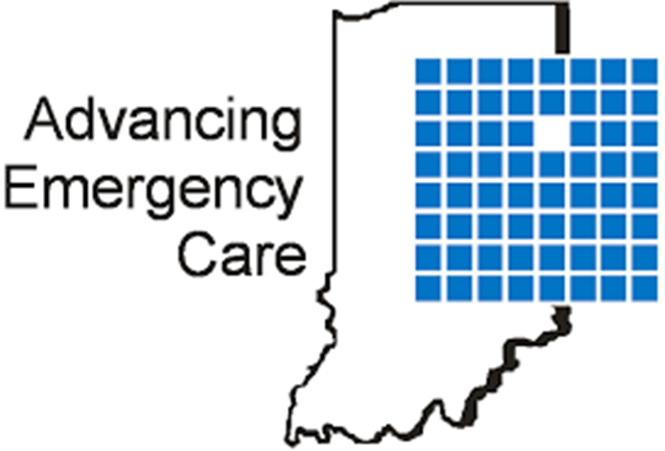

Lunch!!!

