Slide 1
Emergency Medicine and the Opiate Epidemic: Where we were, Where we are, and Where we are going
Jennifer Walthall, MD MPH
Secretary, Indiana Family and Social Services Administration

Slide 2
Data matters, but stories convince.
Notes:
Tell the Scott County story
Talk about the role of physicians in the opiate plan

Slide 3
The data

Slide 8
Percent Change in Leading Causes of Injury Death Indiana, 1999–2015
*Age-adjusted rates
Source: CDC WISQARS, Prepared by ISDH Division of Trauma and Injury Prevention
Notes:
This updated slide shows a 771.4% increase in the rate of unintentional poisoning deaths in Indiana between 1999 and 2015. This unprecedented increase in poisoning deaths mirrored the increase we were witnessing nationally, largely due to the increase in prescription opioid prescribing and misuse.

Slide 9
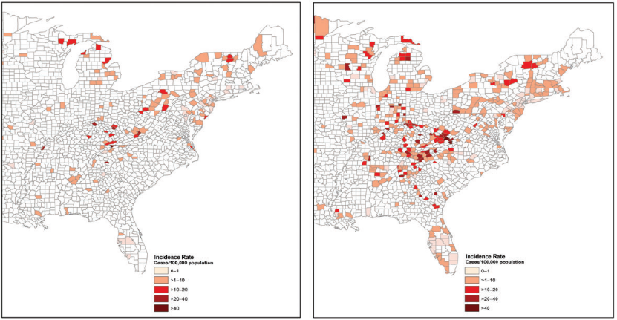
Emerging Epidemic of Hepatitis C Virus Infections Among Young Non-Urban Persons who Inject Drugs in the United States, 2006–2012
2006
2012
Suryaprasad Clin Infect Dis; 2014, 59(10):1411-1419
Notes:
Increasing rates of acute Hepatitis C virus infection among young suburban and rural persons who inject drugs transmission in Indiana and across much of the Midwest and Appalachia were a foreshadowing of the Scott County HIV Outbreak.

Slide 10
The story

Slide 11
How to create an opiate epidemic in three easy steps
Create a culture with an expectation of pain free experience with powerful support
Change the practice of a generation of physicians
Enact regulations to change practice without accounting for a population with substance use and behavioral health infrastructure needs

Slide 12
The whiteboard
Emergency Interventions
Treatment expansion
Prevention and System Change
Sustainability
Notes:
Activities that rely solely on grants rarely can have the long term impact we are seeking to have. Example: we used Cures $$ to build infrastructure for improving access to care (residential beds, ECHO, mobile teams, peers in EDs). The 1115 waiver was designed to be the supporting structure for the long term.

Slide 13
Data build
Dashboard
Open source Medicaid data sets
INSPECT

Slide 15
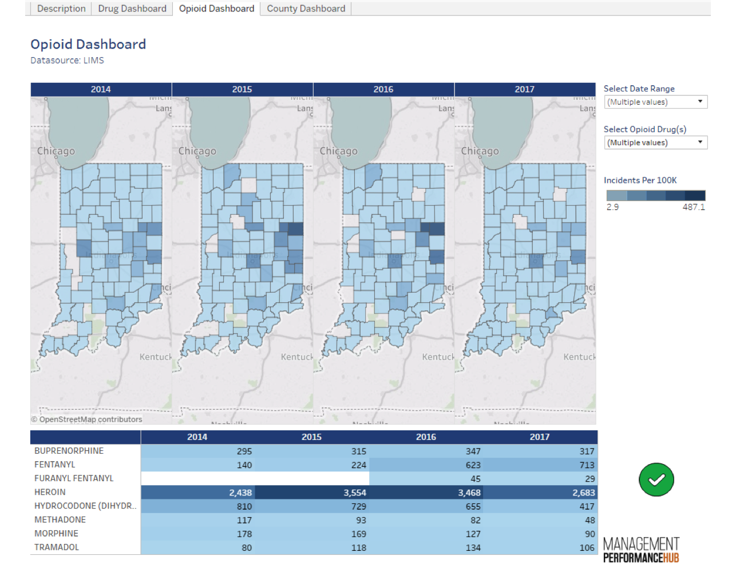

Slide 16
Policy Needs
Naloxone
SSP
MAT coverage
Coroner reporting
OTP expansion
Access
Notes:
one of the important policy decisions has been to support improved access to residential beds, improve healthcare workforce knowledge about treatment, and a focus on special populations (criminal justice, pregnant/parenting women). A bullet labeled Access to care would be appropriate.

Slide 17
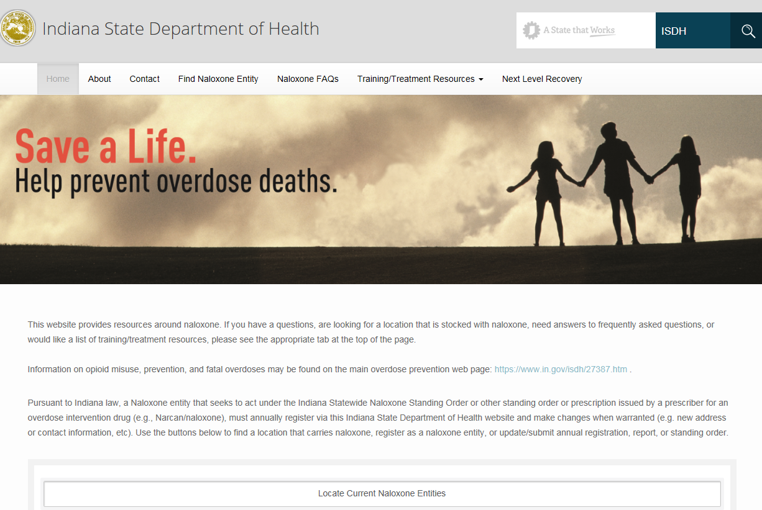
Optin.in.gov

Slide 18
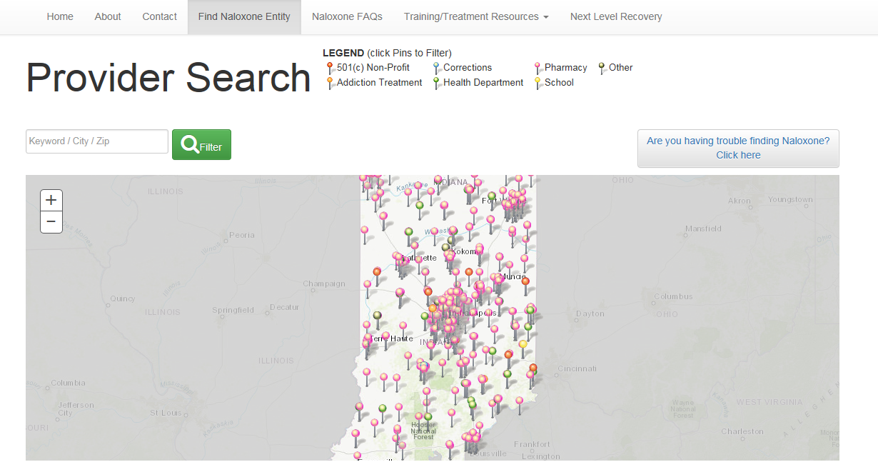
Notes:
ISDH Opt-In registry map as of February 23, 2018.

Slide 19
Future state naloxone continuum
Overdose victim
First responder
EMS
Hospital
Naloxone stocking and reimbursement

Slide 20
Payment Infrastructure
HIP history
1115 renewal
Cures overview
Block grant efficiency
Notes:
with more persons covered by HIP/Medicaid we are taking the opportunity to re-focus a portion of our block grant dollars that used to be for treatment to more services that don’t have a payer source – housing and employment supports, outreach/engagement activities

Slide 21
A Brief History of HIP
HIP 1.0 – cigarette tax expanded coverage for 40,000
HIP 2.0 – partnership with federal government, hospitals, and cig tax expanded coverage for 400,000
POWER account
Medicare reimbursement
Incentives for behavior change

Slide 22
HIP today
415,627 members
42.9% <5% FPL (62% opt into PLUS)
66.2% in PLUS overall
18% medically frail
Improved preventive care

Slide 23
HIP Enhancements
Substance Use Disorder:
Fill treatment gaps by adding new services: inpatient detox, residential treatment, and addiction recovery services (recovery education, peer recovery support services, housing support services, recovery focused case management and relapse prevention)
Lift current Medicaid restriction on IMD providers – expand access of at least 15 more facilities with 12 additional in queue
Within HIP, member incentive programs will target SUD treatment

Slide 24
HIP renewal and the opiate epidemic
Waiver of current IMD exclusion
Allows Medicaid to reimburse for short-term services (30-days of treatment) provided in an Institution for Mental Disease (IMD)—a mental health medical facility of more than 16 beds.
Currently able to reimburse for 15-day IMD stays through managed care programs only (HIP, Hoosier Healthwise, Hoosier Care Connect), but not fee for service.
Expands access
New Medicaid access at nearly 15 new facilities and possible increased capacity at 12 others

Slide 25
Addiction Inpatient Units and Residential Facilities

Slide 26
New or Expanded Points of Access

Slide 27
21st Century Cures Grant – Year 1
Residential capacity has grown from 800 beds to 1008 (26% increase)
Project ECHO launches in March 2018 with a focus on physicians, social workers, community health workers
Provide peer supports in Eds. Adds 65 peers to the workforce
Supporting integration of PDMP into health care records
Two mobile addiction teams covering 14 rural counties (15% of the state)

Slide 28
21st Century Cures – Year 1
8500 naloxone kits distributed to State Police, DNR, and local health departments
Skills training for providers (DBT/12 step, Motivational Interviewing, and Effective Use of MAT)
Establish local Recovery Oriented Systems of Care (ROSC). DMHA will provide a toolkit for other interested communities
Humanizing campaign. KnowtheOFacts.org

Slide 29
Culture change
Physicians
Hospitals
Stakeholders
SUD providers
Public Health
General public
Elected officials
Notes:
we need some culture change in the SUD treatment space as well. The 12 steppers and the MAT crowd tend to focus on one solution. The culture change is that all aspects of the treatment continuum must be available.

Slide 30
Program Build
OTP expansion
ECHO MAT
ECHO HCV
Open Beds/2-1-1
NAS pilots
Recovery Works
Notes:
NAS/Moms programs supported by legislation; Recovery Works for felons

Slide 31
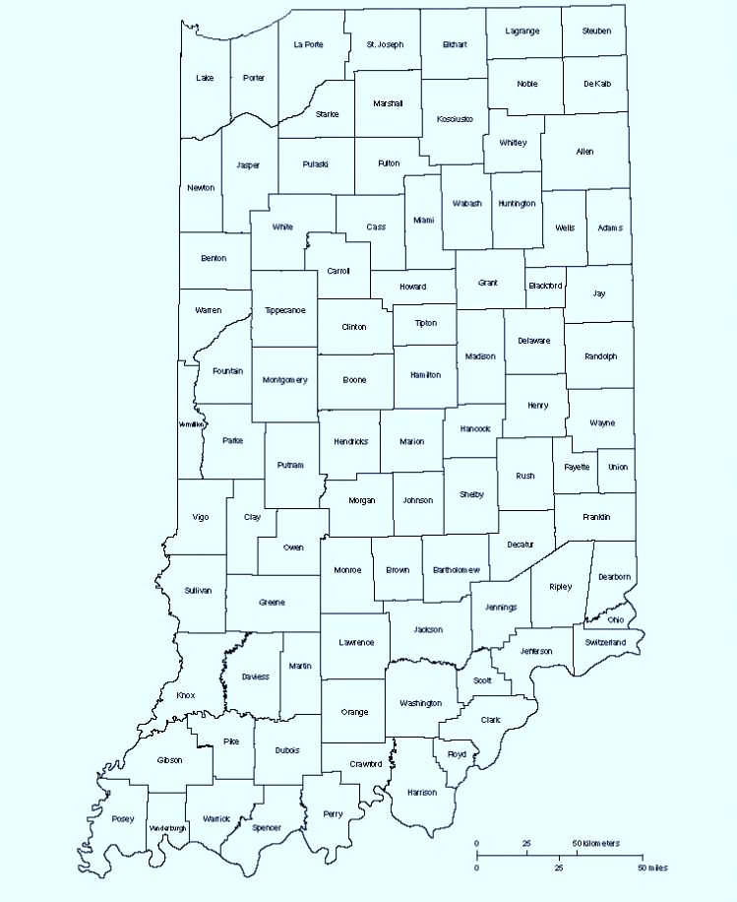
FSSA – OpenBeds® State Referral Process
Acute Care Hospitals
Referrals
Social Workers
Case Managers
Drug Courts
EMS
Individuals
Providers
Referral Channel and Wraparound Services for Sustainability Reporting
Notes:
OpenBeds® is a state-of-the-art Software-As-A-Service (SaaS) platform that identifies, unifies, and tracks all behavioral health, and specifically substance use disorder treatment for inpatient / residential beds, outpatient programs, and social resources to create a single, common network.
The OpenBeds® platform will be immediately utilized to track occupancy of inpatient / residential beds, match individuals with services based on their individual needs and payment types as well as make referrals for those with an SUD.

Slide 32
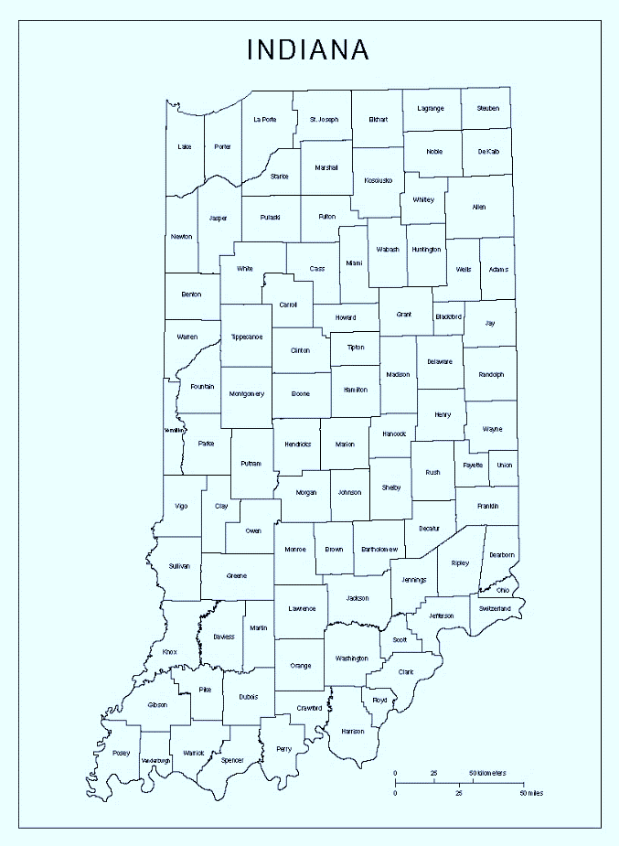
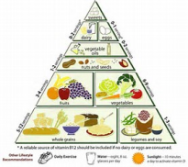
FSSA – 211 Wrap Around Services Process
Referral Channel and Wraparound Services for Sustainability Reporting
Notes:
Indiana 211 Partnership, Inc. (IN211) is a nonprofit 501(c) 3 organization dedicated to providing the 2-1-1 information and referral services for Indiana.
Indiana 211 will provide on-going tracking and comprehensive wrap around services for those individuals who enter treatment and require additional resources for sustainability of their treatment.
This new capability will provide complete transparency into sustainability of treatment and will enable us to make data driven modifications as needed.

Slide 33
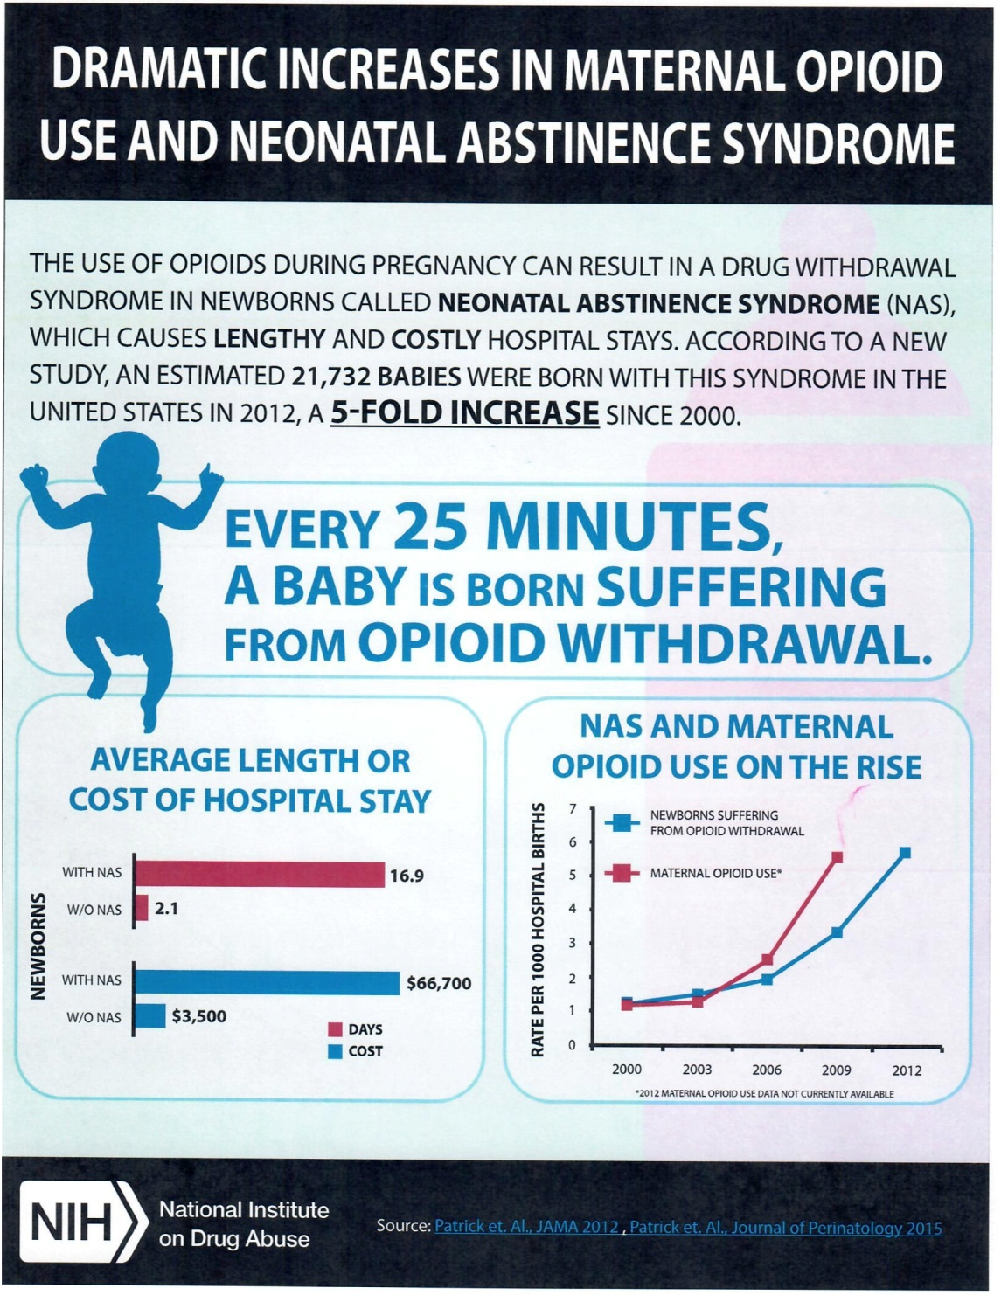

Slide 36
Best or same?

Slide 37
UNDERSTANDING OPIOID USE DISORDER
www.IN.gov/recovery
©2017

Slide 39
FACTS:
OPIOID USE DISORDER IS A DISEASE
THERE IS TREATMENT
RECOVERY IS POSSIBLE
#KnowTheOFacts
Notes:
The facts are simple:
Opioid Use Disorder is a disease
There is treatment
Recovery is possible
But most people are not aware of these basic facts.
Through understanding and knowledge about Opioid Use Disorder, we will decrease stigmas.
But first we need to understand what is an opioid.

Slide 40
Working the whiteboard together
Stigma reduction
PDMP
Counseling and referral - SBIRT
Naloxone kits
Take back programs
Partial fills and prescriber rules
Notes:
Naloxone training

Slide 41
Assessment – what is success?
HIV continuum of care
Treatment capacity
Overdose information
Reduced rates of SUD
Reduced need for naloxone

Slide 42
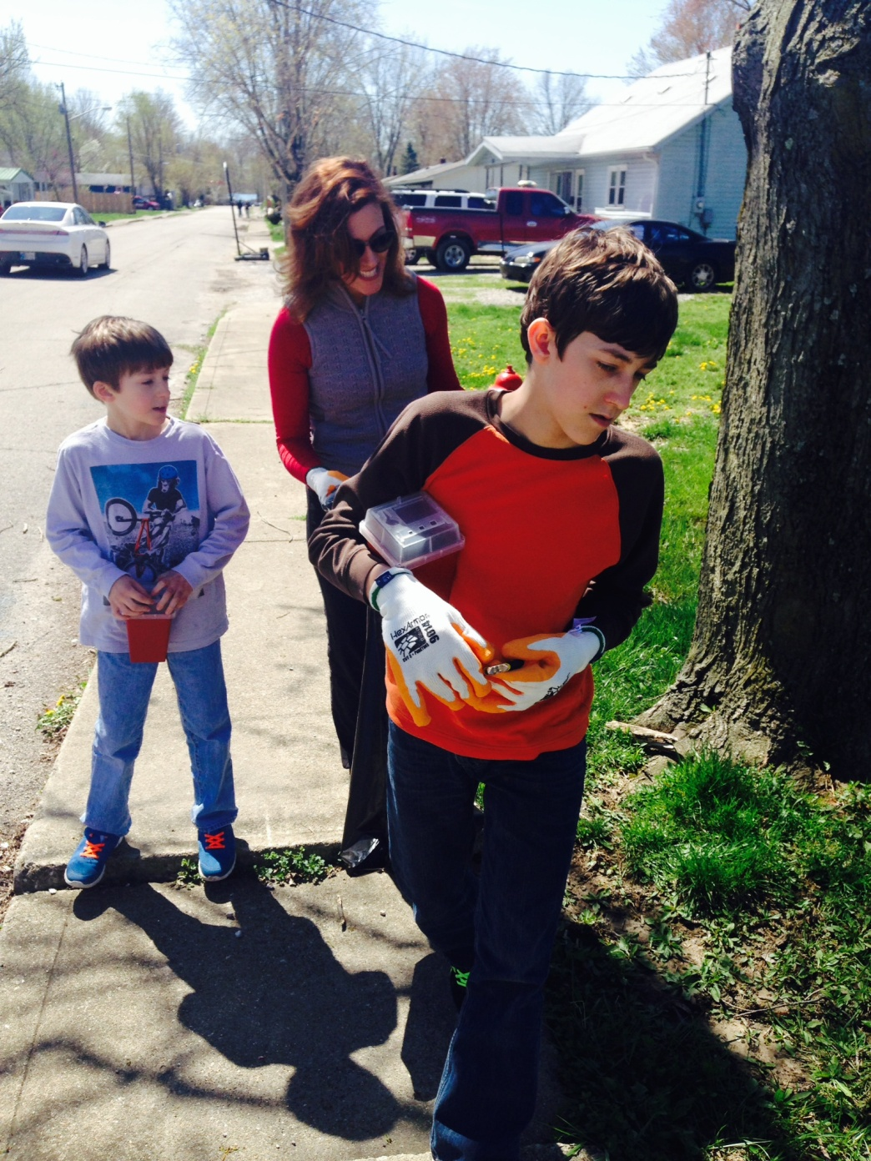
“The world is indeed full of peril, and in it there are many dark places; but still there is much that is fair, and though in all lands love is now mingled with grief, it grows perhaps the greater.”

Slide 43
In a world filled with despair, we must still dare to dream. In a world full of distrust, we must still dare to believe. FSSA Indiana Daring to dream and believe since 1991

