Slide 1
Information Decision Support
JT Finnell, MD MSc FACEP FACMI
ACEP Board of Directors
INACEP Board of Directors
Notes:
Clinical Decision Support –
JT Finnell will present an interactive discussion on utilizing informatics to enhance clinical decision-making.

Slide 3
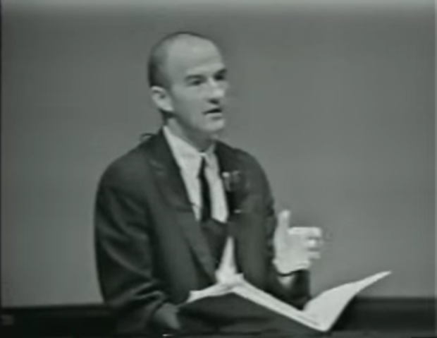
1960s
1960s
Notes:
Larry Weed
-Father of the SOAP Note
The Sixties dominated by the Vietnam War, Civil Rights Protests, the 60s also saw the assassinations of US President John F Kennedy and Martin Luther King, Cuban Missile Crisis, and finally ended on a good note when the first man is landed on the moon

Slide 4
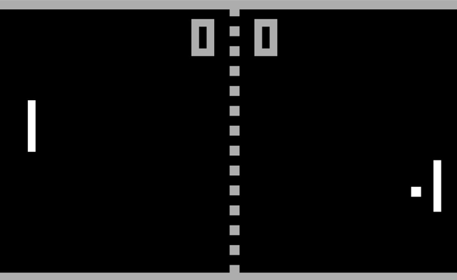
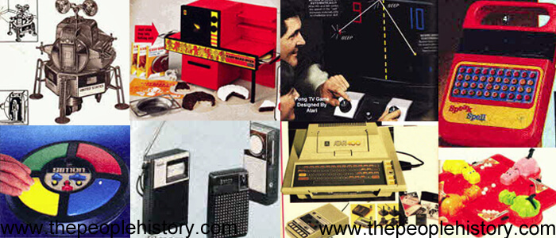
1970s
Notes:
Beatles Disband
The first jumbo-jet, the Boeing 747, makes its debut commercial flight from New York to London.
The U.S. voting age is lowered from 21 to 18 years old when the 26th amendment is ratified.
The Walt Disney World Resort is opened in Orlando, Florida.
The first microprocessor, the 4004, is released by Intel.
PONG, the first video game to have commercial success, is released.
The UPC Bar Code is introduced.
Sony introduces the Betamax video tape system.
Bill Gates and Paul Allen create Microsoft.
The popular late-night sketch show, Saturday Night Live, airs for the first time.
Steve Jobs and Steve Wozniak create the Apple Computer Company.
NASA introduces the first space shuttle, the Enterprise.
The first commercial Concorde flight takes place.
MRI (Magnetic Resonance Imaging) Scanner is first tested.
Louise Brown, the very first test tube baby, is born.
The computer video game Space Invaders is released.
The Walkman is introduced by Sony.

Slide 5
1970s Digital Revolution
Notes:
The 70's were the start in many ways of the Electronics and digital revolution,
with the invention of transistors and Integrated Circuits in the late 60's, companies now found ways to use the technology which caused the phenomenal growth in smaller more powerful and cheaper products ranging from Calculators to Televisions.
The decade also saw the beginning of the Home Computer due to Intel creating the first cheap microprocessor - the Intel 4004, and other integrated circuits. In the beginning the computers were mainly for the hobbyists and included the Apple II, the TRS-80, the Commodore PET, and Atari 400/800 and with the growth of these home computers Bulletin Boards became a popular way for people to find others with similar interests
The first use of card access Electronic Locks appear
As people realized the power of these new home computers a new use was found and that was the beginning of the video game . When we look at those games now we see how basic they were but the technology available and the understanding of what could be done limited those early games.
With the invention earlier of the microwave oven and now the capability to manufacturer and sell cheaply many homes adopted the technology in their kitchens
Due in part to the increased use of the 747 a Jumbo Jet able to carry large numbers of passengers across continents air travel booms and causes new problems with pollution, delays and air traffic control

Slide 6
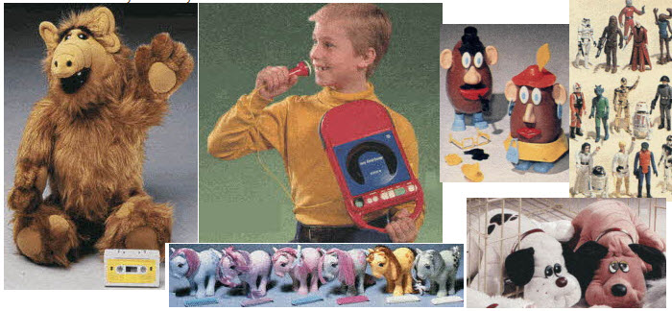
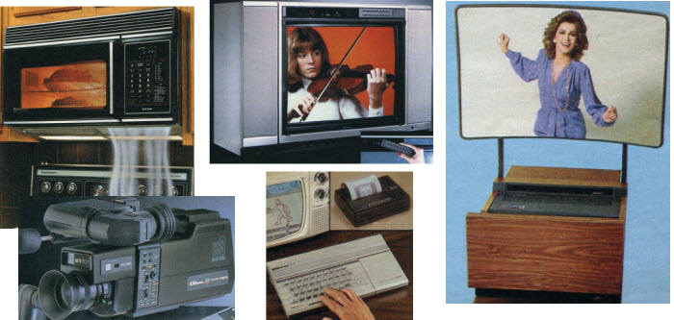
1980s
Notes:
The Eighties see Microsoft, IBM, Intel and Apple begin to have an impact on all our lives as small Computers becomes cheaper and more wide spread including home and Business,
The early beginnings of mobile phones as technology gets cheaper and smaller. .
The cable network MTV (Music Television) is launched.
"The Computer" is named Time Magazine's Man of the Year.
Disney World opens the EPCOT ( Experimental Community of Tomorrow ) park.
Sally Ride becomes the first American woman in space.
The first version of Microsoft Windows is released.
The first triple organ transplant is performed.
The Nintendo Game Boy portable video game system is released.

Slide 7
1980s Digital Revolution
Notes:
The 80's signaled the start of the computer age, following on from the creation of Microsoft and Apple towards the end of the 70's , the technology and the speed of innovation both in Hardware and Software together with the cheapness provided a speed of growth and take up .
The birth of the IBM PC signaled the start of Personal Computers first in the Offices and then into peoples homes becoming an integral part of our lives. following on from Micrsofts MSDOS on PC's to the first versions of Windows a GUI Graphical User Interface
As well as the Hardware and Software changes a new technology was evolving starting as Bulletin boards later to become what we now know as the Internet invented by English physicist Tim Berners and the beginnings of the World Wide Web
This was also the Decade that the Post-It was introduced which came from a glue invented in 1968 accidentally while trying to discover a stronger glue at 3M by Spencer Silver
Another technology that was also just starting was that of cellular mobile phones , in the beginning the phones were big and heavy and hit and miss for signal strength , but as with the Internet would change our lives .

Slide 8
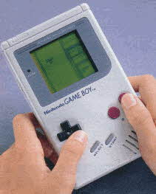
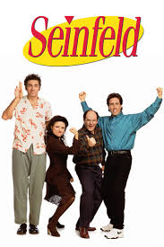
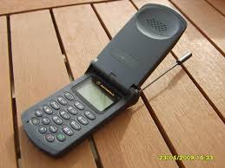
1990s
Notes:
The Internet becomes available for unrestricted commercial use.
The Mall of America opens in Minnesota.
Euro Disney is opened in France.
The Hubble Telescope is repaired in space by a crew on the Space Shuttle Endeavour.
Intel introduces the Pentium Microprocessor.
The online auction website Ebay is founded.
The Java Programming Language is released.
The internet search engine "Ask Jeeves" is created.
The first Harry Potter book is published by author J.K. Rowling.
Scientists at the Roslin Institute unveil "Dolly" the first successfully cloned sheep.
The search engine Google is founded.
Apple Computers reveals the iMac computer.
The file-sharing service Napster is created.
Eleven countries begin to use the Euro as their currency.
The 90's saw the growth of the World Wide Web and the Personal Computer PC, In 1991 when the WWW first became available for the public it grew dramatically with users multiplying at the rate of about 3500 times a year , by the year 2000 there were an estimated 295 million users on the Internet. This in turn caused a continuing revolution in communication and business.
Possibly the field of Medical Science and the advances made in the late 90's will have the biggest impact on our society with 2 advances that leave us with moral and political questions for the future. 1. Cloning is the ability to clone one animal from the cell of another animal. A sheep later called Dolly which was cloned from the cell of an adult Ewe and was fused with an unfertilized egg cell from which the nucleic DNA had been removed. 2. Stem Cell Research In 1998 stem cells derived from the human embryo were first isolated, and research to help in many of the diseases and illnesses we suffer from is currently underway. But any research has a reliance on the use of a human embryo which is morally repugnant to many in our society. Many believed prior to this that this was the stuff of science fiction. The human race will need to wrestle with the moral dilemmas social and political implications of this technology for many years to come. The 90's also saw the development and growth of Genetic engineering or genetic modification (GM) Foods and the growth of the new science of Biotechnology. GM is used to help make plants resistant to herbicides and insecticides, by the late 90's about 100.00 million acres were planted with Soybean, Maize, Cotton, Canola, and it is estimated that over 60% of products on U.S. grocery shelves include GM ingredients.
The first cases of Avian Flu were found in China in the late 70's and China ordered the killing of all chickens in it's territory following the first cases of human deaths. There are 15 types of bird, or avian, flu. The most contagious strains, which are usually fatal in birds, are H5 and H7. The type currently causing concern is the deadly strain H5N1, which can prove fatal to humans.
The 90's saw the growth of many technology companies from small beginnings to a market dominant position , possibly the best example is Microsoft who from small beginnings now have their operating systems installed on 80% of the world's computers. Microsoft managed to provide users with the technology they wanted at an affordable price but also due to it's strength in the market leaves little room for new companies to emerge. After many years of being the hero of people and governments , both the United States and the European Union are attacking Microsoft for the restraint of competition.
The biggest assistance for many of the technological advances in the 90's was the improvements in communication including Internet access, allowing a global sharing of information and Mobile Communications, in the late 80's mobile phone technology was still in it's infancy but by the end of the 1990's owning a mobile phone was a fact of life, they are now part of everyday life, If you love them or hate them depends on your view of privacy including your own and others.

Slide 9
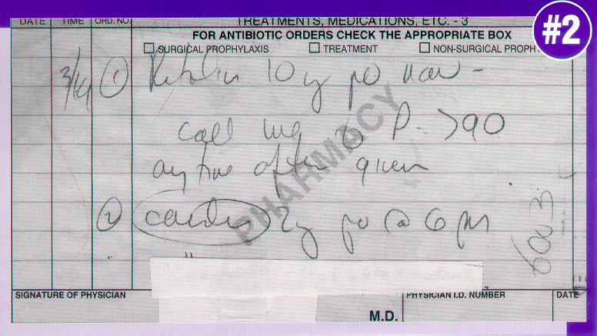
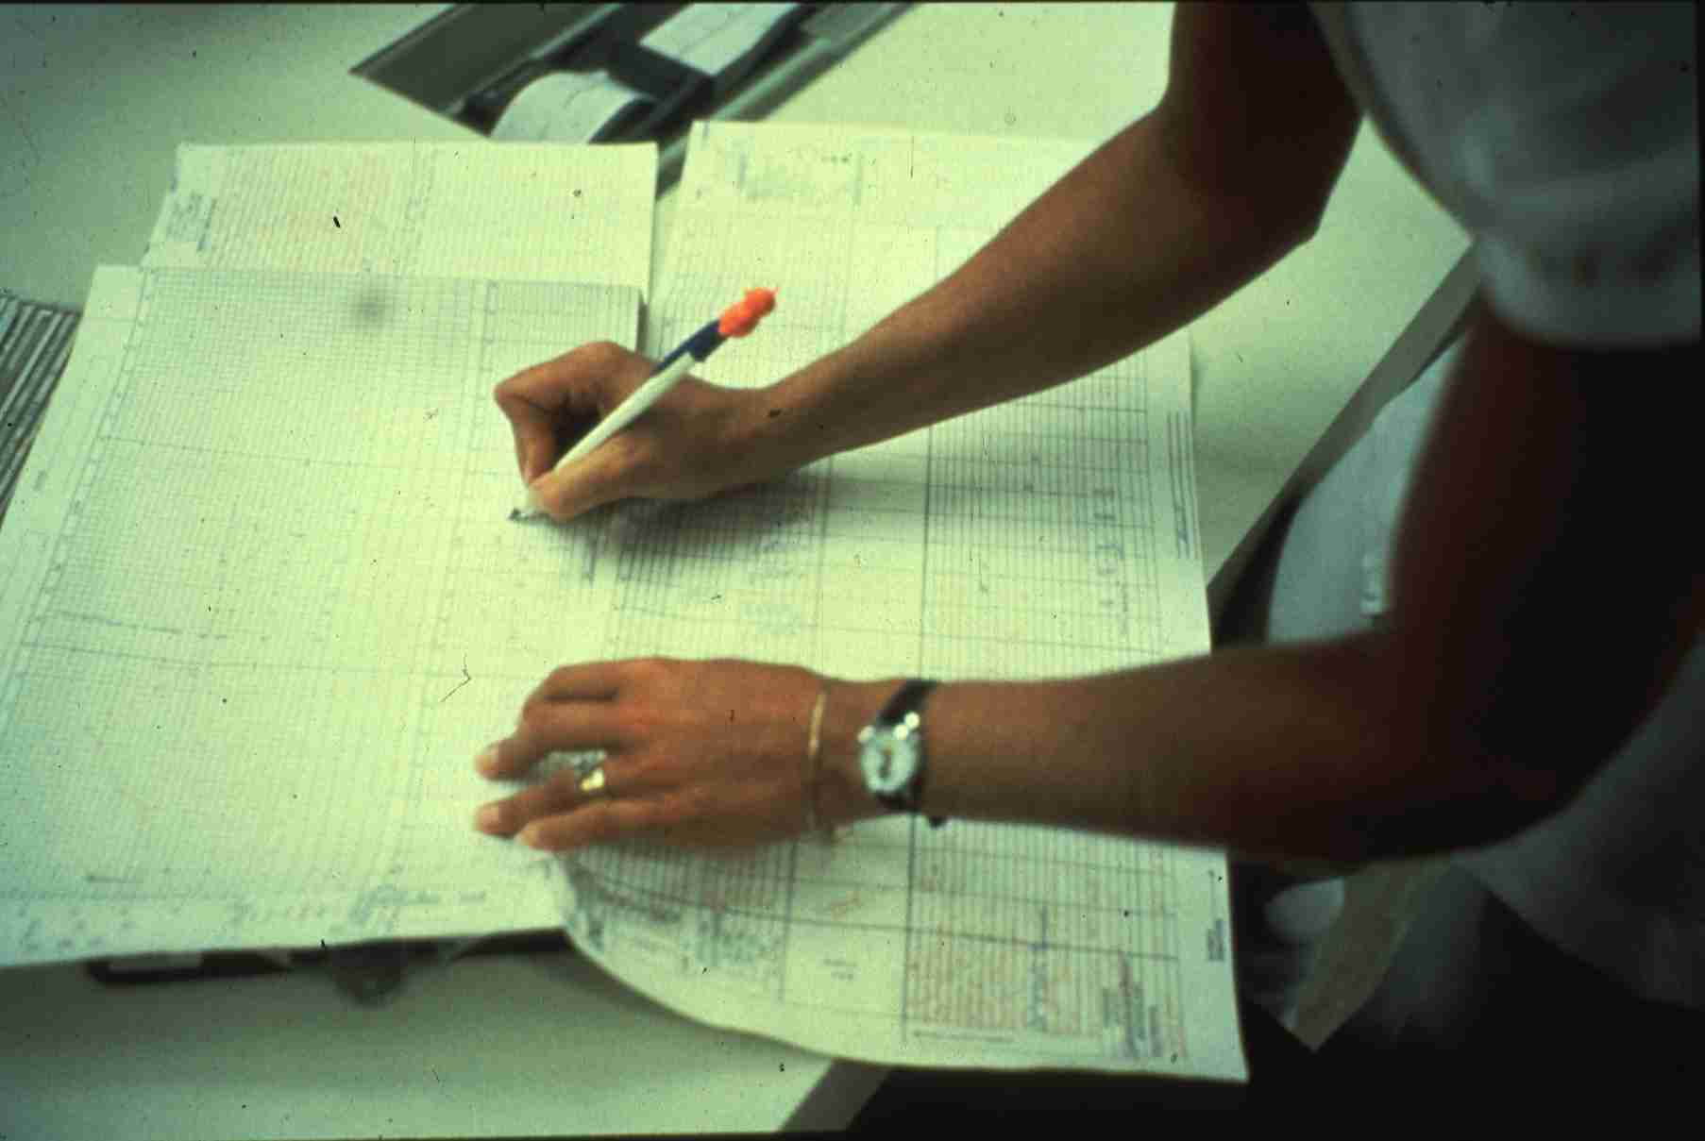
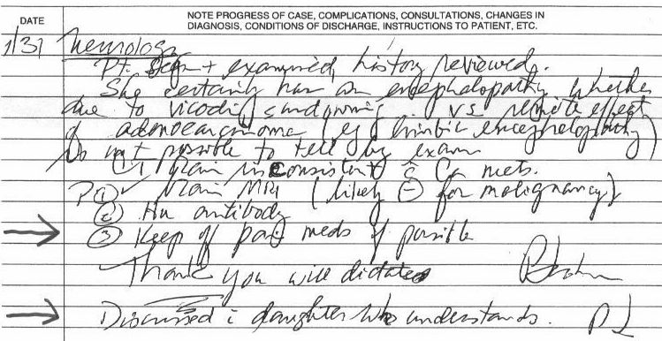
Notes:
My Medical Background
Frustration with clinical inefficiencies - reinvent the wheel each time I saw a patient.
Hand written discharge instructions

Slide 10
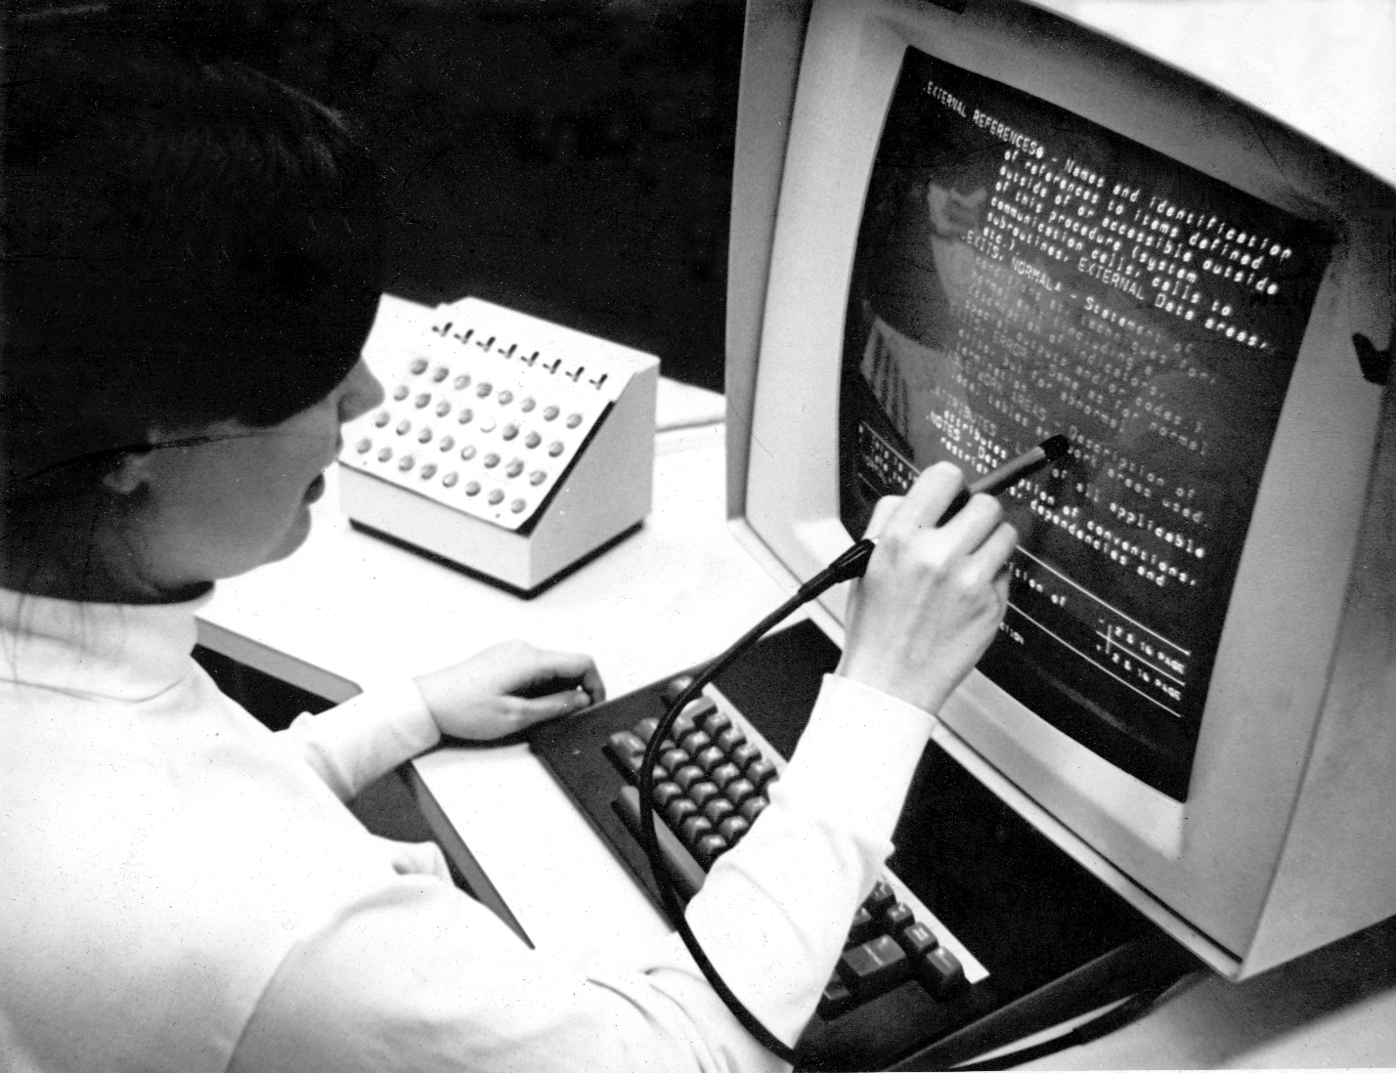
Notes:
Minimal clinical data – paper results
Gained access to lab data through the patient account number
We often repeated tests since we didn’t’ have access
Systems didn’t talk to to each other - Outpatient to Inpatient

Slide 11
Fledgling Interoperability
Data “Lakes”
Notes:
EHRs
Lack of interoperability
Mounds of clinical data
Data “Lakes”

Slide 12
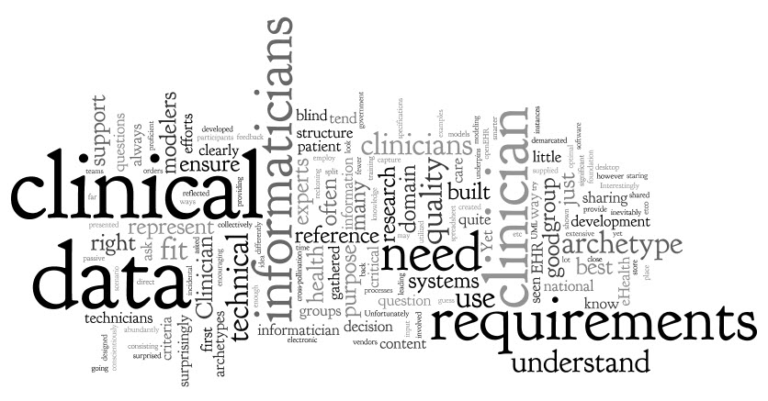
Electronic Records
Notes:
Need structured clinical data to drive decision support
Who will enter this data?

Slide 13
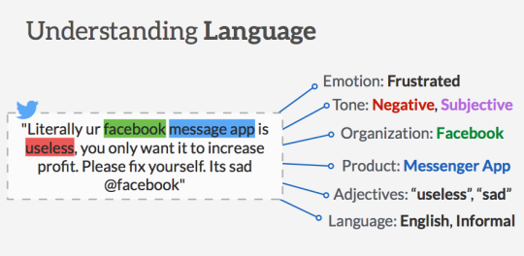
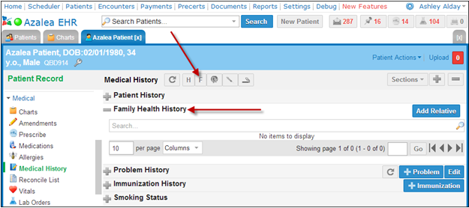
Structured vs Unstructured Data
Notes:
Brief Geek Dive

Slide 14
Health Information Exchanges

Slide 15
Computer Order Entry / Decision Support
Right Information
Right Person
Right Intervention Format
Right Channel
Right Time in Workflow
Notes:
The right information: evidence-based, suitable to guide action, pertinent to the circumstance.
the right information,
to the right person,
in the right intervention format,
through the right channel,
at the right time in workflow.

Slide 16
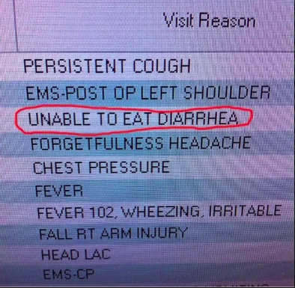
Orders and Documentation
Problem Lists: “The hoarder’s stash”
Revenge of the Ancillaries
Scribes
Occupational burnout

Slide 17
“Bill of Rights”
1. There should be an ED Physician responsible for the IT in the ED.
2. Emergency Medicine Informaticians need to be involved in the build process.
3. Changes / Feature requests should be streamlined with a clear governance process.
4. Reform documentation requirements for ED reimbursement to be time-based and problem-focused billing.
5. Interoperability must exist
6. Specialty Societies/ACEP should be able to maintain "best practice" solutions for their members.
7. PDMP data should be housed in a national data base and integrated into the EMR.
8. State information exchanges should be designed to integrate using national standards for interoperability.
9. National interoperability standards legislation should include EHRs across the spectrum of care (e.g. Pre-hospital, Home Care, Transportation providers, chronic care, Behavioral health, Pharmacy, Medicare, Medicaid).
10. EHR Vendors must seek innovative methods and solutions to providing care
Notes:
1. There should be an ED Physician responsible for the IT in the ED.
This ED Physicians (ideally) should be board certified in clinical informatics.
This person should report to the CMIO in conjunction with the ED Director(s).
2. Emergency Medicine Informaticians need to be involved in the build process.
Too often this is left to other clinical staff that does not fully understand our workflows.
Changes to any systems impacting ED workflows should be signed off by the EM Informatician.
3. Changes / Feature requests should be streamlined with a clear governance process. The governance process will result in streamlined decision making when feature requests occur.
4. Reform documentation requirements for ED reimbursement to be time-based and problem-focused billing. Data collected and entered throughout the entire ED encounter should be used to allow for the highest quality of care reflection. Redundant documentation for the sole purpose of reimbursement should be discouraged.
5. In order to avoid costly duplication of imaging and testing, EMR vendors should achieve a level of unambiguous shared meaning within 2 years while committing efforts to retrieve and display data related to the safe delivery of patient care.
6. Specialty Societies/ACEP should be able to maintain "best practice" solutions for their members. These are often caught up in business/confidentiality agreements with vendors that prohibit distribution. These best practices / guidelines, decision support tools should be easily transferable across systems. (interoperability).
Specialty Societies should have access to their members data / (with appropriate approval from their members) to monitor public health and quality measures.
7. PDMP data should be housed in a national data base and integrated into the EMR.
8. State information exchanges should be designed to integrate using national standards for interoperability.
9. National interoperability standards legislation should include EHRs across the spectrum of care (e.g. Pre-hospital, Home Care, Transportation providers, chronic care, Behavioral health, Pharmacy, Medicare, Medicaid).
10. EHR Vendors must seek innovative methods
- to add ancillary-desired context to orders without requiring providers to click to add them (indications on XRs, Medications, referrals) using machine learning tools to discern them from already available context (e.g. nursing notes, vital signs)
- to prevent wrong-order entry errors without restricting the number of charts open (often cited as a ‘fix’ and a ‘safety measure’)
- to track care team members in complex and fluid environments to best identify key care team members in changing roles (e.g. triage doc, PA as attending vs PA as supervised provider, current attending and current ‘first call’

Slide 19
Critical Thinking
Notes:
Loss of critical thinking
Use of simulation

Slide 20
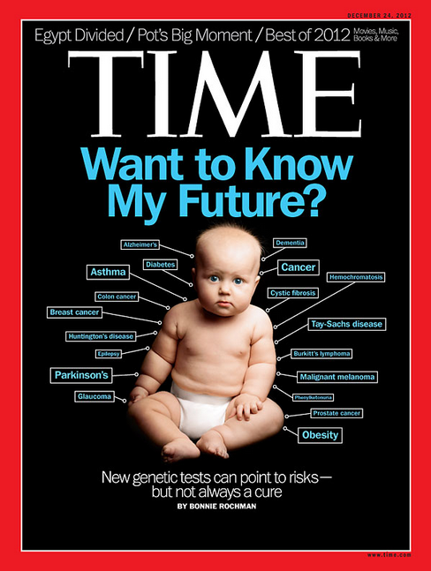
“Information is not just necessary for delivering care, arguably information IS care.”

Slide 21
Problem Lists
Hypertension
Diabetes
Low Back Strain
…
Notes:
What we are working on.

Slide 22
Low Back Strain
History
Imaging
Referrals
Medications
Guideline
Notes:
How do we do this?
Unstructured vs Structured data

Slide 23
Preemptive CDS

Slide 24
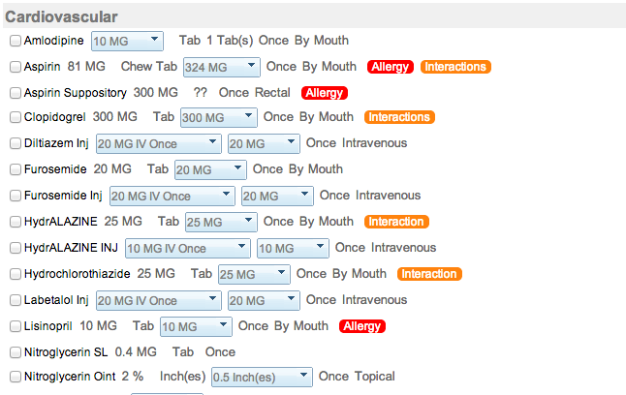
Preemptive CDS

Slide 25
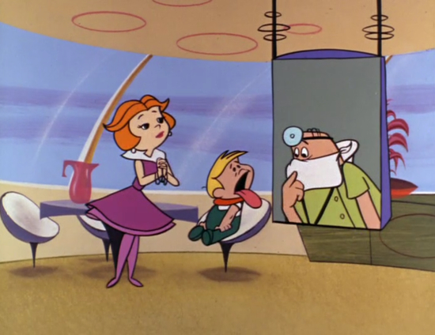
The Future
Interoperability
Population Health
Value Based Care
New Care Delivery Models
Telehealth
AI
Precision Medicine
Oncology
Security
Silver Wave
Notes:
AI – Augmented reality
Consumer demand for greater access to personalized and patient-centered care will increasingly favor those offering convenience, choice and, most importantly, cost transparency,
The silver tsunami will continue to exacerbate these pressures, as 11,000 people per day in the U.S. reach 65 years of age
To meet these demands, health systems, payers and providers will be forced to advance value-based healthcare delivery in ways that keeps costs low both for the industry and the consumer, t

Slide 26
Interoperability
Notes:
IT vs. Health IT
Talk about how health providers accept technology readily in some forms, but not in others… iPhones, email, Facebook, etc…but less receptive to Health IT….Hospital more accepting – “To Err Is Human – back in 1999”. More recently EHR incentive programs…SNF & HCA slower end of the adoption scale – storm from HCAF conference – Value based care – pushing further adoption…
Just like with other technology health care is a business…and fortunately input by stakeholders - can help to development more effective solution…that will ultimately improve the provider and patient experience

Slide 27
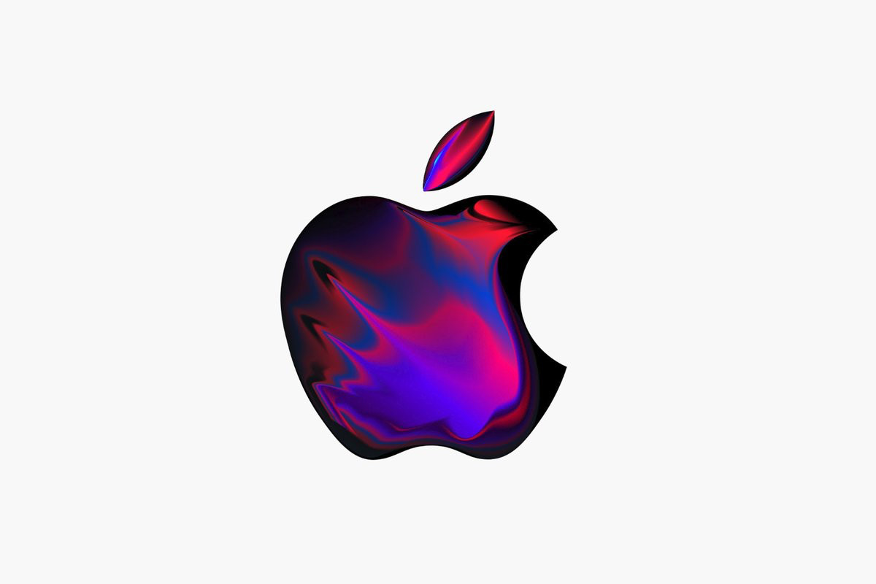
Expectations
Notes:
Expectations
In health care we are also seeing an evolving expectation from patient about their care and what they expected…Patients expect people that are treating them to have their record – and have it immediately.
Where do you get a stamp story? Or the I have to go into the bank story?
Sense of Community - social media – changing concept of community…
Younger generations…Carrie friends story… Social Media – everyday part of life and it is expected that when those things happen that they will be communicated – they will be shared – instantly.
They have that expectation for their health care providers –that when they move from one provider to another that their records will automatically go with them…
Expectations of physicians fresh out of medical school – physicians, nurses, therapist are all trained to use EHR systems in their training programs now…it is a generational shift…– think about 20 years ago – we did not have email – home computers were just coming out…We are moving into a new era – as a society – and in medicine…

Slide 28
þ
Notes:
EHR systems – the base for all other health technology – spiel about finding the right EHR system – acknowledge issue with docs having to transition to new systems…Last year to participate in Medicaid EHR incentive program – reiterate that even if they have used EHR for years – they may still qualify.
Building off of the EHR system – talk about communication and sharing information with colleagues … trust, give and take, etc.
DSM for consults – pharmacy communications – etc.
ENS for getting data alerts on patients
PLU for getting patient records
Telehealth – Survey of Providers, Advisory Council…

Slide 29
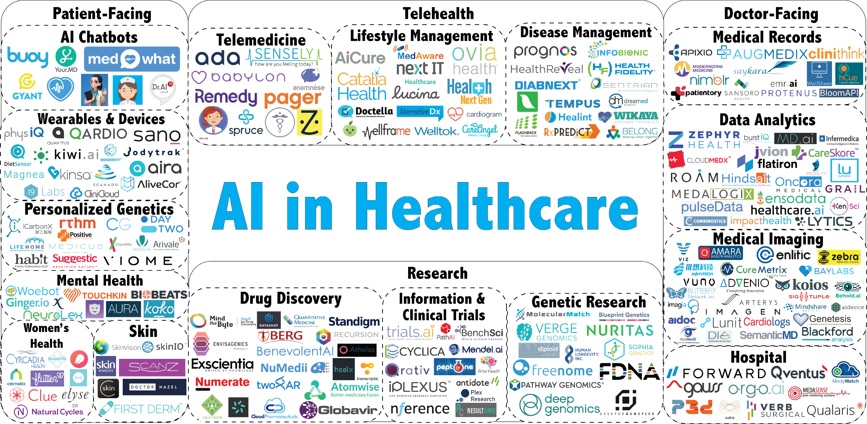

Slide 30
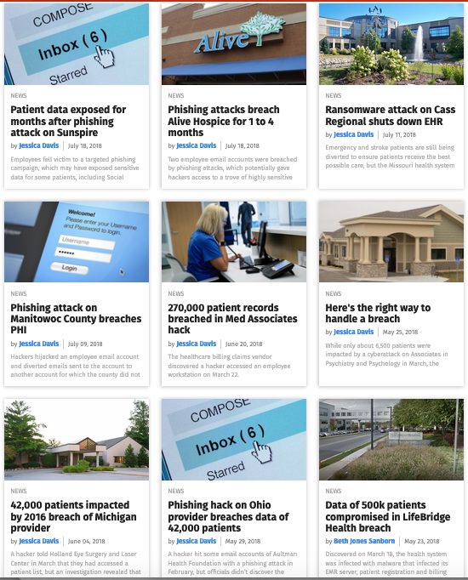
Security

Slide 31
Someday
Notes:
Now instead of jotting indecipherable notes, your conversation is being captured by a microphone array that can detect MD vs patient and capture important clinical data

Slide 32
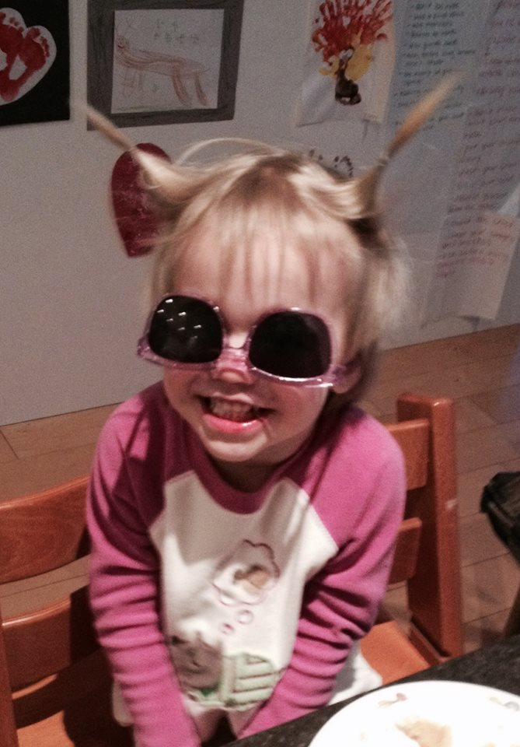
Questions ?
JTFINNELL@ACEP.ORG

